Slide 1
Security of BIOS/UEFI System Firmware from Attacker and Defender Perspectives Introduction
Yuriy Bulygin *
Alex Bazhaniuk *
Andrew Furtak *
John Loucaides **
* Advanced Threat Research, McAfee
** Intel

Slide 2
License
Training materials are shared under Creative Commons “Attribution” license CC BY 4.0
Provide the following attribution:
Derived from “Security of BIOS/UEFI System Firmware from Attacker and Defender Perspective” training by Yuriy Bulygin, Alex Bazhaniuk, Andrew Furtak and John Loucaides available at https://github.com/advanced-threat-research/firmware-security-training

Slide 3
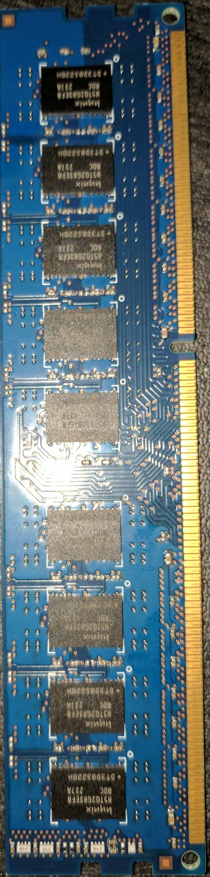
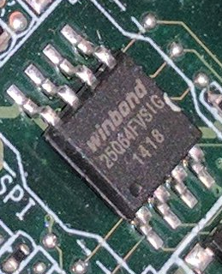
CPU 0 Haswell EP –EP (Socket R3)
CPU 1 Haswell EP –EP (Socket R3)
DDR4 channel E
RDIMM / LRDIMM
1600/1866/2133 MHz
DDR4 channel A
QPI
Port 0
(9.6GT/s)
RDIMM / LRDIMM
1600/1866/2133 MHz
RDIMM / LRDIMM
1600/1866/2133 MHz
DDR4 channel B
DDR4 channel F
RDIMM / LRDIMM
1600/1866/2133 MHz
QPI
Port 1
(9.6GT/s)
RDIMM / LRDIMM
1600/1866/2133 MHz
DDR4 channel C
DDR4 channel G
RDIMM / LRDIMM
1600/1866/2133 MHz
FW
FW
DDR4 channel H
RDIMM / LRDIMM
1600/1866/2133 MHz
DDR4 channel D
RDIMM / LRDIMM
1600/1866/2133 MHz
FW
PCI Express x8
PCIE Gen3 x8
PCIE Gen3 x4
Mini SAS HD
PCI Express x8
PCIE Gen3 x8
DMI Gen2 x4
4GB/S
PCIE Gen3 x4
Mini SAS HD
OCP SLOT1 X8
PCIE Gen3 x8
PCIE Gen3 x4
OCP SLOT2 X8
PCIE Gen3 x8
PCIE Gen3 x4
Mini SAS HD
Mini SAS HD
FW
PCH Wellsburg C612
SATA (6.0Gb/s)*4
FW
SATA (6.0Gb/s)*6
MINI SAS0
RJ45
Intel i350 Gb Lan
PCIE Gen2 x4
MINI S1SA
RJ45
SATA4
SATA5
FW
FW
USB2.0*3/3.0*4
USB 3.0
USB 2.0
USB 2.0
USB 3.0
USB 3.0
USB 3.0
USB 2.0
Rear
Front
NC SI Interface
LPC
FW
PCIE Gen2
DDR III
TPM / Debug Header
DDR3 Frame Buffer Memory
PWM
ASpeed AST2400 / AST1400
Smart Fan Controller
RGB
FW
FW
D-Sub Connector
UART
COM Port

Slide 4
Firmware Everywhere
GBe NIC, WiFi, Bluetooth, WiGig
Baseband (3G, LTE) Modems
Sensor Hubs
NFC, GPS Controllers
HDD/SSD
Keyboard and Embedded Controllers
Battery Gauge
Baseboard Management Controllers (BMC)
Graphics/Video
USB Thumb Drives, keyboards/mice
Chargers, adapters
TPM, security coprocessors
Routers, network appliances
Main system firmware (BIOS, UEFI firmware, coreboot)

Slide 5
In-the-wild Firmware Attacks
Legacy Bootkits (TDL4, Gapz…)
Mebromi BIOS rootkit
Stuxnet
EQUATION Group HDD firmware malware
] Hacking Team [ UEFI rootkit
Petya MBR Ransomware
Legitimate BIOS “backdoors”: Superfish, Computrace

Slide 6
Why Attack Firmware?
Extreme persistence
Stealth
Bypass software (OS or VMM) based security
Unfettered access to hardware
OS independence
Making the system unbootable (bricking)

Slide 7
Extreme Persistence
System firmware rootkit (in SMM or BIOS/UEFI)
Replaces OS boot loader every boot
Which patches OS kernel
Firmware rootkit is protected by the hardware write protections
Only way to fully remove the infection is to physically re-flash the flash “ROM” chip

Slide 8
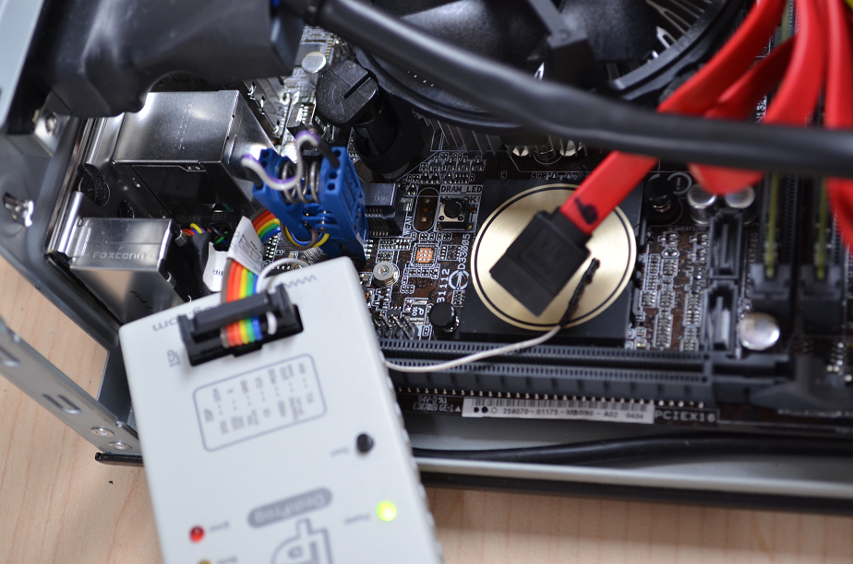

Slide 9
Stealth
Security software usually doesn’t monitor all firmware on the platform
How can software reliably tell infected from good firmware
Devices use obscure hardware interfaces to their firmware
Which tool do we use to find BIOS/UEFI infection? And rootkit in firmware of SSD, NIC, EC, BMC, modem, USB thumb-drive, battery gauge, charger?

Slide 10
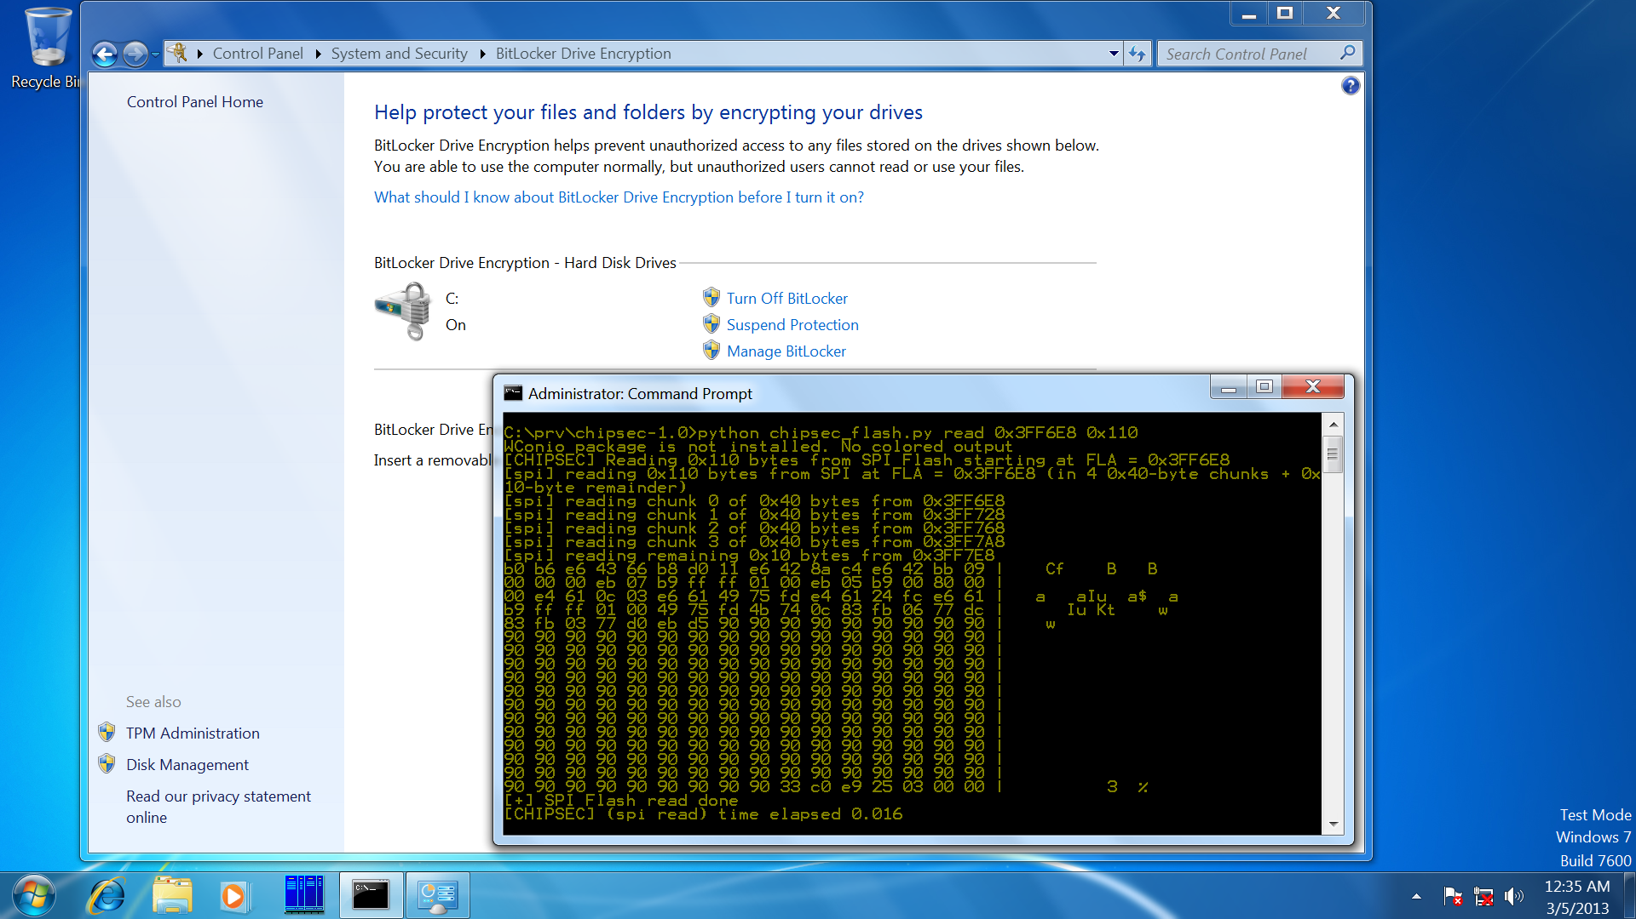
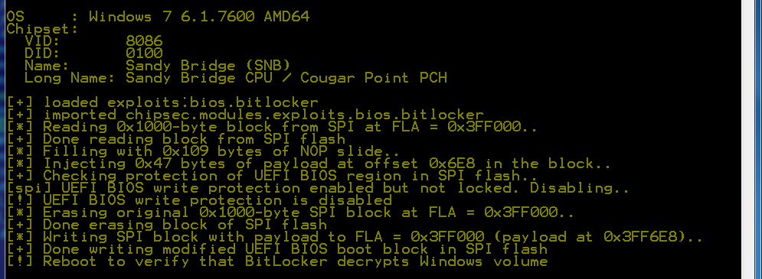
Bypass Software Security – FDE
Source: Evil Maid Just Got Angrier: Why Full-Disk Encryption with TPM is not Secure on Many Systems

Slide 11
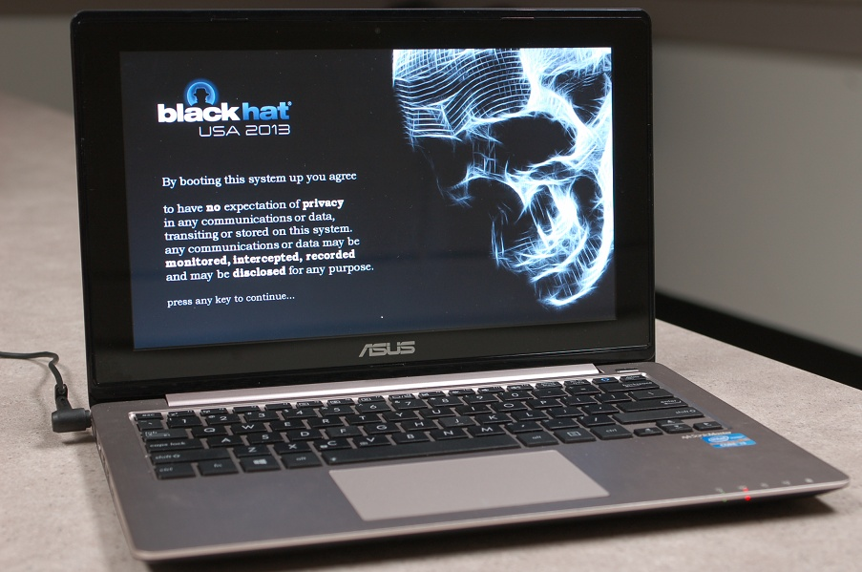
Bypass Software Security – Secure Boot
Source: A Tale of One Software Bypass of Windows 8 Secure Boot

Slide 12
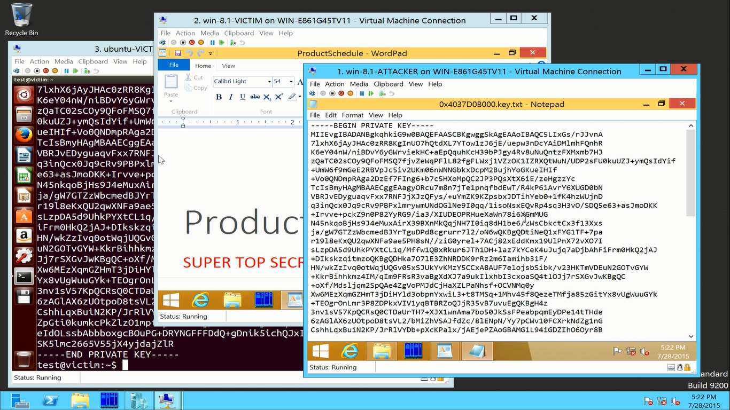
Bypass Software Security - VMM
Source: Attacking Hypervisors via Firmware and Hardware

Slide 13
Unfettered Access to Hardware - DRAM
CPU Skt
DRAM
DDR4 channel A
DDR4 channel B
SW
PCI Express
PCIE Gen3
PCI Express
PCIE Gen3
DMI
PCH
Gbe NIC
PCIE Gen2
Attacks compromising firmware on peripheral I/O devices can use inbound direct memory access (DMA) to expose sensitive contents in DRAM or modify software directly in DRAM
Reference: I/O Attacks in Intel-PC Architecture and Countermeasures by F. Lone Sang et al

Slide 14
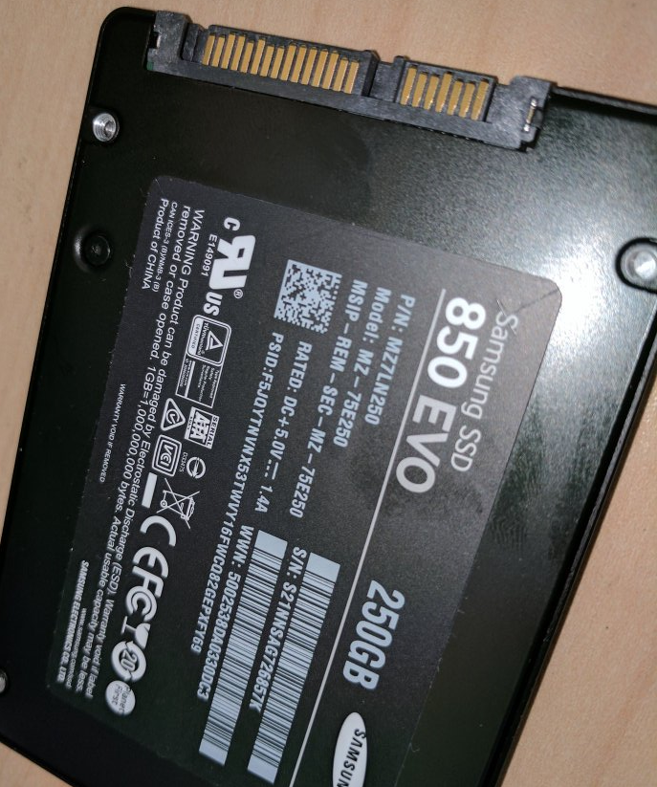
Unfettered Access to Hardware – HDD/SSD
Access to all data stored on HDD/SDD
Even when data is stored on self-encrypting drives (SED)
Example: Equation Group HDD firmware malware
Destroying your hard driver is the only way to stop this super-advanced malware

Slide 15
Unfettered Access to Hardware
NIC, WiFi, baseband modem firmware rootkits have direct access to network communications
EC or BMC firmware rootkit has access to platform management functions (power, thermal, NIC, keystrokes)
…

Slide 16
Making System Unbootable (Bricking)
Corrupt firmware or
Corrupt critical configuration
Stored in flash “ROM” memory
Of a device which is critical for system to boot or operate

Slide 17
References

Slide 18
UEFI/BIOS Security
Security Issues Related to Pentium System Management Mode (CSW 2006)
Implementing and Detecting an ACPI BIOS Rootkit (BlackHat EU 2006)
Implementing and Detecting a PCI Rootkit (BlackHat DC 2007)
Programmed I/O accesses: a threat to Virtual Machine Monitors? (PacSec 2007)
Hacking the Extensible Firmware Interface (BlackHat USA 2007)
BIOS Boot Hijacking And VMWare Vulnerabilities Digging (PoC 2007)
Bypassing pre-boot authentication passwords (DEF CON 16)
Using SMM for "Other Purposes“ (Phrack65)
Persistent BIOS Infection (Phrack66)
A New Breed of Malware: The SMM Rootkit (BlackHat USA 2008)
Preventing & Detecting Xen Hypervisor Subversions (BlackHat USA 2008)
A Real SMM Rootkit: Reversing and Hooking BIOS SMI Handlers (Phrack66)
Attacking Intel BIOS (BlackHat USA 2009)
Getting Into the SMRAM: SMM Reloaded (CSW 2009, CSW 2009)
Attacking SMM Memory via Intel Cache Poisoning (ITL 2009)
BIOS SMM Privilege Escalation Vulnerabilities (bugtraq 2009)
System Management Mode Design and Security Issues (IT Defense 2010)
Analysis of building blocks and attack vectors associated with UEFI (SANS Institute)
(U)EFI Bootkits (BlackHat USA 2012 @snare, SaferBytes 2012 Andrea Allievi, HITB 2013)
Evil Maid Just Got Angrier (CSW 2013)
A Tale of One Software Bypass of Windows 8 Secure Boot (BlackHat USA 2013)
BIOS Chronomancy (NoSuchCon 2013, BlackHat USA 2013, Hack.lu 2013)
Defeating Signed BIOS Enforcement (PacSec 2013, Ekoparty 2013)
UEFI and PCI BootKit (PacSec 2013)
Meet ‘badBIOS’ the mysterious Mac and PC malware that jumps airgaps (#badBios)
All Your Boot Are Belong To Us (CanSecWest 2014 Intel and MITRE)
Setup for Failure: Defeating Secure Boot (Syscan 2014)
Setup for Failure: More Ways to Defeat Secure Boot (HITB 2014)
Analytics, and Scalability, and UEFI Exploitation (INFILTRATE 2014)
PC Firmware Attacks, Copernicus and You (AusCERT 2014)
Thunderstrike (https://trmm.net/Thunderstrike)
Extreme Privilege Escalation (BlackHat USA 2014)
Attacks on UEFI Security (31C3)
A new class of vulnerabilities in SMI Handlers (CanSecWest 2015)
Attacking and Defending BIOS in 2015 (RECon 2015)
Exploiting UEFI boot script table vulnerability (My aimful life)
Technical details of the S3 resume boot script vulnerability (ATR)
How you Mac firmware security is completely broken (reverse.put.as)
Building reliable SMM backdoor for UEFI based systems (My aimful life)
Breaking UEFI security with software DMA attacks (My aimful life)
Attacking Hypervisors Using Firmware and Hardware (Black Hat USA 2015)
Exploiting SMM Callout Vulnerabilities in Lenovo firmware (My aimful life)

Slide 19
Other Firmware Security
CPU/SoC
ITL papers (website)
AMD x86 SMU firmware analysis (https://events.ccc.de/congress/2014/Fahrplan/system/attachments/2503/original/ccc-final.pdf) by Rudolf Marek
The Memory Sinkhole (https://www.blackhat.com/docs/us-15/materials/us-15-Domas-The-Memory-Sinkhole-Unleashing-An-x86-Design-Flaw-Allowing-Universal-Privilege-Escalation.pdf) by Christopher Domas
Full TrustZone Exploit for MSM8974 (http://bits-please.blogspot.com/2015/08/full-trustzone-exploit-for-msm8974.html?m=1)
QSEE privilege escalation vulnerability CVE-2015-6639 (http://bits-please.blogspot.com/2016/05/qsee-privilege-escalation-vulnerability.html?m=1)
USB
Turning USB Peripheral to BadUSB (https://srlabs.de/badusb/)
Practical BadUSB attack software (https://github.com/adamcaudill/Psychson)
DRAM
Cold Boot attacks (https://citp.princeton.edu/research/memory/)
Exploiting the DRAM rowhammer bug (http://googleprojectzero.blogspot.com/2015/03/exploiting-dram-rowhammer-bug-to-gain.html?m=1)
Battery
Battery Firmware Hacking (https://reverse.put.as/wp-content/uploads/2011/06/Battery-Firmware-Hacking.pdf) by Charlie Miller
NIC
NIC SSH Rootkit (http://cryptome.org/2014/02/nic-ssh-rootkit.htm) by Arrigo Triulzi
Project Maux Mk.II (http://www.alchemistowl.org/arrigo/Papers/Arrigo-Triulzi-PACSEC08-Project-Maux-II.pdf) by Arrigo Triulzi
Management Controllers
IPMI: Freight Train to Hell (http://fish2.com/ipmi/bp.pdf) by Dan Farmer
Sticky finger and KBC custom shop (http://esec-lab.sogeti.com/static/publications/11-recon-stickyfingers_slides.pdf) by Alexandre Gazet
Illuminating the security issues surrounding Lights-Out server management (https://jhalderm.com/pub/papers/ipmi-woot13.pdf)

Slide 20
Training materials are available on Github
https://github.com/advanced-threat-research/firmware-security-training
Yuriy Bulygin @c7zero
Alex Bazhaniuk @ABazhaniuk
Andrew Furtak @a_furtak
John Loucaides @JohnLoucaides

Slide 21
Security of BIOS/UEFI System Firmware from Attacker and Defender Perspectives Section 1. BIOS and UEFI Firmware Fundamentals
Yuriy Bulygin *
Alex Bazhaniuk *
Andrew Furtak *
John Loucaides **
* Advanced Threat Research, McAfee
** Intel

Slide 22
License
Training materials are shared under Creative Commons “Attribution” license CC BY 4.0
Provide the following attribution:
Derived from “Security of BIOS/UEFI System Firmware from Attacker and Defender Perspective” training by Yuriy Bulygin, Alex Bazhaniuk, Andrew Furtak and John Loucaides available at https://github.com/advanced-threat-research/firmware-security-training

Slide 23
Section 1. BIOS and UEFI Firmware Fundamentals

Slide 24
1.1 Introduction to Platform Hardware

Slide 25
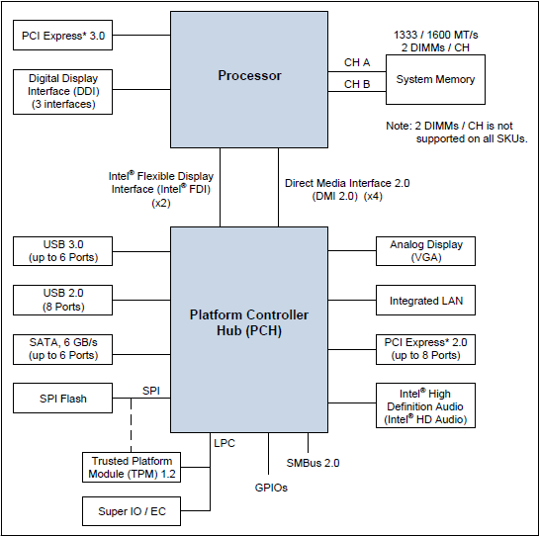
Main PC Platform Components
Source: 4th Generation Intel Core Processor Family Datasheet

Slide 26
PCI Express Overview
PCI Express Fabric consists of PCIe components connected over PCIe interconnect in a certain topology (e.g. hierarchy)
Root Complex is a root component in a hierarchical PCIe topology with one or more PCIe root ports
Components: Endpoints (I/O Devices), Switches, PCIe-to-PCI/PCI-X Bridges
All components are interconnect via PCI Express Links
Physical components can have up to 8 physical or virtual functions
Some endpoints are integrated into Root Complex

Slide 27
PCI Express Overview
CPU
PCI Express Endpoint
PCI Express
Root Complex
DRAM
PCI Express to PCI/PCI-X Bridge
PCI Express
PCI Express
PCI/PCI-X
Switch
PCI Express
PCI Express
Legacy Endpoint
Legacy Endpoint
PCI Express Endpoint
PCI Express Endpoint
Reference: https://www.mindshare.com/files/ebooks/PCI%20Express%20System%20Architecture.pdf

Slide 28
PCIe Configuration Space Layout
Each function has its own configuration (256 bytes of PCI config space and 4kB of PCIe extended config space)
FFFh
Extended configuration space for PCI Express parameters and capabilities (Not available on legacy OS)
PCI Express Capability Structure
Capability needed by BIOS or by driver software on non PCI Express aware OS
PCI 3.0 Compatible Configuration Space Header
PCI Express Extended Configuration Space (Not available for legacy operating system)
PCI Configuration Space (Available on legacy OS through legacy PCI mechanisms)
FFh
3Fh
0
Reference: PCI Express Base Specification Revision 3.0

Slide 29
PCIe Configuration Space Access
SW uses one these mechanisms to access config space:
Legacy configuration access via control CF8h & data CFCh processor I/O ports
PCI config register address
bus << 16 | device << 11 | function << 8 | offset & ~3
CF8h ← 1<<31 | bdf_address
Read data from or write data to port (CFCh + off[1:0])
Enhanced configuration access mechanism (ECAM) to PCIe extended configuration registers
8 * 100h per device
32* 8 * 100h per bus
100h bytes of CFG header

Slide 30
Low Pin Count (LPC) Interface
LPC specification
Substitutes Industry Standard Architecture (ISA) X-bus
7 required signals (LAD3-0,LFRAME,LRESET,LCLK), 6 optional
33 MHz PCI compatible host controller driven clock
LPC controller is integrated into PCH or ICH
Host decodes IO or MMIO cycles on PCI to LPC cycles:
Memory Rd/Wr
I/O Rd/Wr
DMA Rd/Wr (via Intel 8237 DMA controller)
Bus Master Memory Rd/Wr
Bus Master I/O Rd/Wr
Firmware Memory Rd/Wr

Slide 31
Low Pin Count (LPC) Interface
Firmware Hub: legacy Boot ROM (BIOS)
Discrete Trusted Platform Module (TPM)
MMIO 0xFED4xxxx
Super I/O (Floppy Disk Controller, PS/2 KBC, serial and parallel ports)
KB IO 60h/64h
FDD IO 3F0h-3F7h …
SP IO 3F8h-3FFh …
PP IO 378h-37Fh …
Embedded Controller
IO 62h/66h
Audio, AC’97, MIDI…
ISA (optional)
PCI/Host Bus
Host
Flash
BIOS
Super I/O
KBC, PP, SP, FDC
Embedded Controller
Reference: LPC specification

Slide 32
Serial Peripheral Interface (SPI)
4-pin synchronous serial interface
SCLK, MOSI, MISO, CSn/SSn (1 per slave device); optional IOx signals for fast read modes
Master - Slave protocol: 1 master, N slaves
Lower cost for system flash (BIOS) than FWH on LPC
SPI Controller is in PCH or ICH
Supports JEDEC Serial Flash Discoverable Parameter (SFDP) to query capabilities of SPI flash device
Boot BIOS straps (BBS) define if firmware is in LPC or SPI
SPI peripherals: sensors, serial NOR flash memory, MMC/SD...
Devices connected to SPI bus in chipset:
Flash Memory Devices
TPM over SPI (CS2#) on newer systems

Slide 33
Chipset SPI Controller
PCH supports 3 SPI flash devices up to 16MB each
Descriptor and non-descriptor Modes
CS0# must be flash memory device with a valid Flash Descriptor (FD)
Descriptor mode is required on PCH based platforms
Flash descriptor describes contents of the flash memory
Hardware and Software Sequencing operational modes
Hardware sequencing preprograms SPI bus cycles and CS0#
Software sequencing allows software to choose SPI cycles and CS

Slide 34
System Flash Memory
Direct Access (e.g. FFFFFFFFh PA mapped to SPI direct read cycle), Program Register Access (SW programs Flash Linear Address to SPI MMIO registers)
For multiple masters SPI flash should support HW seq
FLA FFFFFFh maps to the top of Flash device
Erase cycles set all Fs: 0 → 1
In descriptor mode, SPI flash memory devices contain multiple ranges
Region | Content
0 | Flash Descriptor
1 | BIOS
2 | Intel Management Engine
3 | Gigabit Ethernet
4 | Platform Data
Reference:
Intel 7 Series Chipset PCH datasheet

Slide 35
SPI Flash Descriptor
4KB
OEM Section
Region 0 at FLA 0 – FFFh (4 KB)
Signature: 0FF0A55Ah at 10h LBA
Contains the following sections:
Component: flash device configuration
Region: describes other regions
Master: defines Rd/Wr Access Control table
CPU and PCH soft straps
ME VSCC Table: JEDEC ID & VSCC info
OEM: reserved for OEM use
Access Control table defines which masters (CPU, ME, GbE) can access regions (FD has to be write-protected)
Descriptor Upper MAP
Management Engine VSCC Table
Reserved
PCH Soft Straps
Master
Region
Component
Descriptor MAP
10h
Reference: Intel 7 Series Chipset PCH datasheet
Signature

Slide 36
System Flash Security
Chipset (SPI controller) based protections
SMM based BIOS Write Protection: write-protects entire BIOS region from software other than SMI handler firmware executing in SMM
SPI Protected Range registers (PR0-PR4): read/write protection of SPI flash regions based on FLA for program register access
Flash Descriptor based access control: defines read/write access to each flash region by each master
Firmware may use SPI flash chips write protection (WP#)

Slide 37
System Management Bus (SMBus)
SMBus 2.0 specification
2-pin interface (SMBDATA, SMBCLK), opt. SMBALERT#
SMBus host controller to communicate over SMBus:
DIMM Serial Presence Detect (SPD) EEPROM
DIMM Thermal Sensors
EC or BMC (host-to-uC, uC-to-sensors, BMC-to-NIC)
Commands: Read/Write Byte/Word, Send/Receive Byte, Process Call..
Can operate in I²C mode
Intel ME has SMBus controller(s)
PCIe connectors include SMBus pins for side band management
DMTF Alert Standard Format (ASF) sensors
PMBus for power supplies

Slide 38
Where is system firmware?
VM
VM
App
App
App
App
OS
OS
System firmware (BIOS/SMM, EFI) & OS/VMM share access, but not trust
VMM / Hypervisor
SMM / BIOS
Privilege
Hypervisor can grant VM direct hardware access
CPU
Memory
Peripherals
Firmware
Hardware
A specific Peripheral may have its own processor, and its own firmware, which is undetectable by host CPU/OS.
Platform
DMA
Source: Symbolic execution for BIOS security

Slide 39
Hardware Boot Sequence
External power supplied (e.g. 12V) to the system and settles
Power is driven in a sequence to multiple processor and chipset voltage rails
Platform clocks are derived from external clock and oscillators
Processor reset signal is de-asserted
Power management logic in the CPU executes reset sequence (samples fuses, handshake with the PCH, reads Power-On configuration etc.)
Power management logic brings cores out of reset
Processor cores execute reset microcode (initializes x86 state, parses FW interface table, etc.)
Finally, reset microcode fetches the first instruction at physical address FFFFFFF0h known as reset vector

Slide 40
x86 Reset Vector
CPU starts in Real-Address Mode (or Real Mode)
CS = F000h, CS limit = FFFFh, EIP = FFF0h
So reset vector should be at F000:FFF0 = (F000h << 4) + FFF0h = 000FFFF0h
In 8086 BIOS ROM was mapped under 1MB. Now CPU/chipset map larger BIOS ROM under 4GB (FFFFFFFFh)
CPU asserts upper 12 address bits high by programming reset value of CS descriptor cache CS base to FFFF0000h
So reset vector is CS base + EIP = FFFF0000h + FFF0h = FFFFFFF0h
Until firmware executes FAR JMP to reload CS with F000h to stay in real mode under 1MB or enter protected mode early

Slide 41
Reset Vector Decode
CPU decodes addresses FFFxxxxxh down to system bus (DMI) to chipset
Chipset decoded memory reads to SPI flash controller (or Firmware Hub) per configurable decoding rules
Memory reads are claimed by SPI flash controller which sends them as direct SPI read cycle to FFFFF0h flash address (FLA)
This ensures that memory reads (i.e. reset vector code fetch) to mapped BIOS ROM range are directed to firmware ROM (e.g. SPI flash memory device)

Slide 42
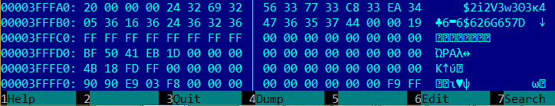
x86 Reset Vector Example
Reset vector: near jump to the rest of the BIOS Boot Block
NOP
NOP
JMP SHORT Rel16 ; EarlyBSPInit or SEC entry-point

Slide 43
Firmware Start
CPU start executing system firmware code at reset vector which is mapped to firmware ROM
Reset vector contains a jump to the initial firmware known as [Initial] Boot Block
Boot block consists of most of the early platform initialization functionality (SEC and PEI phases for UEFI based firmware)
Boot block executes early pre-memory initialization code, and memory initialization code (Memory Reference Code)

Slide 44
Firmware Boot Sequence – Early Boot
Firmware in multiprocessor system chooses Bootstrap Processor (BSP). Other processors are in Wait-For-SIPI
Firmware on BSP initializes BSP CPU
Loads early CPU microcode update on BSP
Initializes Local APIC
Ensure all APs are in Wait-For-SIPI or broadcast INIT IPI
Initializes IDT/GDT and switches to flat 32-bit protected mode (CR0.PE)
Configure fixed and variable memory types (MTRR)
Enable cache on BSP (CR0.CD/CR0.NW)
Enable No-Evict Mode (NEM) to set up Cache-As-RAM (CAR) for stack and code
Initialize basic chipset interfaces (Root Complex, SMBus controller, MMCFG…)

Slide 45
Firmware Boot Sequence – DRAM Init
FW performs SoC specific DRAM initialization (MRC)
Read DIMM parameters from SPD EEPROM over SMBus
Trains DDR busses
Initializes memory controller
Initializes memory map, stolen ranges
Memory shadowing: FW Copies the rest of the firmware to DRAM
Decompression code decompresses FV from SPI flash and copies below 1MB
Exit CAR mode and transition to shadowed code in DRAM
Modify Programmable Attribute Map (PAM) registers to decode to DRAM

Slide 46
Firmware Boot Sequence – DRAM Init
Wake other processors (APs)
APs will execute wake-up init code
SMRAM Init
BSP copies SMM relocation handler at 0x30000p
Allocates TSEG and copies run-time SMI handler
Sends SMI to relocate SMI handler to TSEG
SMM relocation handler will configure SMRR
Continue with chipset initialization (DXE for UEFI)
USB, SATA …
Enumerate and initialize PCI devices
PCI devices enumeration
Allocate MMIO spaces for device MMIO BARs
Load and execute PCI Expansion/Option ROMs

Slide 47
Memory Map: System View
High MMIO
Low DRAM
Memory vs MMIO
Low MMIO
4GB boundary
High DRAM
High MMIO
Top of High DRAM
4GB
Low MMIO
BAR 1 – BAR n
ECAM
Top of Low DRAM
Reference: 4th Gen Intel Core Processor Family Datasheet

Slide 48
Memory Map (Below 4GB)
System View
Memory Controller View
Legacy Ranges (PAMx)
ISA Hole
SMRAM
Graphics Stolen Memory
Low DRAM (TOLUD)
Memory vs MMIO
PCIe MMCFG
MMIO BARs
Reserved Ranges (APIC, TPM, TXT)
High BIOS
4GB
Direct-mapped BIOS, APIC, TPM
OS invisible
Reclaim
Memory area
Low MMIO (PCI memory range)
TOLUD
BAR 1 – BAR n
Graphics Stolen
& GTT Memory
ECAM
BGSM
SMM Memory
TSEG
SMM Memory
Low DRAM
Low DRAM
1 MB
Legacy Memory
0
Reference: 4th Gen Intel Core Processor Family Datasheet

Slide 49
Memory Map (Above 4GB)
Memory Reclaim
High DRAM (TOUUD)
ME Stolen Range
Top Of Memory
System View
Memory Controller View
High MMIO
TOUUD
TOM
OS invisible
Reclaim
Memory area
ME Stolen Mmeory
REMAP BASE
MESEG
High DRAM
High DRAM
4GB
OS invisible
Reclaim
Memory area
Reference: 4th Gen Intel Core Processor Family Datasheet

Slide 50
1.2 Platform Firmware: BIOS

Slide 51
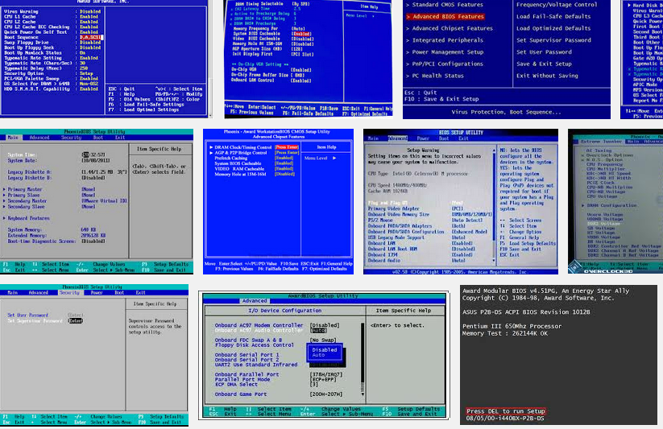

Slide 52
Legacy BIOS
The Basic Input / Output System (BIOS) is the software embedded on a ROM chip (SPI flash memory devices) located on the computer’s main board
The BIOS is fetched by the processor at reset vector address (FFFFFFF0h) and executes Power-On Self Test (POST) to test and initialize the system components, initializes add-on devices and then boots the OS.
The BIOS also handles the low-level input/output to the various peripheral devices connected to the computer
Plug and Play BIOS Specification

Slide 53
Legacy BIOS Stages
CPU Reset vector in BIOS ’ROM’ (Boot Block) →
Boot Block
Basic CPU, chipset initialization →
Initialize CAR, load and run from cache →
Initialize DRAM memory →
POST (Power-On Self Test)
Decompress and relocate system BIOS in DRAM →
Enumerate add-on devices (ISA, PCI).. →
Execute Option ROMs on expansion cards →
INT 19h
Locate, load and execute Initial Boot Loader code in MBR (at 0x7C00 PA) →
2nd Stage Boot Loader → OS Loader → OS kernel
Also Technical Note: UEFI BIOS vs. Legacy BIOS, Advantech

Slide 54
Legacy Option ROMs
Legacy option ROMs are BIOS extensions required to initialize add-on devices (ISA, PCI, PCIe) not supported by the system BIOS nor required to boot the system
Option ROMs are detected by the BIOS during after POST and their entry points are called
Scanned in physical memory between addresses C0000h and F0000h and detected by 0x55 0xAA signature
During initialization, an Option ROM may hook any IVT vectors and update any data structures required for it to access attached devices and perform the necessary identifications and initializations
BIOS Boot Specification

Slide 55
1.3 Platform Firmware: (U)EFI Firmware

Slide 56
Industry Transition
Pre-2000
All Platforms BIOS were proprietary
Intel invented the Extensible Firmware Interface (EFI) and provided sample implementation under free BSD terms
2000
tianocore.org, open source EFI community launched
2004
Unified EFI (UEFI)
Industry forum, with 11 members, was formed to standardize EFI
2005
240 members
Major MNCs shipping; UEFI platforms crossed most of IA worldwide units; Microsoft* UEFI x64 support in Server 2008, Vista* and Win7*; RedHat* and SuSEl* OS support. Mandatory for Windows 8 client. ARM 32 and 64 bit support. ACPI added.
2015
Source: http://www.slideshare.net/k33a/uefi

Slide 57
(Unified) Extensible Firmware Interface
Industry Standard Interface Between Firmware & OS
Processor Architecture and OS Independent
C Development Environment (EDK2/UDK)
Rich GUI Pre-Boot Application Environment
Includes Modular Driver Model
UEFI executables: PE/COFF or TE executable files
UEFI file system is FAT32
UEFI OS uses UEFI compliant bootloader:
/efi/boot/bootx64.efi /efi/redhat/grub.efi
Secure Boot of Microsoft Windows 8 or above requires UEFI
UEFI firmware supports booting legacy OS from legacy MBR via Compatibility Support Module (CSM)

Slide 58
UEFI Firmware Evolution
Class 0:
Legacy BIOS
Class 1:
UEFI CSM only
Class 2:
UEFI switch:
CSM & UEFI
Class 3:
UEFI only

Slide 59
Compatibility Support Module (CSM)
CSM is a UEFI component which allows legacy OS boot loader (MBR) and legacy Option ROM to execute on top of UEFI based firmware without modifications
CSM has to emulate some legacy BIOS runtime services required for legacy boot
CSM consists of the following components:
EfiCompatoibility (Legacy BIOS driver, drivers for legacy devices like PIC 8259)
Compatibility16BIOS (provides legacy BIOS runtime services as INT13, INT15, INT19 etc.)
Compatibility16SMM (provides legacy SMI handlers)
Thunk/ReserveThunk (switching between 32-bit and 16-bit modes)
Legacy Option ROM interface

Slide 60

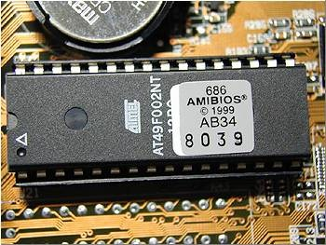
(U)EFI Firmware
OS Kernel / Drivers
UEFI OS Loaders
DXE
Driver
DXE
OROM
UEFI App
UEFI
Boot Loader
Bootx64.efi
Bootmgfw.efi
HDD
DXE
Driver
DXE
OROM
UEFI App
UEFI DXE Core / Dispatcher
System Firmware (SEC/PEI)
Hardware
I/O
Memory
Network
Graphics

Slide 61
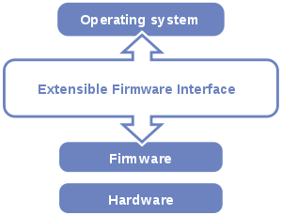
(U)EFI Firmware
OS Kernel / Drivers
UEFI OS Loaders
DXE
Driver
DXE
OROM
UEFI App
UEFI
Boot Loader
Bootx64.efi
Bootmgfw.efi
HDD
DXE
Driver
DXE
OROM
UEFI App
UEFI DXE Core / Dispatcher
System Firmware (SEC/PEI)
Hardware
I/O
Memory
Network
Graphics

Slide 62
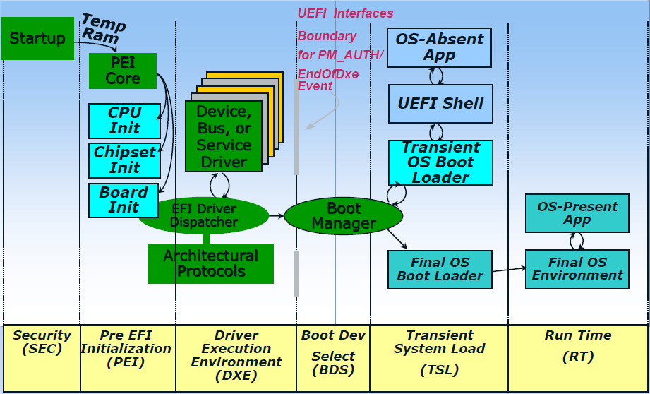
UEFI Boot
From Secure Boot, Network Boot, Verified Boot, oh my and almost every publication on UEFI

Slide 63
UEFI [Compliant] Firmware
CPU Reset
SEC
S-CRTM; Init caches/MTRRs; Cache-as-RAM (NEM); Recovery; TPM Init
Pre-EFI Init (PEI)
S-CRTM: Measure DXE/BDS
Early CPU/PCH Init
Memory (DIMMs, DRAM) Init, SMM Init
Driver Exec Env (DXE)
Continue initialization of platform & devices
Enum FV, dispatch drivers (network, I/O, service..)
Produce Boot and Runtime Services
Boot Dev Select (BDS)
Boot Manager (Select Boot Device)
EFI Shell/Apps; OS Boot Loader(s)
ACPI, UEFI SystemTable, SMBIOS table
Runtime / OS
ExitBootServices. Minimal UEFI services (Variable)

Slide 64
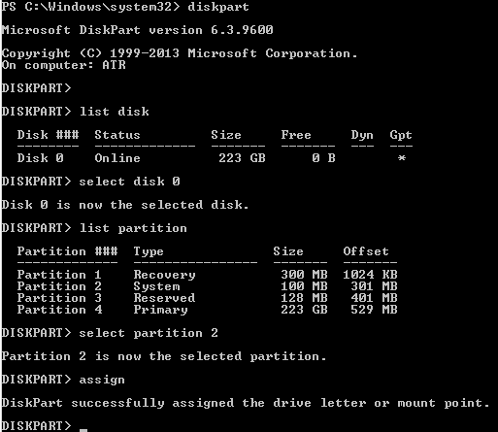
UEFI OS Booting
Exit UEFI Boot Services
Looking into UEFI boot variable: BootXXXX for discover UEFI storage devices
UEFI transfer control to OS bootloader from storage device
GPT
DISK
UEFI FS FAT32 partition with /EFI/BOOT/OS-loader.efi
OS partition
other partition…

Slide 65
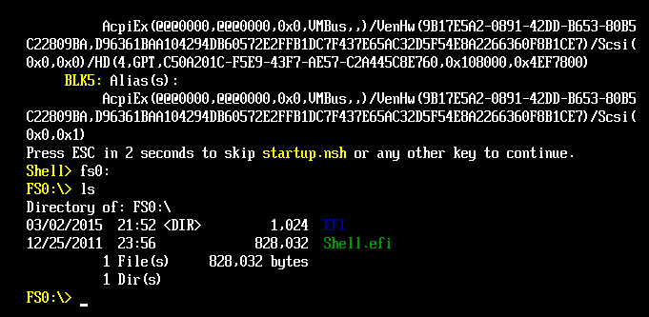
UEFI Shell
UEFI shell is a shell command line environment
Used to run shell commands and UEFI applications: dmpstore
UEFI OS boot loaders are also UEFI “applications”

Slide 66
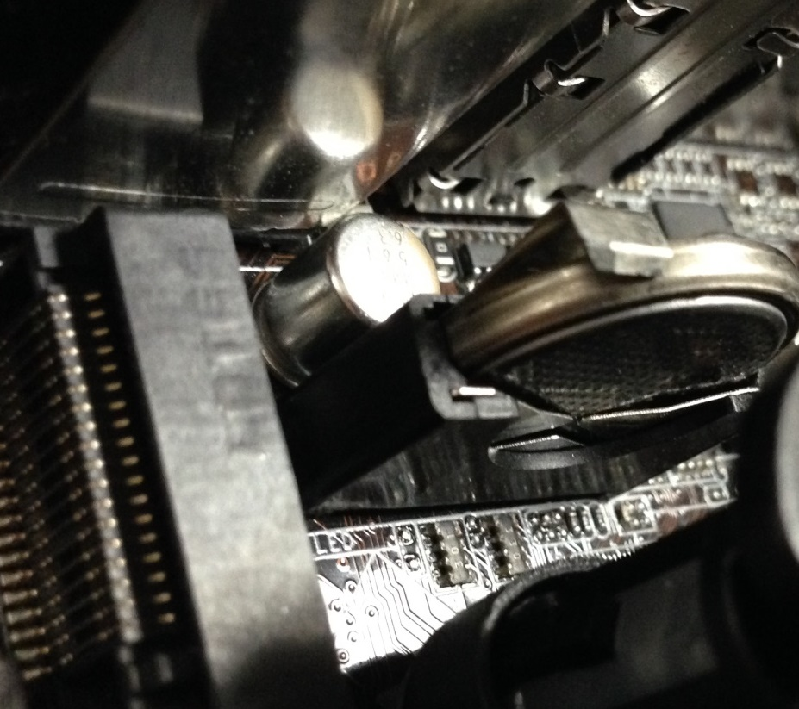
BIOS Configuration: CMOS Memory
256 bytes (low & high 128)
Backed by a small battery. Can be cleared by removing the “coin” battery (or a jumper)
Stores BIOS specific configuration settings
# chipsec_util.py cmos dump

Slide 67
UEFI Configuration: UEFI “Variables”
UEFI variables contain configuration setup, vendor information, language information, input/output console, error console, and boot order setting, secure boot configuration, long information after capsule update, pointer to S3 boot script and so on.
Attributes of UEFI variables:
NV (Non-Volatile)
BS (Boot Service)
RT (Run-Time)
Authentication attributes
NV variables are stored in NVRAM in SPI flash memory

Slide 68
Windows API to access UEFI variables
Windows 8+ provides user mode API to access run-time UEFI variables
GetFirmwareEnvironmentVariable http://msdn.microsoft.com/en-us/library/windows/desktop/ms724325(v=vs.85).aspx
SetFirmwareEnvironmentVariable http://msdn.microsoft.com/en-us/library/windows/desktop/ms724934(v=vs.85).aspx

Slide 69
UEFI, EDK I, EDK II, UDK, Tianocore
TianoCore is an open source implementation of UEFI, the Unified Extensible Firmware Interface
EDK II is a modern, feature-rich, cross-platform firmware development environment for the UEFI and PI specifications: http://www.tianocore.org/edk2/
UDK (UEFI Developers Kit) is a stable release of portions of the EDK II (UDK2015)
The UDK2015 is the EDKII support for all currently published UEFI specifications UDK2015 currently supports UEFI 2.5 and PI 1.4 level of specifications
EDK I is the older EFI 1.x development environment

Slide 70

UEFI Working Groups
USWG
UEFI Specification Working Group
PIWG
Platform Initialization Working Group
ASWG
ACPI Specification Working Group
BOS
Board Of Directors
USST
USWG Security Sub-team
Chaired by Vincent Zimmer (Intel)
Responsible for all security related material and the team that has added security infrastructure in the UEFI spec
USRT
UEFI Security Response Team
Chaired by Dick Wilkins (Phoenix)
Provide response to security issues.
UNST
UEFI Network Sub-team (VZ chairs, too)
Evolve network boot & network security infrastructure for UEFI Specification
www.uefi.org
ASWG, PIWG
BOD
USRT
USWG
UNST
USST
……
Note: Engaged in firmware/boot
Related WG’s of Trusted Computing Group (TCG), IETF, DMTF

Slide 71
The road from core to platform
tianocore.org
Open Source
Reference Tree
OEM BIOS
New product
Open Source
Existing product
End users updating?
Commercial product in the field
Consumer product in the field
IBV

ODM BIOS
All
Intel
OEM
IBV
ODM
ODMs updating?
New product
Existing ODM product
Time
Source: http://vzimmer.blogspot.com/2015_05_01_archive.html

Slide 72
1.4 Platform Firmware: SMI Handlers

Slide 73
x86 System Management Mode (SMM)
Real-Address Mode
SMI#
Reset or
PE=0
PE=1
Protected Mode
SMI#
RSM
System Management Mode
Reset
RSM
LME=1,CR0.PG=1
SMI#
IA-32e
Mode
VM=0
VM=1
RSM
Virtual-8086
Mode
SMI#
Source: Intel® 64 and IA-32 Architectures Software Developer’s Manual

Slide 74
System Management Mode (SMM)
SMRAM is a range of DRAM reserved by BIOS for runtime part - SMI handlers
CPU enters System Management Mode (SMM) upon receiving System Management Interrupt (SMI#) from the chipset or other logical CPU
SMI handler firmware is executing in SMM
CPU (OS) state is saved in SMRAM upon entry to SMM and restored upon exit from SMM
CPU exits SMM to the interrupted OS when SMI handler executes RSM instruction (“Resume from SMM”)

Slide 75
Initial SMM Execution Environment
Separate address space (SMRAM)
SMM starts as Read-Address Mode with flat 32-bit addressable space without paging (CR0 PE/PG = 0)
SMI handler firmware can enable paging later
Segments: base = 0, limit = FFFFFFFFh
Addressable physical memory: 0 to FFFFFFFFh (4G)
CS.base = SMBASE (30000h at reset), EIP=8000h
➔ SMM entry point = SMBASE + 8000h
All hardware interrupts are disabled upon entry

Slide 76
System Management RAM (SMRAM)
0xFFFFFFFF
SMRAM
SMRAM
SMBASE + FFFFh
SMM state save area
SMRR_PHYSBASE
SMBASE + FE00h
SMI handlers
SMBASE + 8000h
0x00000000
SMBASE

Slide 77
x64 SMM Save State
Offset (Added to SMBASE + 8000H) | Register | Writable?
7FF8H | CR0 | No
7FF0H | CR3 | No
7FE8H | RFLAGS | Yes
7FE0H | IA32_EFER | Yes
7FD8H | RIP | Yes
7FD0H | DR6 | No
7FC8H | DR7 | No
7FC4H | TR SEL1 | No
7FC0H | LDTR SEL1 | No
7FBCH | GS SEL1 | No
7FB8H | FS SEL1 | No
7FB4H | DS SEL1 | No
7FB0H | SS SEL1 | No
7FACH | CS SEL1 | No
7FA8H | ES SEL1 | No
7FA4H | IO_MISC | No
7F9CH | IO_MEM_ADDR | No
7F94H | RDI | Yes
Reference: Intel® 64 and IA-32 Architectures Software Developer’s Manual

Slide 78
x64 SMM Save State (cont’d)
Offset (Added to SMBASE + 8000H) | Register | Writable?
7F8CH | RSI | Yes
7F84H | RBP | Yes
7F7CH | RSP | Yes
7F74H | RBX | Yes
7F6CH | RDX | Yes
7F64H | RCX | Yes
7F5CH | RAX | Yes
7F54H | R8 | Yes
7F4CH | R9 | Yes
7F44H | R10 | Yes
7F3CH | R11 | Yes
7F34H | R12 | Yes
7F2CH | R13 | Yes
7F24H | R14 | Yes
7F1CH | R15 | Yes
7F1BH-7F04H | Reserved | No
7F02H | Auto HALT Restart Field (Word) | Yes
7F00H | I/O Instruction Restart Field (Word) | Yes
7EFCH | SMM Revision Identifier Field (Doubleword) | No
7EF8H | SMBASE Field (Doubleword) | Yes
Reference: Intel® 64 and IA-32 Architectures Software Developer’s Manual

Slide 79
Locating SMRAM using CHIPSEC
python chipsec_util.py msr 0x1f2
..
[*] loading common platform config from ‘..chipsec\tool\chipsec/cfg\common.xml'..
[*] loading 'hsw' platform config from ‘..chipsec\tool\chipsec/cfg\hsw.xml'..
[CHIPSEC] Executing command 'msr' with args ['0x1f2']
[CHIPSEC] CPU0: RDMSR( 0x1f2 ) = 00000000DA000006 (EAX=DA000006, EDX=00000000)
[CHIPSEC] CPU1: RDMSR( 0x1f2 ) = 00000000DA000006 (EAX=DA000006, EDX=00000000)
[CHIPSEC] CPU2: RDMSR( 0x1f2 ) = 00000000DA000006 (EAX=DA000006, EDX=00000000)
[CHIPSEC] CPU3: RDMSR( 0x1f2 ) = 00000000DA000006 (EAX=DA000006, EDX=00000000)
python chipsec_util.py msr 0x1f3
..
[*] loading common platform config from ‘..chipsec\tool\chipsec/cfg\common.xml'..
[*] loading 'hsw' platform config from ‘..chipsec\tool\chipsec/cfg\hsw.xml'..
[CHIPSEC] Executing command 'msr' with args ['0x1f3']
[CHIPSEC] CPU0: RDMSR( 0x1f3 ) = 00000000FF000800 (EAX=FF000800, EDX=00000000)
[CHIPSEC] CPU1: RDMSR( 0x1f3 ) = 00000000FF000800 (EAX=FF000800, EDX=00000000)
[CHIPSEC] CPU2: RDMSR( 0x1f3 ) = 00000000FF000800 (EAX=FF000800, EDX=00000000)
[CHIPSEC] CPU3: RDMSR( 0x1f3 ) = 00000000FF000800 (EAX=FF000800, EDX=00000000)

Slide 80
System Management Interrupt (SMI) Handler
SMM code flow
SMM Core dispatcher
SMST
SMI
RSM
I/O info
Memory info
CPU info
SMM callback
SMM Driver
SMM Driver
SMM callback
SMM callback
SMM Driver
...

Slide 81
1.4 Platform Firmware: Hardware Reference Code, etc.

Slide 82
Hardware Reference Code
Reference Code is a part of BIOS / system firmware which initializes specific piece of platform
CPU reference code (microcode update, CAR/NEM init)
Memory reference code trains DDR, initializes DIMMs, initializes memory controller, creates memory map
Chipset reference code initializes internal PCH interfaces
Provided by CPU/chipset vendors to original equipment manufacturers (OEMs) or BIOS vendors (IBV) for integration into the final BIOS for specific platform

Slide 83
Intel® Firmware Support Package (FSP)
The Intel FSP provides processor, memory & chipset initialization in a format that can easily be incorporated into existing boot loader (firmware) frameworks
EDKII Repo
FSP FV
Silicon initialization binaries (CPU, mem, PCH/SoC) packaged into FSP
Plugs into existing FW frameworks
Binary customization
PeiCore
Core PEIMs
CPU RC
Final BIOS
FSP
Reference
BIOS
Mem RC
Chipset RC
Si Init
Platform PEIMs
Other Glue
Reference: www.intel.com/fsp

Slide 84
References and Further Reading
For further details on platform and BIOS fundamentals take
Advanced x86: Introduction to BIOS & SMM
class by John Butterworth, Xeno Kovah and Corey Kallenberg at http://OpenSecurityTraining.info

Slide 85
References and Further Reading
Advanced x86: Introduction to BIOS & SMM by John Butterworth and Xeno Kovah at OpenSecurityTraining.info
4th Generation Intel® Core™ Processor Family Datasheet (vol 1, vol 2)
PCI Express System Architecture by Budruk, Anderson and Shanley (MindShare)
PCI System Architecture by Shanley and Anderson (MindShare)
An Introduction to PCI Express by Budruk (MindShare)
PCI/PCI Express Configuration Space Access (AMD)
PCI Express Base Specification Revision 3.0 (https://pcisig.com/specifications)
LPC specification
SPI Block Guide (Motorola, Inc.)
SMBus specification
Designing with SMBus 2.0 by Dale Stolitzka (Analog Devices, Inc.)
Minimal Intel Architecture Boot Loader by Jenny M Pelner & James A Pelner (Intel)
Pentium Processor Family Developer’s Manual (Initialization and Mode Switching)
Power Sequence and Reset Utilizing the Intel® EP80579 Processor by Julio Pineda (Intel)
Plug and Play BIOS Specification
BIOS Boot Specification
Booting an Intel Architecture System by Pete Dice (Intel)
Intel® 64 and IA-32 Architectures Software Developer’s Manual
UEFI Platform Initialization Specification 1.5
UEFI Specification 2.6
A Tour Beyond BIOS: Using Intel FSP with EDKII

Slide 86
Training materials are available on Github
https://github.com/advanced-threat-research/firmware-security-training
Yuriy Bulygin @c7zero
Alex Bazhaniuk @ABazhaniuk
Andrew Furtak @a_furtak
John Loucaides @JohnLoucaides

Slide 87
Security of BIOS/UEFI System Firmware from Attacker and Defender Perspectives Section 2. Bootkits and Secure Boot
Yuriy Bulygin *
Alex Bazhaniuk *
Andrew Furtak *
John Loucaides **
* Advanced Threat Research, McAfee
** Intel

Slide 88
License
Training materials are shared under Creative Commons “Attribution” license CC BY 4.0
Provide the following attribution:
Derived from “Security of BIOS/UEFI System Firmware from Attacker and Defender Perspective” training by Yuriy Bulygin, Alex Bazhaniuk, Andrew Furtak and John Loucaides available at https://github.com/advanced-threat-research/firmware-security-training

Slide 89
Section 2. Bootkits and Secure Boot

Slide 90
2.1 In the beginning

Slide 91
Early days. Boot sector infection
Elk Cloner – one of the first known viruses. Created by CAS freshman Richard Skrenta (Sprengelmeyer) in 1981. Infected Apple II DOS 3.3 OS, occupied unused space inside “boot sector”. Resident in memory. Infects uninfected floppy disks.
http://virus.wikidot.com/elk-cloner

Slide 92
Early days. Boot sector infection
Brain – considered to be the first PC virus.
This virus originated in January, 1986, in Lahore Pakistan. The first noticeable infection problems did not surface until 1988.
The Brain is a boot sector infector, approximately 3 K in length, that infects 5 1/4" floppies.
The virus stores the original boot sector, and six extension sectors, containing the main body of the virus, in available sectors which are then flagged as bad sectors.
Brain is the only virus yet discovered that contains the valid names, phone numbers and addresses of the creators.
http://virus.wikidot.com/brain
http://www.textfiles.com/virus/braininf.vir (David Stang, NCSA)

Slide 93
Early days. BIOS infection
BIOS Meningitis – the worlds first flash BIOS infecting virus. Infects floppy boot-sector and hard drive MBR as well. It was coded by Qark of VLAD and appeared in Issue 2 of VLAD magazine in November 1994.
BIOS Meningitis uses various INT 16h AH=E0h (BIOS Flash routines) calls to manipulate the Flash memory. Hooks INT 19h (BIOS Boot Strap Loader) handler. The virus INT 19h handler copies the virus to 0000:7C00h (standard boot sector load address), emulates an infected MBR execution and then does the job of a standard INT 19h handler – boots from floppy or HDD.
http://virus.wikidot.com/bios-meningitis
http://www.wiw.org/~meta/vlad/vlad2/art44.htm (source code)

Slide 94
BIOS damage - CIH
In 1998-99 CIH (“Chernobyl”) virus infected 60 million and damaged 0.5 million computers causing ~$1B in damages
CIH destructive payload, when activated, attempts to corrupt system BIOS in ROM and 2048 sectors on all hard drives including boot sectors
Sources: Wikipedia, F-Secure, Kaspersky Lab, GRC

Slide 95
2.2 Boot Sectors

Slide 96
Master Boot Record (MBR)
MBR helps BIOS to locate OS partition and boot the OS
MBR is located at LBA 0 (the first boot sectors) of the disk
MBR contains:
boot code (initial program loader) which is loaded and invoked by the BIOS
up to four partition records each defining starting and ending logical block addresses (LBA) for corresponding partitions on a disk
Legacy MBR
Partition
Partition
Partition
Partition
LBA 0
Source: https://technet.microsoft.com/en-us/library/cc976786.aspx

Slide 97
Legacy MBR structure
Mnemonic | Byte Offset | Byte Length | Description
BootCode | 0 | 424 | X86 code used on a no-UEFI system to select an MBR partition record and load the first logical block of the partition. This code shall not be executed on UEFI systems
UniqueMBRDiskSignature | 440 | 4 | Unique Disk Signature. This may be used by the OS to identify the disk from other disks in the system. This value is always written by the OS and is never written by EFI firmware
Unknown | 444 | 2 | Unknown. This field shall not be used in UEFI firmware
PartitionRecord | 446 | 16*4 | Array of four legacy MSR partition records
Signature | 510 | 2 | Set to 0xAA55 (i.e., byte 510 contains 0x55 and byte 511 contains 0xAA)
Reserved | 512 | Logical BlockSize - 512 | The rest of the logical block, if any, is reserved.
As defined in UEFI Spec 2.5, Chapter 5 GPT Disk Layout
Source: https://technet.microsoft.com/en-us/library/cc976786.aspx

Slide 98
Legacy MBR partition record
Mnemonic | Byte Offset | Byte Length | Description
BootIndicator | 0 | 1 | 0x80 indicates that this is the bootable legacy partition. Other values indicate that this is not a bootable legacy partition. This field shall not be used by UEFI firmware
StartingCHS | 1 | 3 | Start of partition in CHS address format. This field shall not be used by UEFI firmware
OSType | 4 | 1 | Type of partition.
EndingCHS | 5 | 3 | Array of four legacy MSR partition records
StartingLBA | 8 | 4 | End of partition in CHS address format. This field shall not be used by UEFI firmware.
SizeInLBA | 12 | 4 | Size of the partition of LBA units of logical blocks. This field is used by UEFI firmware to determine the size of the partition
The partition defined by each MBR Partition Record must physically reside on the disk (i.e., not exceeding the capacity of the disk).
Each partition must not overlap with other partitions.
Source: https://technet.microsoft.com/en-us/library/cc976786.aspx

Slide 99
Protective MBR
Instead of legacy MBR a protective MBR may be located at LBA0 of the disk if it is using the GPT disk layout
One of the Partition Records shall be defined in a way reserving the entire space on the disk after the Protective MBR itself for the GPT disk layout
Protective MBR
Primary GPT
UEFI system partition
Partition
Partition
Partition
Backup GPT
GPT Protective partition
LBA 0
Reference: http://blog.fpmurphy.com/2011/10/fedora-16-mbr-grub-legacy-to-gpt-grub2.html

Slide 100
Protective MBR structure
The Protective MBR precedes the GUID Partition Table Header to maintain compatibility with existing tools that do not understand GPT partition structures
Mnemonic | Byte Offset | Byte Length | Description
Boot Code | 0 | 424 | Unused by UEFI systems
Unique MBR Disk Signature | 440 | 4 | Unused. Set to zero
Unknown | 444 | 2 | Unused. Set to zero
Partition Record | 446 | 16*4 | Array of four MSR partition records. Contains: One partition record Three partition record each set to zero
Signature | 510 | 2 | Set to 0xAA55 (i.e., byte 510 contains 0x55 and byte 511 contains 0xAA)
Reserved | 512 | Logical BlockSize - 512 | The rest of the logical block, if any, is reserved. Set to zero
Reference: https://en.wikipedia.org/wiki/GUID_Partition_Table#Protective_MBR_.28LBA_0.29

Slide 101
Volume Boot Record (VBR)
A Volume Boot Record (VBR) is the first sector of a partition (opposite to MBR which is the first sector of a hard disk).
VBR (just like MBR) also contain some code and data, but it's far less standard.
The code is always OS specific, but in common all versions does the same: locate the kernel on the partition, load and execute it.
A really good example for VBR is the original DOS bootsector, which used FAT and loaded IO.SYS and MSDOS.SYS from the root directory.
Source: OS Dev Wiki http://wiki.osdev.org/Volume_Boot_Record

Slide 102
2.3 Bootkits (Boot Rootkits)

Slide 103
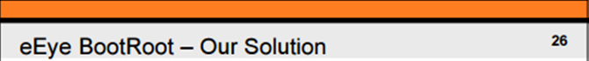
eEye BootRoot
eEye BootRoot was the first pubic proof-of-concept bootkit developed by Derek Soeder and Ryan Permeh
Hooked INT 13h (Disk access ISR) to patch OSLOADER
OSLOADER patch was able to modify OS further, e.g. patch boot drivers

Slide 104
Chronology
OS Kernel Rootkits (~ 1999+)
Research: NTRootkit, SucKIT, adore, knark
In-the-Wild: HackerDefender, Haxdoor
MBR,VBR Bootkits (~ 2005+)
Defense: Windows DSE, Patch Guard
Research: eEye BootRoot, BOOT-KIT, Vbootkit, Stoned Bootkit, Deep Boot, EvilCore
In-the-Wild: Mebroot, TDL4, FIN1, Rovnix, Olmasco, XPAJ, Gapz, Petya and Goldeneye
BIOS Rootkits (~ 2006+)
Research: Heasman’s ACPI and PCI OpROM Rootkits, Clear Hat SMM Rootkit, Phrack 65 SMM, Persistent BIOS Infection, Phrack 66 “A Real SMM Rootkit”, Rakshasa
In-the-Wild: IceLord BIOS Rootkit, Mebromi, ANT catalog
UEFI Bootkits (~ 2012+)
EFI/UEFI (support in Windows Vista, Windows 7, Server 2008)
Research: Andrea Allievi’s UEFI Bootkit, Dreamboot
(U)EFI Firmware Rootkits (~ 2012+)
Defense: Windows 8 and UEFI Secure Boot
Research: Angry Evil-Maid SRTM rootkit, A Tale of Secure Boot Bypass UEFI Bootkit, Project Maux, snare’s Mac EFI Rootkit, Thunderstrike 1 and 2, Light Eater, firmware rootkit vs VMM, Dmytro Oleksiuk’s SmmBackdoor
In-the-Wild: HackingTeam UEFI Rootkit, Mac EFI Der Starke/DarkMatter implant, Sonic Scredriver

Slide 105
Types of Bootkits
MBR
MBR Bootstrap code area modification (TDL4 here & here, Goblin, Petya & Goldeneye ransomware)
MBR Partition Table modification (Olmasco)
VBR
VBR boot code (IPL) modification (FIN1, Rovnix)
VBR BIOS Parameter Block (BPB) modification (Gapz here & here)
BIOS, UEFI
Injecting malicious Option ROMs (Mebromi)
Replacing EFI boot loaders
Installing custom firmware (EFI DXE) executables (HackingTeam UEFI Rootkit)
Additional references: Bootkits step by-step

Slide 106
MBR Bootkit: TDL4 (Olmarik, Alureon)
BIOS
EFI
Load ldr16
Hook INT 13h
MBR
VBR
bootmgr
bootmgfw.efi
BcdLibraryBoolean_DisableIntegrityCheck
BcdOSLoaderBoolean_WinPEMode
Process BCD
Winload.exe
Driver Signing Check
ntoskrnl.exe
Hall.dll
Kdcom.dll
CI.dll
Driver Signing Check
Code Integrity Check
Load ldr32
Load drv32 or drv64
Source: What's different with TDL4 and TDL3

Slide 107
VBR Bootkit: Fin1
The installer (BOOTRASH) reads the original boot sector into memory
Saves an backup copy of the VBR code at 0xE sectors from the start of the partition. Apple integrity check.
Installer decodes the new bootstrap code from one of its embedded resources and overwrites the existing bootstrap code
BOOTRASH hijacks boot process in order to load the Nemesis payload before the OS.
BOOTRASH creates its own custom virtual file system (VFS) to store the components of the Nemesis
BIOS
MBR
VBR
bootmgr
Nemesis payload
Virtual File System (VFS)
Source: fin1 targets boot record

Slide 108
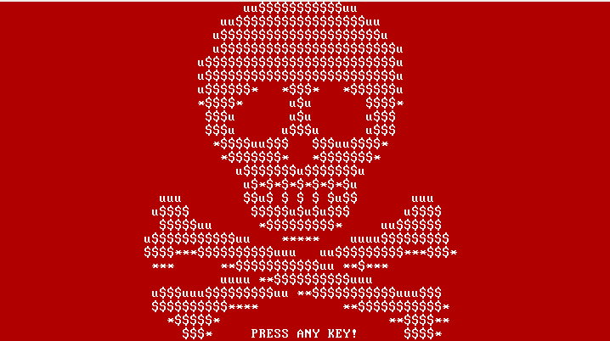
Ransomware Bootkit: Petya
Launched by Windows executable dropper
Overwrites the beginning of the disk (including MBR) and makes an XOR encrypted backup of the original data
The second stage is executed by the fake CHKDSK scan. After this, the file system is destroyed and cannot be read
This first ransomware targeting disk with MBR rather than individual files
Source: Petya – Taking Ransomware To The Low Level

Slide 109
Mebromi BIOS Infection
Mebromi malware includes BIOS infector & MBR bootkit components
Patches BIOS ROM binary injecting malicious ISA Option ROM with legitimate BIOS image mod utility
Triggers SW SMI 0x29/0x2F to erase SPI flash then write patched BIOS binary
# chipsec_util.py smi 0x2F
Infected BIOS injects boot strap code to MBR

Slide 110
Exercise 2.1
Extract and Parse Master Boot Record

Slide 111
2.3 GUID Partition Table

Slide 112
GUID Partition Table
GUID Partition Table (GPT) is a hard disk partition table layout using GUIDs defined as part of UEFI standard
The GPT Header defines the range of LBAs that are usable by GPT Partition Entries
Disk GUID is a GUID that uniquely identifies the entire GPT Header and all its associated storage

Slide 113
GUID Partition Table Disk Layout
First useable block
Start partition
LBA0
LBA1
End partition
LBAn
PMBR
Partition Table HDR
0
1
…
n
Partition 1
0
1
…
n
Partition Table HDR
Start partition
End partition
Last useable block
Primary Partition
Table
Backup Partition
Table
Source: http://kurtqiao.github.io/uefi/2014/12/31/GUID-Partition-Table-Disk.html

Slide 114
GUID Partition Table Header
Offset | Length | Contents
0x00 | 8 bytes | Signature ("EFI PART", 45h 46h 49h 20h 50h 41h 52h 54h or 0x5452415020494645ULL on littleendian machines)
0x08 | 4 bytes | Revision (for GPT version 1.0 (through at least UEFI version 2.3.1), the value is 00h 00h 01h 00h)
0x0C | 4 bytes | Header size in little endian (in bytes, usually 5Ch 00h 00h 00h or 92 bytes)
0x10 | 4 bytes | CRC32 of header (offset +0 up to header size), with this field zeroed during calculation
0x14 | 4 bytes | Reserved; must be zero
0x18 | 8 bytes | Current LBA (location of this header copy)
0x20 | 8 bytes | Backup LBA (location of the other header copy)
0x28 | 8 bytes | First usable LBA for partitions (primary partition table last LBA + 1)
0x30 | 8 bytes | Last usable LBA (secondary partition table first LBA 1)
0x38 | bytes | Disk GUID (also referred as UUID on UNIXes)
0x48 | 8 bytes | Starting LBA of array of partition entries (always 2 in primary copy)
0x50 | 4 bytes | Number of partition entries in array
0x54 | 4 bytes | Size of a single partition entry (usually 80h or 128)
0x58 | 4 bytes | CRC32 of partition array
0x5C | * | Reserved; must be zeroes for the rest of the block (420 bytes for a sector size of 512 bytes; but can be more with larger sector sizes)
GPT Entry
Source: http://ntfs.com/guid-part-table.htm

Slide 115
GUID Partition Table Entry
Offset | Length | Contents
0 (0x00) | 16 bytes | Partition type GUID
16 (0x10) | 16 bytes | Unique partition GUID
32 (0x20) | 8 bytes | First LBA (little endian)
40 (0x28) | 8 bytes | Last LBA (inclusive, usually odd)
48 (0x30) | 8 bytes | Attribute flags (e.g. bit 60 denotes readonly)
56 (0x38) | 72 bytes | Partition name (36 UTF16LE code units)
Source: http://www.datarecovery.institute/guid-partition-table-windows-10/

Slide 116
Exercise 2.2
Access ESP from Linux, UEFI shell and Windows; find OS boot loaders and GPT

Slide 117
2.4 UEFI Bootkits

Slide 118
UEFI Based Windows Boot
UEFI Firmware
Performs CPU and Chipset initialization, load drivers, etc.
UEFI Boot Manager
Loads UEFI device drivers (based on NVRAM DriverXxx variable), loads boot application
Windows Boot Manager (bootmgfw.efi)
Load Windows OS loader selected by user
Windows OS Loader (winload.efi)
Loads the Windows OS, calls ExitBootServices()
Kernel
(ntoskrnl.exe)
Source: Windows Boot Environment by Murali Ravirala

Slide 119
Types of UEFI Bootkits
Replacing Windows Boot Manager
EFI System Partition (ESP) on Fixed Drive
ESP\EFI\Microsoft\Boot\bootmgfw.efi
UEFI technology: say hello to the Windows 8 bootkit! by ITSEC
Replacing Fallback Boot Loader
ESP\EFI\Boot\bootx64.efi
Dreamboot by Sébastien Kaczmarek, QUARKSLAB
Adding New Boot Loader (bootkit.efi)
Modified BootOrder / Boot#### EFI variables
Adding/Replacing DXE Driver
Stored on Fixed Drive
Not embedded in Firmware Volume (FV) in ROM
Modified DriverOrder / Driver#### EFI variables

Slide 120
Types of UEFI Bootkits
Patching UEFI “Option ROM”
UEFI DXE Driver in Add-On Card (Network, Storage..)
Non-Embedded in FV in ROM
Mac EFI Rootkits by @snare, Black Hat USA 2012
Thunderstrike Mac EFI Rootkit by Trammell Hudson
Replacing OS Loaders (winload.efi, winresume.efi)
Patching GUID Partition Table (GPT)

Slide 121
Replacing Boot Loaders
Malware
OS Kernel / Drivers
UEFI OS Loaders
UEFI
OROM
DXE
Driver
UEFI
Boot Loader
Bootx64.efi
Bootmgfw.efi
HDD
UEFI
OROM
DXE
Driver
UEFI DXE Core / Dispatcher
System Firmware (SEC/PEI)
Hardware
I/O
Memory
Network
Graphics

Slide 122
Adding/Replacing DXE Drivers
Malware
OS Kernel / Drivers
UEFI OS Loaders
UEFI
OROM
DXE
Driver
UEFI
Boot Loader
Bootx64.efi
Bootmgfw.efi
HDD
UEFI
OROM
DXE
Driver
UEFI DXE Core / Dispatcher
System Firmware (SEC/PEI)
Hardware
I/O
Memory
Network
Graphics

Slide 123
Replacing DXE Option ROM Drivers
Malware
OS Kernel / Drivers
UEFI OS Loaders
UEFI
OROM
DXE
Driver
UEFI
Boot Loader
Bootx64.efi
Bootmgfw.efi
HDD
UEFI
OROM
DXE
Driver
UEFI DXE Core / Dispatcher
System Firmware (SEC/PEI)
Hardware
I/O
Memory
Network
Graphics

Slide 124
UEFI Bootkits
Malware
OS Kernel / Drivers
UEFI OS Loaders
UEFI
OROM
DXE
Driver
UEFI
Boot Loader
Bootx64.efi
Bootmgfw.efi
HDD
UEFI
OROM
DXE
Driver
UEFI DXE Core / Dispatcher
System Firmware (SEC/PEI)
Hardware
I/O
Memory
Network
Graphics

Slide 125
UEFI Bootkit: Dreamboot
Replaces Windows 8 loader
Patches OS to disable kernel protections
Disables DEP (NX flag)
Disables Windows Patch Guard
Open source: https://github.com/quarkslab/dreamboot
Source: UEFI and Dreamboot by Sebastien Kaczmarek

Slide 126
Windows 8 UEFI Bootkit
Source: A Tale of One Software Bypass of Windows 8 Secure Boot

Slide 127
2.5 UEFI Secure Boot

Slide 128
Secure Boot (UEFI + OS)
OS
Secure
Boot
OS Driver
OS Driver
Signed BIOS
Update
OS Kernel
UEFI OS Loaders
UEFI
Secure
Boot
DXE
Driver
DXE
OROM
UEFI App
UEFI
Boot Loader
Bootx64.efi
Bootmgfw.efi
DXE
Driver
DXE
OROM
UEFI App
UEFI DXE Core / Dispatcher
System Firmware (SEC/PEI)
Hardware
I/O
Memory
Network
Graphics

Slide 129
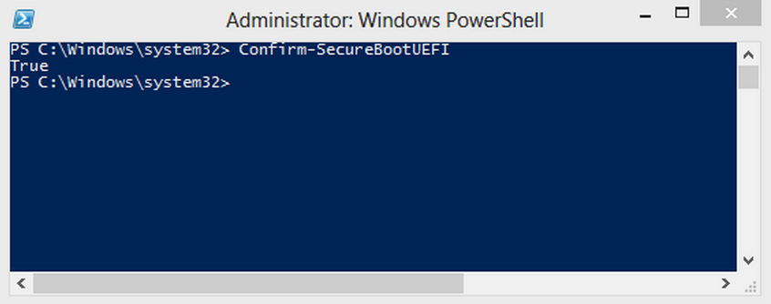
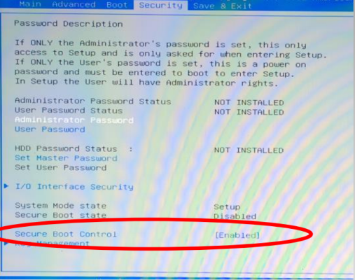
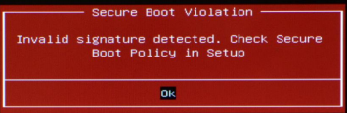

Slide 130
UEFI Secure Boot Configuration
SecureBoot
Enables/disables image signature checks
SetupMode
PK is installed (USER_MODE) or not (SETUP_MODE)
SETUP_MODE allows updating KEK/db(x), self-signed PK
CustomMode
Modifiable by physically present user
Allows updating KEK/db/dbx/PK even when PK is installed
SecureBootEnable
Global non-volatile Secure Boot Enable
Modifiable by physically present user

Slide 131
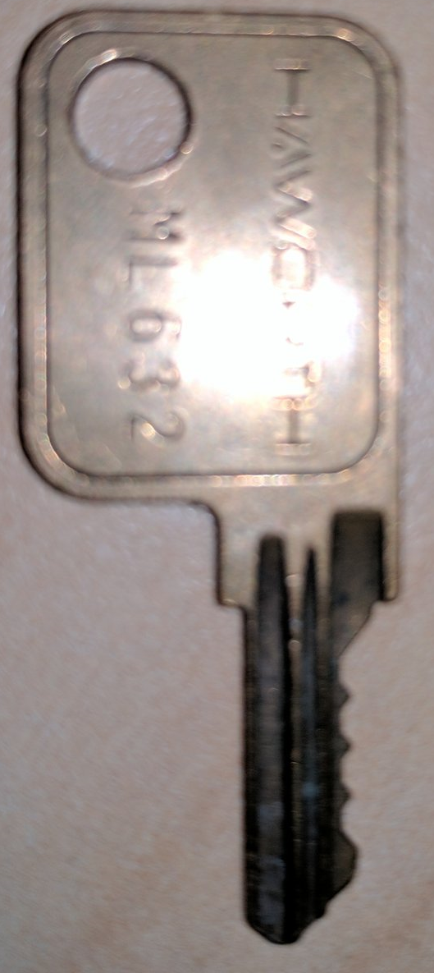
Secure Boot Key Hierarchy
PK
Update
Platform Key (PK)
Verifies KEKs
Platform Vendor’s Cert
Key Exchange Keys (KEKs)
Verify db and dbx
Earlier rev’s: verifies image signatures
Authorized Database (db)
Forbidden Database (dbx)
X509 certificates, SHA1/SHA256 hashes of allowed & revoked images
Earlier revisions: RSA-2048 public keys, PKCS#7 signatures
Update
KEK
Update
db
dbx
If signed by key in db, executable can be loaded
If signed by key in dbx, executable load is forbidden

Slide 132
PK (openssl x509 -in PK.pem –text)
Certificate:
Data:
Version: 3 (0x2)
Serial Number:
53:41:e0:15:c4:3a:f8:a8:48:36:b9:a5:ff:69:14:88
Signature Algorithm: sha256WithRSAEncryption
Issuer: CN=ASUSTeK MotherBoard PK Certificate
Validity
Not Before: Dec 26 23:34:50 2011 GMT
Not After : Dec 26 23:34:49 2031 GMT
Subject: CN=ASUSTeK MotherBoard PK Certificate
Subject Public Key Info:
Public Key Algorithm: rsaEncryption
Public-Key: (2048 bit)
Modulus:
00:d9:84:15:36:c5:d4:ce:8a:a1:56:16:a0:e8:74:
..
Exponent: 65537 (0x10001)
X509v3 extensions:
2.5.29.1:
?=.../0-1+0)..U..."ASUSTeK MotherBoard PK Certificate..SA...:..H6...i..
Signature Algorithm: sha256WithRSAEncryption
73:27:1a:32:88:0e:db:13:8d:f5:7e:fc:94:f2:1a:27:6b:c2:
..
-----BEGIN CERTIFICATE-----
MIIDRjCCAi6gAwIBAgIQU0HgFcQ6+KhINrml/2kUiDANBgkqhkiG9w0BAQsFADAt
..
-----END CERTIFICATE-----

Slide 133
Secure Boot Modes
Enroll PK
SETUP MODE
USER MODE
Delete PK
Platform specific Clear PK
Source: https://www.wzdftpd.net/blog/tag/debian.html

Slide 134
Secure Boot Modes
PK variable exists in NVRAM?
Yes: Set SetupMode variable to USER_MODE
No: Set SetupMode variable to SETUP_MODE
SecureBootEnable variable exists in NVRAM?
Yes
SecureBootEnable variable is SECURE_BOOT_ENABLE and SetupMode is USER_MODE? Set SecureBoot to ENABLE
Else? Set SecureBoot to DISABLE
No
SetupMode variable is USER_MODE? Set SecureBoot to ENABLE
SetupMode variable is SETUP_MODE? Set SecureBoot to DISABLE

Slide 135
Image Verification Policies
DxeImageVerificationLib defines policies applied to different types of images and on security violation
IMAGE_FROM_FV (ALWAYS_EXECUTE), IMAGE_FROM_FIXED_MEDIA,
IMAGE_FROM_REMOVABLE_MEDIA, IMAGE_FROM_OPTION_ROM
ALWAYS_EXECUTE, NEVER_EXECUTE,
ALLOW_EXECUTE_ON_SECURITY_VIOLATION
DEFER_EXECUTE_ON_SECURITY_VIOLATION
DENY_EXECUTE_ON_SECURITY_VIOLATION
QUERY_USER_ON_SECURITY_VIOLATION

Slide 136
Let’s have a look at the Secure Boot image verification process
SecurityPkg\Library\DxeImageVerificationLib
http://sourceforge.net/apps/mediawiki/tianocore/index.php?title=SecurityPkg

Slide 137
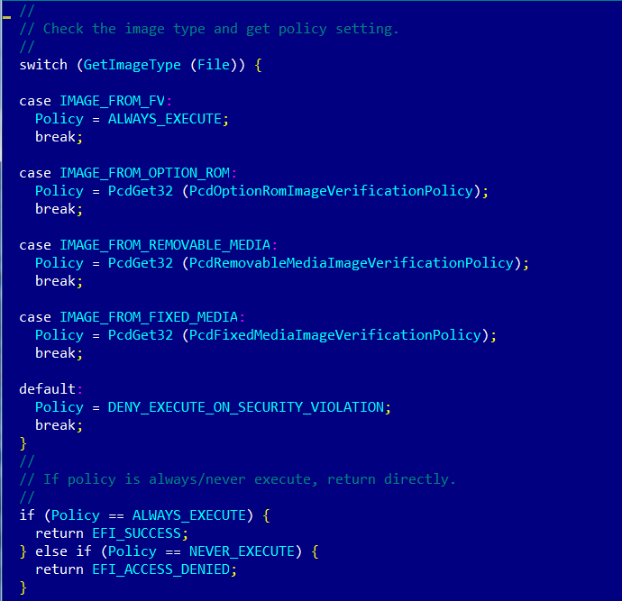
Verifying Policies
Image Verification Policy
(IMAGE_FROM_FV) ALWAYS_EXECUTE? EFI_SUCCESS
NEVER_EXECUTE? EFI_ACCESS_DENIED

Slide 138
Image Verification Handler
SecureBoot EFI variable doesn’t exist or equals to SECURE_BOOT_MODE_DISABLE? EFI_SUCCESS
File is not valid PE/COFF image? EFI_ACCESS_DENIED
SecureBootEnable NV EFI variable doesn’t exist or equals to SECURE_BOOT_DISABLE? EFI_SUCCESS
SetupMode NV EFI variable doesn’t exist or equals to SETUP_MODE? EFI_SUCCESS

Slide 139
Authenticating EFI Images (EDK2)
Image is not signed
Image signature or SHA256 hash in DBX? EFI_ACCESS_DENIED
Image signature or SHA256 hash in DB? EFI_SUCCESS
Image is signed
For each signature in PE file:
Signature verified by root/intermediate cert in DBX? EFI_ACCESS_DENIED
Image signature or SHA256 hash in DBX? EFI_ACCESS_DENIED
For each signature in PE file:
Signature verified by root/intermediate cert in KEK or DB? EFI_SUCCESS
Image signature or SHA256 hash in DB? EFI_SUCCESS
Else EFI_ACCESS_DENIED

Slide 140
Open source packages for Secure Boot Flow
MdeModulePkg
LoadImage Boot Service
gBS->LoadImage
CoreLoadImage()
EFI_SECURITY_ARCH_PROTOCOL
SecurityStubDxe
SecurityStubAuthenticateState()
DxeSecurityManagementLib
RegisterSecurityHandler()
ExecuteSecurityHandlers()
MdePkg
BasePeCoffLib
PeCoffLoaderGetImageInfo()
CryptoPkg
BaseCryptLib
Sha256Init()
Sha256Update()
Sha256Final()
Sha256GetContextSize()
AuthenticodeVerify()
Pkcs7Verify()
WrapPkcs7Data()
OpenSslLib
Openssl-0.9.8w
IntrinsicLib
SecurityPkg
DxeImageVerificationLib
DxeImageVerificationHandler()
HashPeImage()
HashPeImageByType()
VerifyWinCertificateForPkcsSignedData()
DxeImageVerificationLibImageRead()
IsSignatureFoundInDatabase()
IsPkcsSignedDataVerifiedBySignatureList()
VerifyCertPkcsSignedData()
Authenticated Variables
gRT->GetVariable
Source: A Tour Beyond BIOS into UEFI Secure Boot by Rosenbaum, Zimmer

Slide 141
2.6 Linux Secure Boot

Slide 142
Linux Secure Boot with Shim
UEFI
shim
db
UEFI CA
verify
Signature
Microsoft UEFI CA cert
verify
SUSE
Signature
SUSE UEFI cert
Either the UEFI public key or SUSE public key will let the shim boot with UEFI secure boot
Source: UEFI Open Platforms by Vincent Zimmer

Slide 143
Multiple OS Boot with MOK
DB
SUSE
SUSE
shim
grub2
kernel
load
load
SUSE UEFI key
SUSE boot path
Load
custom boot path
Load
BS Var
User
User
MOKList
grub2
Load
Kernel
User
Source: UEFI Open Platforms by Vincent Zimmer

Slide 144
Exercise 2.3
Secure Boot on Linux

Slide 145
Training materials are available on Github
https://github.com/advanced-threat-research/firmware-security-training
Yuriy Bulygin @c7zero
Alex Bazhaniuk @ABazhaniuk
Andrew Furtak @a_furtak
John Loucaides @JohnLoucaides

Slide 146
Security of BIOS/UEFI System Firmware from Attacker and Defender Perspectives Section 3. Hands-On Learning of Platform Hardware and Firmware
Yuriy Bulygin *
Alex Bazhaniuk *
Andrew Furtak *
John Loucaides **
* Advanced Threat Research, McAfee
** Intel

Slide 147
License
Training materials are shared under Creative Commons “Attribution” license CC BY 4.0
Provide the following attribution:
Derived from “Security of BIOS/UEFI System Firmware from Attacker and Defender Perspective” training by Yuriy Bulygin, Alex Bazhaniuk, Andrew Furtak and John Loucaides available at https://github.com/advanced-threat-research/firmware-security-training

Slide 148
Section 3. Hands-On Learning of Platform Hardware and Firmware

Slide 149
3.0 Building and Installing CHIPSEC

Slide 150
Bootable Linux USB with CHIPSEC

Slide 151
Bootable Linux USB with CHIPSEC
Ubuntu bootable USB with CHIPSEC (includes all dependencies)
Building and running CHIPSEC:
# cd ~/Desktop/chipsec/source/
# git pull (you already have latest CHIPSEC on USB)
# python setup.py build_ext -i
# sudo python chipsec_util.py platform

Slide 152
Installing CHIPSEC on Windows
Install Python 2.7.x (http://www.python.org/download/)
Install additional packages for installed Python release
pip install setuptools
pip install pywin32
Build CHIPSEC Windows driver. Skip this step if you already have chipsec_hlpr.sys built
Copy CHIPSEC driver (chipsec_hlpr.sys) to proper path in CHIPSEC \chipsec\chipsec\helper\win\win7_amd64 or win7_x86
Install CHIPSEC
pip install chipsec
Turn off kernel driver signature checks in Windows 8, 8.1, 10 64-bit
Refer to CHIPSEC manual:
https://github.com/chipsec/chipsec/blob/master/chipsec-manual.pdf

Slide 153
3.1 Access to Hardware Resources

Slide 154
Hardware Configuration
CPU
x86 state: GPR (RAX, …), Control Registers (CRx), Debug Registers (DRx), etc.
CPU Model Specific Registers (MSR)
CPU and Chipset (SoC)
Processor I/O space: I/O ports and I/O BARs
PCIe devices configuration space
Memory-mapped PCIe configuration access a.k.a. Enhanced Configuration Access Mechanism (ECAM)
Memory-mapped I/O ranges
IOSF Message Bus registers

Slide 155
Processor I/O Space: I/O Ports and BARs
Legacy I/O interface accessible via x86 IN and OUT assembly instructions
Offset in I/O space is I/O register or I/O port. I/O space contains multiple ranges assigned to some device or controller
I/O ranges can be fixed:
60h/62h/64h/66h: keyboard/embedded uController
CF8h/CFCh: PCIe devices CFG access
CF9h: platform reset
B2h/B3h: APMC/SMI
Or variable (defined by I/O BAR registers)
SMBus
ACPI/PMBASE
GPIO
I/O Trap

Slide 156
Processor I/O Space: I/O Ports and BARs
# chipsec_util io <io_port> <width> [value]
# chipsec_util.py io 0xcf8 dword 0x80000000
[CHIPSEC] OUT 0x0CF8 <- 0x80000000 (size = 0x04)
# chipsec_util.py io 0xcfc dword
[CHIPSEC] IN 0x0CFC -> 0x0A048086 (size = 0x04)

Slide 157
PCIe Configuration Space Access
SW uses one these mechanisms to access config space:
Legacy configuration access via control CF8h & data CFCh processor I/O ports
PCI config register address
bus << 16 | device << 11 | function << 8 | offset & ~3
CF8h ← 1<<31 | bdf_address
Read data from or write data to port (CFCh + off[1:0])
Extended (memory-mapped) config access (see later)
8 * 100h per device
32* 8 * 100h per bus
100h bytes of CFG header

Slide 158
PCIe Configuration Space and Registers
Enumerate all available PCIe devices:
# chipsec_util pci enumerate
[CHIPSEC] Enumerating available PCIe devices..
BDF | VID:DID | Vendor | Device
--------------------------------------------------------------------------------
00:00.0 | 8086:0A04 | Intel Corporation |
00:02.0 | 8086:0A16 | Intel Corporation |
Reading from/writing to PCIe device’s configuration space:
# chipsec_util.py pci <bus> <dev> <fun> <off> <width> [value]
# chipsec_util.py pci 0 0 0 0x0 dword
[CHIPSEC] reading PCI B/D/F 0/0/0, off 0x00: 0xA048086
# chipsec_util.py pci 0 0x1F 0 0xDC byte
[CHIPSEC] reading PCI B/D/F 0/31/0, off 0xDC: 0x2A

Slide 159
Extended PCIe Configuration
Enhanced Configuration Access Mechanism (ECAM) allows accessing PCIe extended configuration space (4kB) beyond PCI configuration space (256 bytes)
To access entire PCIe extended configuration space CPU reserves memory-mapped range in physical addressable memory (MMCFG)
Range is re-locatable (e.g. PCIEXBAR register in B.D:F 0.0:0 on Core/Xeon, ECBASE msgbus register on Atom, MSR on AMD APUs…)
All access to MMCFG range is mapped to PCI configuration cycles
MMCFG is split into consecutive 4kB large chunks, each is extended CFG header per bus/device/function
Access is done at memory offset within MMCFG range
MMCFG offset =
bus*32*8*1000h + dev*8*1000h + fun*1000h + offset

Slide 160
ECAM (MMCFG) Address Mapping
Memory Address | PCI Express Configuration Space
A[(20+n-1):20] | Bus Numbers 1 ≤ n ≤ 8
A[19:15] | Device Number
A[14:12] | Function Number
A[11:8] | Extended Register Number
A[7:2] | Register Number
A[1:0] | Along with size of the access, used to generate Byte Enable

Slide 161
Memory Mapped PCIe Configuration
chipsec_util.py mmio with ‘MMCFG’ BAR
# chipsec_util.py mmio list
-------------------------------------------------------------------------------
MMIO Range | BAR | Base | Size | En? | Description
-------------------------------------------------------------------------------
...
MMCFG | 00:00.0 + 60 | 00000000F8000000 | 00001000 | 1 | PCI Express Range
...
# chipsec_util.py mmio read MMCFG 0x0 0x4
[CHIPSEC] Read MMCFG + 0x0: 0x0A048086
# chipsec_util.py mmcfg <b> <d> <f> <off> <width> [value]
# chipsec_util.py mmcfg
[CHIPSEC] Memory Mapped Config Base: 0x00000000F8000000
# chipsec_util.py mmcfg 0 0 0 0x0 dword
[CHIPSEC] reading MMCFG register (00:00.0 + 0x00): 0xA048086
# chipsec_util.py mmcfg 0 0 0 0xF80DC byte
[CHIPSEC] reading MMCFG register (00:00.0 + 0xF80DC): 0x2A
It doesn’t work at MinnowBoard, because Bay Trail has different interface for MMCFG (use address 0xE0000000 as MMCFG)

Slide 162
Memory Mapped I/O Registers
Devices may have more registers than I/O and PCIe CFG spaces can fit so BIOS may reserve physical address ranges for devices
Ranges are defined by Base Address Registers (BAR). MMIO registers are offsets off of base of MMIO ranges
Any access to such MMIO range is forwarded to the device which owns this range (local in the CPU or over a system bus to chipset) rather than decoded to DRAM
mmio command in CHIPSEC can be used to list predefined MMIO BARs, dump entire BAR, and read/write MMIO registers
# chipsec_util.py mmio list
-------------------------------------------------------------------------------
MMIO Range | BAR | Base | Size | En? | Description
-------------------------------------------------------------------------------
GTTMMADR | 00:02.0 + 10 | 00000000F0000000 | 00001000 | 1 | Graphics Translation Table Range
SPIBAR | 00:1F.0 + F0 | 00000000FED1F800 | 00000200 | 1 | SPI Controller Register Range
HDABAR | 00:03.0 + 10 | 0000007FFFFFF000 | 00001000 | 1 | HD Audio Controller Register Range
GMADR | 00:02.0 + 18 | 00000000E0000000 | 00001000 | 1 | Graphics Memory Range
DMIBAR | 00:00.0 + 68 | 00000000FED18000 | 00001000 | 1 | Root Complex Register Range
MMCFG | 00:00.0 + 60 | 00000000F8000000 | 00001000 | 1 | PCI Express Register Range
RCBA | 00:1F.0 + F0 | 00000000FED1C000 | 00004000 | 1 | PCH Root Complex Register Range
MCHBAR | 00:00.0 + 48 | 00000000FED10000 | 00008000 | 1 | Host Memory Mapped Register Range
...
# chipsec_util.py mmio read|write|dump <BAR_name> <off> <width> [value]
# chipsec_util.py mmio read SPIBAR 0x78 4
[CHIPSEC] Read SPIBAR + 0x78: 0x8FFF0F40

Slide 163
CPU Model Specific Registers (MSR)
CPU contains many Model Specific Registers (MSR) to enable/disable/configure various features & read statuses
MSRs can be architectural (e.g. IA32_APIC_BASE) and specific to some CPU models (e.g. LBR_TO/FROM_MSR)
MSRs can be per logical CPU, core or entire CPU package
Reading from / writing to CPU MSRs:
# chipsec_util.py msr <msr> [eax] [edx] [cpu_id]
Specifying cpu_id allows access to MSRs of specific logical CPU
When omitted the command reads/writes MSR for all logical CPU in the package

Slide 164
IA-32 Control Registers (CR)
x86 CPU CRs control behavior/state of the logical CPU
Example:
CR0.PG - paging enabled
CR0.PE - protection enabled
CR3 (PDBR) - physical address of page directory
CR4.SMEP / CR4.SMAP
Reading from / writing to CRs:
# chipsec_util.py cpu cr <cpu_id> <cr_number> [value]
Access to CRs is per logical CPU, you need to specify the # of the logical CPU (cpu_id) in CHIPSEC

Slide 165
Exercise 3.1
Read BIOS/SPI Security Configuration

Slide 166
Exercise 3.2
Access Hardware Resources

Slide 167
3.2 Overview of Open Source CHIPSEC Framework

Slide 168
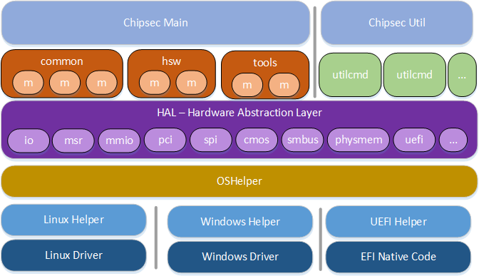
*Other names and brands may be claimed as the property of others.

Slide 169
Structure
chipsec_main.py runs modules (see modules dir below)
chipsec_util.py runs manual utilities (see utilcmd dir below)
/chipsec
/cfg platform specific configuration
/hal all the HW stuff you can interact with
/helper support for OS/environments
/modules modules (tests/tools/PoCs) go here
/utilcmd utility commands for chipsec_util

Slide 170
OS/Environment Specific Helpers
CHIPSEC supports Windows, Linux and UEFI shell environment.
OS/environment specific helpers for:
Windows : helper\win\win32helper.py
Linux : helper\linux\helper.py
UEFI (shell) : helper\efi\efihelper.py
Abstracts for support various OS/environments, wrapper around platform specific code that invokes kernel driver implemented in: helper/oshelper.py
Call path:
Module (or util) → HAL component → oshelper
→ helper [Linux] → OS native code [LKM]

Slide 171
Helper Code Example
OS independent function which all HAL components invoke (read_cr)
helper/oshelper.py
# Read/Write CR registers
def read_cr(self, cpu_thread_id, cr_number):
return self.helper.read_cr( cpu_thread_id, cr_number )
helper\linux\helper.py
def IOCTL_RDCR(): return _IOCTL_BASE + 0x10
. . .
class LinuxHelper:
def __init__(self):
import platform
self.os_system = platform.system()
self.os_machine = platform.machine()
. . .
self.init()
. . .
def read_cr(self, cpu_thread_id, cr_number):
self.set_affinity(cpu_thread_id)
cr = 0
in_buf = struct.pack( "3"+_PACK, cpu_thread_id, cr_number, cr)
unbuf = struct.unpack("3"+_PACK, fcntl.ioctl( _DEV_FH, IOCTL_RDCR(), in_buf ))
return (unbuf[2])
IOCTL invoking handler in the kernel module (“read CR”)
OS specific (Linux) helper class specific to each OS
read_cr function in Linux helper invokes IOCTL within the kernel module

Slide 172
Detecting the Platform
Each platform supports its own set of hardware resources (interfaces, configuration registers)
Different modules may be applicable to only specific platforms or family of platforms
To support above, CHIPSEC detects the platform it’s running on
Detection is done using Host Controller Device ID (b.d:f 00.00:0). Supported DIDs are in chipsec/chipset.py
Tip: to add support of a new platform, add its description in Chipset_Dictionary. Alternatively, create custom_chipsets.py, add my_dict with additional DIDs and add them to the main dictionary using chipset.Chipset_Dictionary.update(my_dict)
After detection, configuration (XMLs) for the detected platform is initialized (chipset.init_xml_configuration)

Slide 173
Detecting the Platform
# chipsec_util.py platform
Supported platforms:
DID | Name | Code | Long Name
-------------------------------------------------------------------------------------
...
0xa04 | Haswell | hsw | 4th Generation Core Processor (Haswell U/Y)
0xc08 | Haswell | hsw | Intel Xeon Processor E3-1200 v3 (Haswell CPU, C220 Series PCH)
0xa08 | Haswell | hsw | 4th Generation Core Processor (Haswell U/Y)
0xa00 | Haswell | hsw | 4th Generation Core Processor (Haswell U/Y)
0xc00 | Haswell | hsw | Desktop 4th Generation Core Processor (Haswell CPU / Lynx Point PCH)
0xc04 | Haswell | hsw | Mobile 4th Generation Core Processor (Haswell M/H / Lynx Point PCH)
0x158 | Ivy Bridge | ivb | Intel Xeon Processor E3-1200 v2 (Ivy Bridge CPU, C200/C216 Series PCH)
0x150 | Ivy Bridge | ivb | Desktop 3rd Generation Core Processor (Ivy Bridge CPU / Panther Point PCH)
0x154 | Ivy Bridge | ivb | Mobile 3rd Generation Core Processor (Ivy Bridge CPU / Panther Point PCH)
...
Platform: 4th Generation Core Processor (Haswell U/Y)
VID: 8086
DID: 0A04
Additional command-line options:
--platform (-p): use it if you know the platform but CHIPSEC doesn’t auto detect the platform
--ignore_platform (-i): avoid platform detection when using platform agnostic functionality (e.g. access to UEFI variables)

Slide 174
HW Abstraction Layer (HAL)
HAL is the set of components providing access to various hardware resources on the platform
HAL components abstract HW access specific to OS environment and expose it via a set of common APIs consumed by all modules in any OS environment
HAL components are OS unaware and invoke common helper functions from OS agnostic oshelper.py
HAL components can be basic primitives or complex
Basic primitive HAL components provide access to basic HW resource (Example: CPU I/O, MMIO, etc.)
Complex HAL components use basic primitive HAL to implement access to higher level HW resources (Example: SPI access is implemented via MMIO access)

Slide 175
HW Abstraction Layer (HAL)
File name | Description
hal/pci.py | Access to PCIe configuration space
hal/physmem.py | Access to physical memory
hal/msr.py | Access to CPU resources (for each CPU thread): Model Specific Registers (MSR), IDT/GDT
hal/mmio.py | Access to MMIO (Memory Mapped IO) BARs and Memory-Mapped PCI Configuration Space (MMCFG)
hal/spi.py | Access to SPI Flash parts
hal/ucode.py | Microcode update specific functionality
hal/io.py | Access to Port I/O Space
hal/smbus.py | Access to SMBus Controller in the PCH
hal/uefi.py | Main UEFI component using platform specific and common UEFI functionality
hal/uefi_common.py | Common UEFI functionality (EFI variables, db/dbx decode, etc.)
hal/uefi_platform.py | Platform specific UEFI functionality (parsing platform specific EFI NVRAM, capsules, etc.)
hal/interrupts.py | CPU Interrupts specific functions (SMI, NMI)
hal/cmos.py | CMOS memory specific functions (dump, read/write)
hal/cpuid.py | CPUID information
hal/spi_descriptor.py | SPI Flash Descriptor binary parsing functionality

Slide 176
HAL: Basic HW Access
Basic HAL primitives is a set of HAL components which provide access to basic HW resources which are used to access any other HW resources
Each basic HAL primitive has its own OS native functions (e.g. in kernel module) implementing access to corresponding HW resource specific to that OS
Basic HAL primitives are IO, MEM, MSR, MMIO, PCIE, CR, CPUID, etc.
All other HAL components are complex and can be implemented using the above set of basic HAL primitives
Basic primitives can be accessed through Chipset instance:
cs = chipsec.chipset.cs()
pci_devs = cs.pci.enumerate_devices()

Slide 177
HAL Example: SPI Flash Memory Access
SPI Flash Memory Access is a HAL component which implements access to system SPI flash memory devices
Current SPI HAL implementation uses hardware sequencing access (which predefines SPI flash opcodes and can operate in descriptor mode only)
Exposes the following API:
read_spi, write_spi, erase_spi_block – access to SPI flash
get_SPI_regions – returns SPI flash regions
get_SPI_Protected_Range – returns SPI flash protected ranges
display_SPI_Flash_Descriptor – decodes SPI flash descriptor
Accessed through chipsec_util spi/decode commands

Slide 178
HAL Example: CPU Configuration Access
SPI Flash Memory Access is a HAL components which implement access to CPU HW resources (MSR, descriptor tables, microcode updates, CPUID, CR, interrupts ..)
Provide the following API:
msr.read_msr, msr.write_msr – access to CPU MSRs
msr.get_IDTR, msr.get_GDTR – read IDT/GDT
ucode.ucode_update_id – read microcode update ID
cpuid.cpuid – read CPU CPUID
interrupts.send_SMI_APMC – send SMI through port B2h
cr.read_cr, cr.write_cr – access to CPU Control Registers
Accessed through chipsec_util spi/cr/ucode/cupid/smi/idt/gdt commands

Slide 179
HAL Example: UEFI
UEFI HAL components implements functionality to work with UEFI interfaces and structures
Dumping UEFI Variables at run-time through UEFI API
Extracting UEFI Variables from NVRAM store in SPI memory dump
Decoding certificates/hashes from UEFI variables
Parsing UEFI Volumes with executables from SPI memory dump
Extracting and decoding S3 resume boot script
Common UEFI API consumed by modules is exposed through chipsec.hal.uefi
UEFI functionality can be common for all UEFI based firmware or can depend on BIOS implementation or UEFI version
Common UEFI functionality is in hal/uefi_common.py
BIOS dependent UEFI functionality is in hal/uefi_platform.py
Accessed through chipsec_util uefi command

Slide 180
Platform Configuration
Each platform (chipset, CPU, devices) has it’s own configuration defined by registers/ranges in I/O, MMIO, PCIe CFG, MSR spaces...
The same register may be defined at different offsets, even in different places on different platforms
The definition of the register may change (bits, masks ..)
Definitions of I/O or MMIO ranges change (location, size ..)
Each platform may have its own set of internal devices or controllers
We don’t want to re-write modules for every new platform
It would be nice to be able do this (regardless of where register is):
reg = read_register( “MY_REGISER” )
reg_field = read_register_field( “MY_REGISER”, “MY_FIELD” )
CHIPSEC does that using configuration described in XML files for each platform, or per-feature, or common (chipsec/cfg directory)
Look for these lines in the output:
[*] loading common platform config from ‘..\chipsec/cfg\common.xml'..
[*] loading 'hsw' platform config from ‘..\chipsec/cfg\hsw.xml'..

Slide 181
Platform Configuration: IO, MMIO…
Internal PCIe devices (devices, controllers, interfaces ..)
<pci>
<device name='HOSTCTRL' bus=‘0x0' dev='0x0' fun='0x0'../>
Memory Mapped I/O ranges (BARs)
<mmio>
<bar name=‘SPIBAR'.. reg=‘0xF0‘ enable_bit=‘0‘ ../>
Legacy port I/O ranges (BARs)
<io>
<bar name=‘ABASE'.. reg=‘0x40‘ ../>
Memory ranges
<memory>
<range name=‘LEGACY‘ address=‘0x00‘ size=‘0x100000‘ ../>

Slide 182
Platform Configuration: Registers
Configuration registers
<registers>
<register name='BC' type='pcicfg' desc='BIOS Control'>
<field name='BIOSWE' bit='0' />
<field name='BLE' bit='1' />
..
<field name='SMM_BWP' bit='5' />
</register>
<register name='HSFS' type='mmio'>
..
<field name='FLOCKDN' bit='15'/>
</register>
<register name='IA32_SMRR_PHYSMASK' type='msr'>
<field name='Valid' bit='11'/>
</register>
</registers>

Slide 183
Platform Configuration: “Controls”
Controls are important hardware lock bits, hardware protection enables, etc.
<control name=‘FlashLock' register=‘HSFS' field=‘FLOCKDN'/>
Modules can read the value of controls on any platform by the name regardless of where this control is (which register)
flock = chipsec.chipset.get_control(self.cs, 'FlashLockDown')

Slide 184
CHIPSEC Has Two Entry-Points
chipsec_main.py (module launcher)
Runs modules/tools automatically in a “security regression suite” mode
Runs only modules applicable to current platform
chipsec_main.py [--type BIOS]
Or individually via “--module” command-line option
chipsec_main.py --module common.bios_wp
chipsec_util.py (manual utilities)
Provides manual access to HW resources (io, mem, pci ..)
Individual utility commands are in utilcmd/*_cmd.py
chipsec_util.py spi dump spi.bin
(e.g. spi util command is implemented in spi_cmd.py file)

Slide 185
Useful Options
-a (--module_args): Specifies arguments to each module individually
-n (--no_driver): Tells CHIPSEC to not launch Windows kernel driver (in case module doesn’t need it)
-x (--xml):Outputs result in JUnit compatible XML form which may be useful to integrate in validation env.
-t (--module_type): Run only modules of a specific type. Examples: BIOS, SMM, SECUREBOOT, HWCONFIG
New types may be defined in chipsec/module_common.py
-v (--verbose): Logs all output from HAL components, helpers, dumps buffers, logs exception back-traces, etc.

Slide 186
The Meat: CHIPSEC Modules
Modules encapsulate the main functionality of CHIPSEC:
Tests for known vulnerabilities in firmware
Tests for insufficient or incorrectly configured hardware protections
Hardware/firmware-level security tools
Fuzzing tools for firmware interfaces/formats
Manual security checkers (e.g. TE checker, DMA dumper)
Reside in modules/tools directory are not launched automatically (only through –m command-line option)
PoC exploit modules demonstrating vulnerabilities

Slide 187
The Meat: CHIPSEC Modules
All modules reside in chipsec/modules directory
Modules can be specific to one or more platforms or common for all supported platforms
Modules in modules/<platform_code> directory will only be executed on <platform_code> platform
Modules in modules/common directory will always be executed
Modules can implement is_supported function which can further check for supported platforms, OS environments (legacy vs UEFI boot), etc.

Slide 188
Raising the Bar for Platform Security
Security Research
Platform Validation
Risk Profile
New Attacks
Test Modules for OEMs/IBVs
End-user Risk
Empowering End-Users to Make a Risk Decision
Source: https://cansecwest.com/slides/2014/Platform%20Firmware%20Security%20Assessment%20wCHIPSEC-csw14-final.pdf

Slide 189
Summary of Modules in CHIPSEC
Issue | CHIPSEC Module | References
SMRAM Locking | common.smm | CanSecWest 2006
BIOS Keyboard Buffer Sanitization | common.bios_kbrd_buffer | DEFCON 16
SMRR Configuration | common.smrr | ITL 2009, CanSecWest 2009
BIOS Protection | common.bios_wp | BlackHat USA 2009, CanSecWest 2013, Black Hat 2013, NoSuchCon 2013
SPI Controller Locking | common.spi_lock | Flashrom, Copernicus
BIOS Interface Locking | common.bios_ts | PoC 2007
Secure Boot variables with keys and configuration are protected | common.secureboot.variables | UEFI 2.4 Spec , All Your Boot Are Belong To Us (here & here)
Memory remapping attack | remap | Preventing and Detecting Xen Hypervisor Subversions
DMA attack against SMRAM | smm_dma | Programmed I/O accesses: a threat to VMM?, System Management Mode Design and Security Issues
SMI suppression attack | common.bios_smi | Setup for Failure: Defeating Secure Boot
Access permissions to SPI flash descriptor | common.spi_desc | Flashrom
Access permissions to UEFI variables defined in UEFI Spec | common.uefi.access_uefispec | UEFI 2.4 Spec
Module to detect PE/TE Header Confusion Vulnerability | tools.secureboot.te | All Your Boot Are Belong To Us
Module to detect SMI input pointer validation vulnerabilities | tool.smm.smm_ptr | CanSecWest 2015

Slide 190
3.3 Developing Modules in CHIPSEC

Slide 191
Module template
Inherits BaseModule template
from chipsec.module_common import *
_MODULE_NAME = 'module_template'
class module_template (BaseModule):
def __init__(self):
BaseModule.__init__(self)
def check_something( self ):
self.logger.start_test( "Module Template" )
self.logger.log_passed_check( "Test Passed" )
return ModuleResult.PASSED
def is_supported(self):
return False
# --------------------------------------------------------------------------
# run( module_argv )
# Required function: run here all tests from this module
# --------------------------------------------------------------------------
def run( self, module_argv ):
return self.check_something()
Return result
FAILED
PASSED
WARNING
SKIPPED
DEPRECATED
ERROR
Check if this module can run on this platform/OS
Module starts here.
Can pass arguments to each module

Slide 192
Example: common.spi_lock
from chipsec.module_common import *
TAGS = [MTAG_BIOS]
class spi_lock(BaseModule):
def __init__(self):
BaseModule.__init__(self)
def is_supported(self):
return (self.cs.get_chipset_id() in \
[chipsec.chipset.CHIPSET_FAMILY_CORE,chipsec.chipset.CHIPSET_FAMILY_XEON])
def check_spi_lock(self):
self.logger.start_test( "SPI Flash Controller Configuration Lock" )
spi_lock_res = ModuleResult.FAILED
hsfs_reg = chipsec.chipset.read_register( self.cs, 'HSFS' )
chipsec.chipset.print_register( self.cs, 'HSFS', hsfs_reg )
flockdn = chipsec.chipset.get_register_field( self.cs, 'HSFS', hsfs_reg, 'FLOCKDN' )
if 1 == flockdn:
spi_lock_res = ModuleResult.PASSED
self.logger.log_passed_check( "SPI Flash Controller configuration is locked" )
else:
self.logger.log_failed_check( "SPI Flash Controller configuration is not locked" )
return spi_lock_res
def run( self, module_argv ):
return self.check_spi_lock()
Type of the check (e.g. BIOS security)
Checks SPI controller configuration is locked down

Slide 193
Logging
Output module’s result:
log_passed/failed/skipped/warn_check()
Various output modes:
log(),error(),warning(),log_bad(),log_good(), log_important()
Turning VERBOSE output mode. Verbose mode logs everything from HAL, OS helpers etc.
self.logger.VERBOSE = True
# chipsec_main.py -m common.spi_lock –-verbose
Turn on/off logging by HAL components
self.logger.HAL
Utility logging (ON by default when CHIPSEC_UTIL is used)
self.logger.UTIL_TRACE
Flushing log output to a file (what if a fuzzer crashes OS?)
self.logger.flush()
self.logger.set_always_flush( True )

Slide 194
3.4 Developing Fuzzers for the System Firmware

Slide 195
Passing arguments to CHIPSEC modules
More complex modules (e.g. tools, fuzzers, PoCs..) may define module specific command-line arguments to be passed by CHIPSEC via “-a” option:
# chipsec_main -m tools.fuzzer –a rnd,1000,0xDEADBEEF
def run( module_argv ):
logger.start_test( “Some fuzzer" )
if len(module_argv) > 2:
_mode = module_argv[0]
_attempts = int(module_argv[1])
_address = int(module_argv[2],16)
fuzz( _mode, _attempts, _address )
return ModuleResult.PASSED

Slide 196
Training materials are available on Github
https://github.com/advanced-threat-research/firmware-security-training
Yuriy Bulygin @c7zero
Alex Bazhaniuk @ABazhaniuk
Andrew Furtak @a_furtak
John Loucaides @JohnLoucaides

Slide 197
Security of BIOS/UEFI System Firmware from Attacker and Defender Perspectives Section 4. Common Attack Vectors against System Firmware
Yuriy Bulygin *
Alex Bazhaniuk *
Andrew Furtak *
John Loucaides **
* Advanced Threat Research, McAfee
** Intel

Slide 198
License
Training materials are shared under Creative Commons “Attribution” license CC BY 4.0
Provide the following attribution:
Derived from “Security of BIOS/UEFI System Firmware from Attacker and Defender Perspective” training by Yuriy Bulygin, Alex Bazhaniuk, Andrew Furtak and John Loucaides available at https://github.com/advanced-threat-research/firmware-security-training

Slide 199
Section 4. Common Attack Vectors Against BIOS and UEFI Firmware

Slide 200
So What is System Firmware?
Runtime
System
Firmware
(UEFI RT,
SMM)
Operating System
App
App
Kernel + Drivers
Privilege
System Firmware
(BIOS, UEFI firmware, Coreboot…)
Hardware
Memory
CPU
Graphics
I/O
Network

Slide 201
How Can System Firmware Be Attacked?
Inadequate hardware write protections of firmware “ROM”
Firmware update implementation
Persistent Configuration (UEFI Variables, CMOS settings)
Inadequate hardware protections of runtime firmware (System Management Interrupt Handlers)
Runtime firmware (SMI handlers)
Resume from sleep states
Network stack implementation in firmware
Other interfaces with OS/software, network, devices…

Slide 202
Do BIOS Attacks Require Kernel Privileges?
Malicious App
A matter of finding legitimate signed kernel driver which can be used on behalf of user-mode exploit as a confused deputy.
RWEverything driver signed for Windows 64bit versions (co-discovered with researchers from MITRE)
OS Driver
OS Kernel
UEFI OS Loaders
UEFI DXE Core / Dispatcher
System Firmware (SEC/PEI)
Hardware
I/O
Memory
Network
Graphics

Slide 203
4.1 Attacking UEFI Secure Boot

Slide 204
4.1 (1) Attacking Secure Boot via Corruption of Firmware Root Signing Certificate (Platform Key)

Slide 205
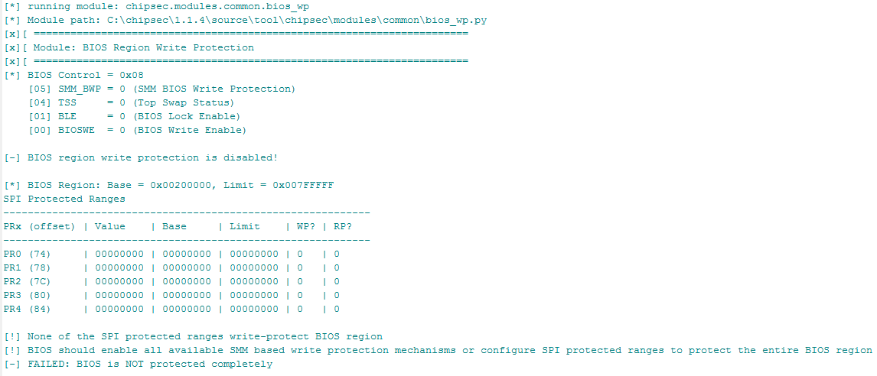
HW protection of FW in ROM
# chipsec_main.py --module common.bios_wp

Slide 206
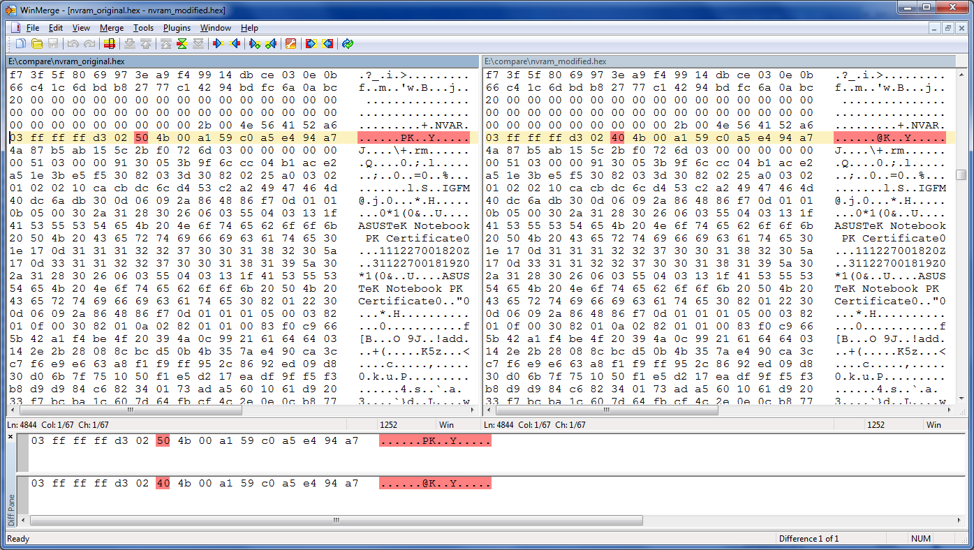
Platform Key certificate is stored in the NVRAM potion of SPI flash memory

Slide 207
Modify PK in SPI if Writes are Allowed
OS Driver
OS Exploit
Signed BIOS
Update
OS Kernel
UEFI OS Loaders
DXE
Driver
UEFI
Boot Loader
Bootx64.efi
Bootmgfw.efi
Modify UEFI BIOS Firmware in ROM
DXE
Driver
UEFI DXE Core / Dispatcher
System Firmware (SEC/PEI)
Hardware
I/O
Memory
Network
Graphics

Slide 208
Modifying Platform Key in NVRAM
Corrupt Platform Key EFI variable in NVRAM
Name (“PK”) or Vendor GUID {8BE4DF61-93CA-11D2-AA0D-00E098032B8C}
AuthenticatedVariableService DXE driver enters Secure Boot SETUP_MODE when correct “PK” EFI variable cannot be located in EFI NVRAM
Main volatile SecureBoot variable is then set to DISABLE
DXE ImageVerificationLib then assumes Secure Boot is off and skips Secure Boot checks
Generic exploit, independent of the platform/vendor
1 bit modification!

Slide 209
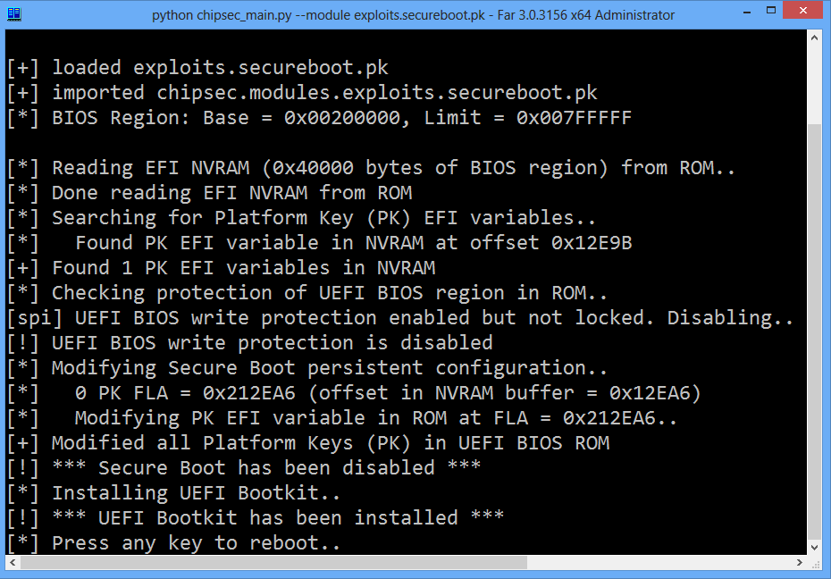

Slide 210
4.1 (2) Attacking Secure Boot via Setup UEFI Variable (On/Off, Verification Policies, CSM Enabled, “Clear Keys” control)

Slide 211
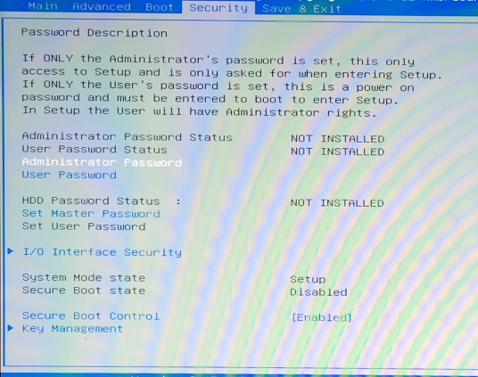
Secure Boot Can Be Turned On/Off in BIOS Setup Options

Slide 212
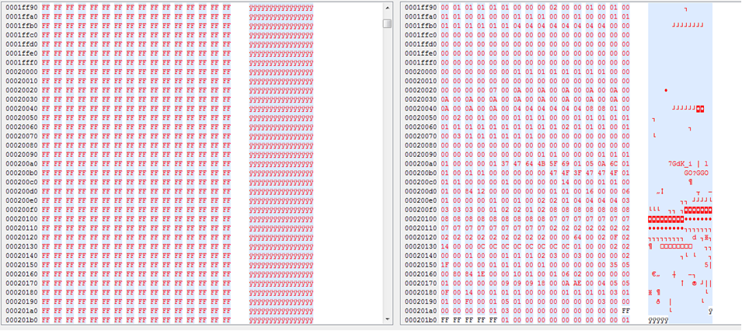
Looking for Enable Policy in SPI Dump…
chipsec_util.py spi dump spi.bin

Slide 213
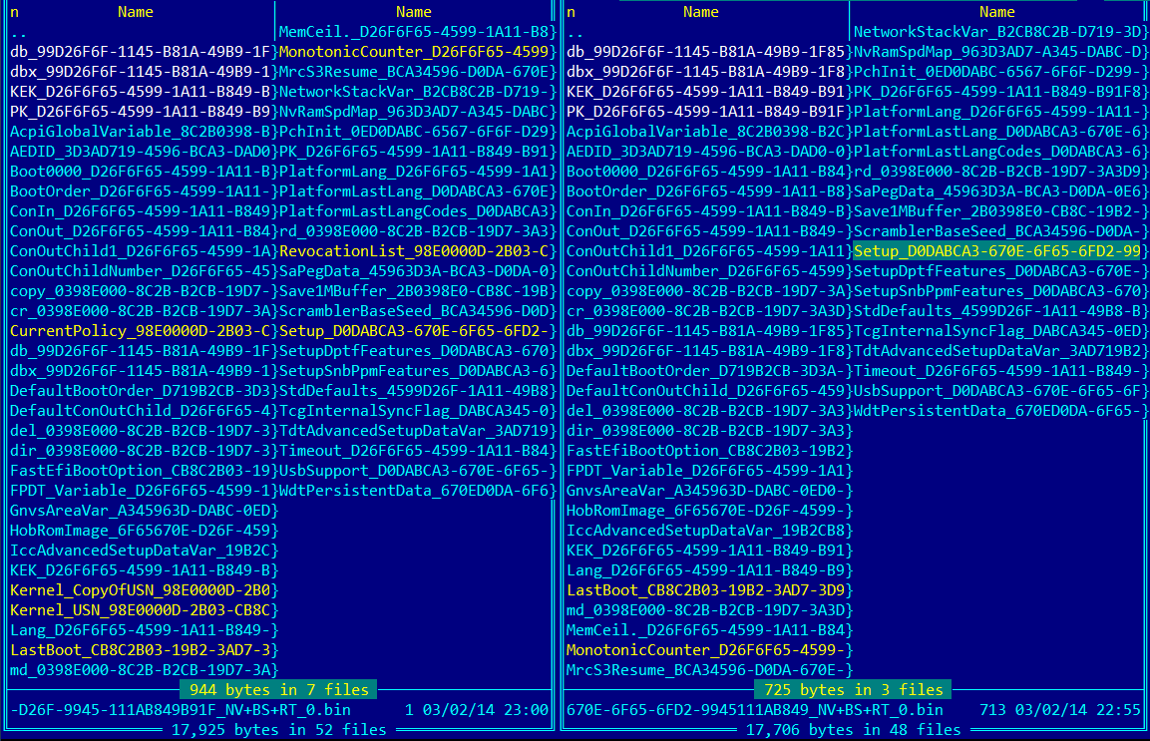
Extracting Runtime UEFI Variables…
Secure Boot On Secure Boot Off

Slide 214
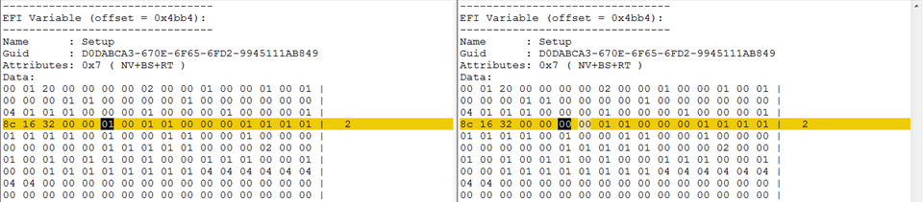
Secure Boot On/Off is Stored in “Setup”
Secure Boot On Secure Boot Off

Slide 215
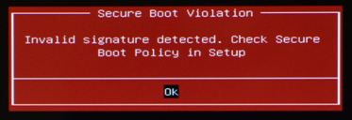
Verification Policies are Stored in “Setup”
Read ‘Setup’ UEFI variable and look for sequences
04 04 04, 00 04 04, 05 05 05, 00 05 05
We looked near Secure Boot On/Off Byte!
Modify bytes corresponding to policies to 00 (ALWAYS_EXECUTE) then write modified ‘Setup’ variable

Slide 216
Patching Image Verification Policies…
[CHIPSEC] Reading EFI variable Name='Setup' GUID={EC87D643-EBA4-4BB5-A1E5-3F3E36B20DA9} from 'Setup_orig.bin' via Variable API..
EFI variable:
Name : Setup
GUID : EC87D643-EBA4-4BB5-A1E5-3F3E36B20DA9
Data :
..
01 01 01 00 00 00 00 01 01 01 00 00 00 00 00 00 |
00 00 00 00 00 00 01 01 00 00 00 04 04 |
[CHIPSEC] (uefi) time elapsed 0.000
[CHIPSEC] Writing EFI variable Name='Setup' GUID={EC87D643-EBA4-4BB5-A1E5-3F3E36B20DA9} from 'Setup_policy_exploit.bin' via Variable API..
Writing EFI variable:
Name : Setup
GUID : EC87D643-EBA4-4BB5-A1E5-3F3E36B20DA9
Data :
..
01 01 01 00 00 00 00 01 01 01 00 00 00 00 00 00 |
00 00 00 00 00 00 01 01 00 00 04 00 00 |
[CHIPSEC] (uefi) time elapsed 0.203
OptionRomPolicy
FixedMediaPolicy
RemovableMediaPolicy

Slide 217
CSM Enabled With Secure Boot
CSM allows legacy OS to boot on top of UEFI firmware without any Secure Boot checks
Some systems have CSM enabled by default with Secure Boot enabled and fallback to boot from MBR when UEFI signature verification fails
Mitigations: Never load CSM when Secure Boot is enabled

Slide 218
Other Critical Secure Boot Config Stored in Unprotected Setup UEFI Variable
CSM Enable policy: allows malware to enable CSM with Secure Boot and boot from MBR
“Clear Secure Boot Keys” control: allows malware to clear all keys including PK thus disabling Secure Boot
“Restore Default Secure Boot Keys” control: allows malware to revert all keys and blacklist to potentially insecure “default” values
Mitigations: UEFI firmware must never store setting critical for Secure Boot in unprotected UEFI variables (such as Setup)

Slide 219
4.1 (3) Attacking Secure Boot via PE/TE Header Vulnerability

Slide 220
Does firmware allow unsigned TE executables?
SecureBoot EFI variable doesn’t exist or equals to SECURE_BOOT_MODE_DISABLE? EFI_SUCCESS
File is not valid PE/COFF image? EFI_ACCESS_DENIED
SecureBootEnable NV EFI variable doesn’t exist or equals to SECURE_BOOT_DISABLE? EFI_SUCCESS
SetupMode NV EFI variable doesn’t exist or equals to SETUP_MODE? EFI_SUCCESS

Slide 221
PE/TE Header Handling by the BIOS
Decoded UEFI BIOS image from SPI Flash

Slide 222
PE/TE Header Confusion Issue
TE format doesn’t support signatures so BIOS has to deny loading such image
In practice, BIOS implementations may differ…
ExecuteSecurityHandler calls GetFileBuffer to read an executable image
Which reads the image, checks if it has a valid PE/COFF header and returns EFI_LOAD_ERROR if not
In case of an image load error, ExecuteSecurityHandler returns EFI_SUCCESS (0)
Signature Checks are Skipped!

Slide 223
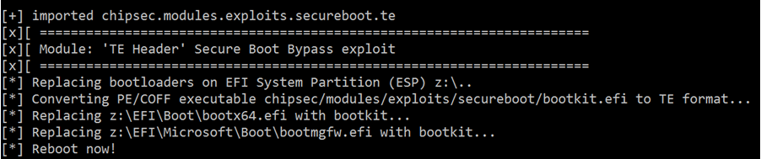
PE/TE Header Confusion Attack
Convert malicious PE/COFF EFI executable (bootkit.efi) to TE by replacing the image header
Replace OS boot loaders with resulting TE EFI executable
Vulnerable BIOS skips signature check for this executable
Malicious bootkit.efi loads & patches original OS boot loader

Slide 224
Exercise 4.1
Bypassing UEFI Secure Boot (PE/TE)

Slide 225
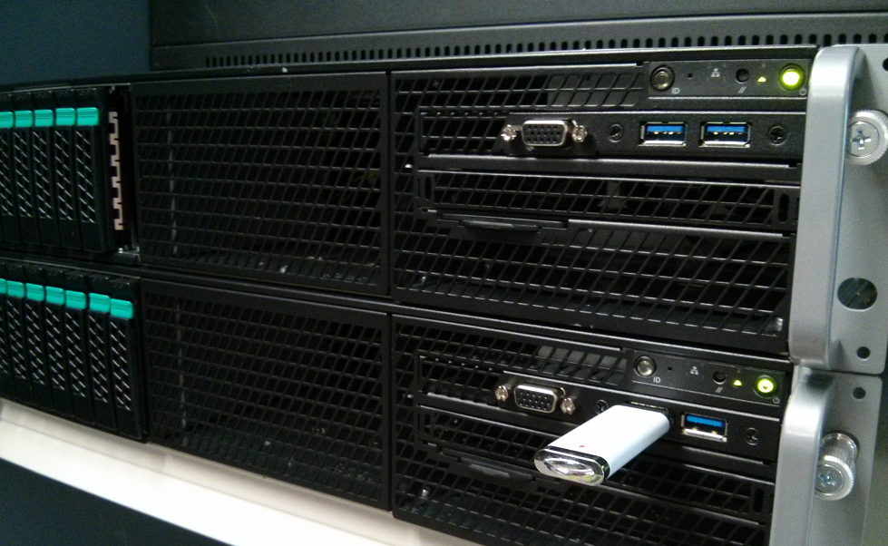
4.2 Attacking SPI Flash Protections

Slide 226
BIOS Range is Not Protected in SPI
BIOS Write Protections often still not properly enabled on many systems
SMM based write protection of entire BIOS region is often not used: BIOS_CONTROL[SMM_BWP]
If SPI Protected Ranges (mode agnostic) are used (defined by PR0-PR4 in SPI MMIO), they often don’t cover entire BIOS & NVRAM
Some platforms use SPI device specific write protection but only for boot block/startup code or SPI Flash descriptor region
Mitigations:
Set BIOS_CONTROL[SMM_BWP] ← 1
Program SPI flash protected ranges (PRx) to cover BIOS range
References: Persistent BIOS Infection (used flashrom on legacy BIOS), Evil Maid Just Got Angrier, BIOS Chronomancy, A Tale Of One Software Bypass Of Windows 8 Secure Boot

Slide 227
Checking with common.bios_wp
# chipsec_main.py --module common.bios_wp
[*] running module: chipsec.modules.common.bios_wp
[x][ =======================================================================
[x][ Module: BIOS Region Write Protection
[x][ =======================================================================
[*] BIOS Control = 0x02
[05] SMM_BWP = 0 (SMM BIOS Write Protection)
[04] TSS = 0 (Top Swap Status)
[01] BLE = 1 (BIOS Lock Enable)
[00] BIOSWE = 0 (BIOS Write Enable)
[!] Enhanced SMM BIOS region write protection has not been enabled (SMM_BWP is not used)
[*] BIOS Region: Base = 0x00500000, Limit = 0x007FFFFF
SPI Protected Ranges
------------------------------------------------------------
PRx (offset) | Value | Base | Limit | WP? | RP?
------------------------------------------------------------
PR0 (74) | 87FF0780 | 00780000 | 007FF000 | 1 | 0
PR1 (78) | 00000000 | 00000000 | 00000000 | 0 | 0
PR2 (7C) | 00000000 | 00000000 | 00000000 | 0 | 0
PR3 (80) | 00000000 | 00000000 | 00000000 | 0 | 0
PR4 (84) | 00000000 | 00000000 | 00000000 | 0 | 0
[!] SPI protected ranges write-protect parts of BIOS region (other parts of BIOS can be modified)
[!] BIOS should enable all available SMM based write protection mechanisms or configure SPI protected ranges to protect the entire BIOS region
[-] FAILED: BIOS is NOT protected completely

Slide 228
SMI Suppression Attack (If SMM Based BIOS WP is Not Used)
Some systems write-protect BIOS by disabling BIOS Write-Enable (BIOSWE) and setting BIOS Lock Enable (BLE) but don’t use SMM based write-protection BIOS_CONTROL[SMM_BWP]
SMI event is generated when Update SW writes BIOSWE=1
Possible attack against this configuration is to block SMI events
E.g. disable all chipset sources of SMI: clear SMI_EN[GBL_SMI_EN] if BIOS didn’t set GBL_SMI_LOCK: Setup for Failure: Defeating SecureBoot
Another variant is to disable specific TCO SMI source used for BIOSWE/BLE (clear TCO_EN in SMI_EN if BIOS didn’t set TCO_LCK)
Mitigations:
Set BIOS_CONTROL[SMM_BWP] ← 1 and lock SMI configuration (set GBL_SMI_LCK, TCO_LCK)

Slide 229
Checking with common.bios_smi
# chipsec_main.py --module common.bios_smi
[*] running module: chipsec.modules.common.bios_smi
[x][ =======================================================================
[x][ Module: SMI Events Configuration
[x][ =======================================================================
[-] SMM BIOS region write protection has not been enabled (SMM_BWP is not used)
[*] PMBASE (ACPI I/O Base) = 0x0400
[*] SMI_EN (SMI Control and Enable) register [I/O port 0x430] = 0x00002033
[13] TCO_EN (TCO Enable) = 1
[00] GBL_SMI_EN (Global SMI Enable) = 1
[+] All required SMI events are enabled
[*] TCOBASE (TCO I/O Base) = 0x0460
[*] TCO1_CNT (TCO1 Control) register [I/O port 0x468] = 0x1800
[12] TCO_LOCK = 1
[+] TCO SMI configuration is locked
[*] GEN_PMCON_1 (General PM Config 1) register [BDF 0:31:0 + 0xA0] = 0x0A14
[04] SMI_LOCK = 1
[+] SMI events global configuration is locked
[+] PASSED: All required SMI sources seem to be enabled and locked!

Slide 230
Unlocked SPI Flash Config. / PRx
Some BIOS rely on SPI Protected Ranges (PR0-PR4 registers in SPI MMIO) to provide write protection of regions of SPI Flash
SPI Flash Controller configuration including PRx has to be locked down by BIOS via Flash Lockdown
If BIOS doesn’t lock SPI Controller configuration (by setting FLOCKDN bit in HSFS SPI MMIO register), malware can disable SPI protected ranges re-enabling write access to SPI Flash
Mitigations:
Set HSFS[FLOCKDN] ⬅ 1

Slide 231
Checking with common.spi_lock
# chipsec_main.py --module common.spi_lock
[*] running module: chipsec.modules.common.spi_lock [x][ ======================================================= [x][ Module: SPI Flash Controller Configuration Lock [x][ ======================================================= [*] HSFSTS register = 0x0004E008 FLOCKDN = 1 [+] PASSED: SPI Flash Controller configuration is locked

Slide 232
Insecure Access Permissions in SPI Flash Descriptor
SPI flash memory is operating in descriptor mode, i.e. when valid flash descriptor is present in SPI flash
In descriptor mode, flash descriptor defines access permissions to various regions in SPI flash by different SPI bus masters, e.g. by CPU host software such as BIOS or OS
FD itself is a region and is access permission to FD allows writes from BIOS/OS after manufacturing then any code at BIOS/OS level can modify it
Master Read/Write Access to Flash Regions
--------------------------------------------------------
Region | CPU/BIOS | ME | GBe
--------------------------------------------------------
0 Flash Descriptor | R | R |
1 BIOS | RW | |
...
Access permissions to SPI flash descriptor

Slide 233
Checking with common.spi_desc
# chipsec_main.py --module common.spi_desc
[*] running module: chipsec.modules.common.spi_desc
[x][ =======================================================================
[x][ Module: SPI Flash Region Access Control
[x][ =======================================================================
[*] FRAP = 0x00004A4B << SPI Flash Regions Access Permisions Register (SPIBAR + 0x50)
[00] BRRA = 4B << BIOS Region Read Access
[08] BRWA = 4A << BIOS Region Write Access
[16] BMRAG = 0 << BIOS Master Read Access Grant
[24] BMWAG = 0 << BIOS Master Write Access Grant
[*] Software access to SPI flash regions: read = 0x4B, write = 0x4A
[+] PASSED: SPI flash permissions prevent SW from writing to flash descriptor

Slide 234
Exercise 4.2
BIOS/SPI Flash Protections

Slide 235
4.3 Attacking BIOS Update

Slide 236
Exploiting Unsigned BMP Image File
Unsigned sections within BIOS update (e.g. boot splash logo BMP image)
BIOS displayed the logo before SPI Flash write-protection was enabled
EDK ConvertBmpToGopBlt() integer overflow followed by memory corruption during DXE while parsing BMP image
Copy loop overwrote #PF handler and triggered #PF
References:
Attacking Intel BIOS

Slide 237
UEFI Exploit via .BMP Logo File
High DRAM
Page Tables
Page Fault due to access to unmapped page takes to overwritten #PF handler
GDT
BMP destination buffer overflow direction
IDT / #PF ISR
Destination buffer
BMP copy to dest buffer
BMP boot logo file
UEFI copy loop
Source: Attacking Intel BIOS by Rafal Wojtczuk & Alexander Tereshkin

Slide 238
RBU Packet Parsing Vulnerability
Legacy BIOS with signed BIOS update
OS schedules BIOS update placing new BIOS image in DRAM split into RBU packets
Upon reboot, BIOS Update SMI Handler reconstructs BIOS image from RBU packets in SMRAM and verifies signature
Buffer overflow (memcpy with controlled size/dest/src) when copying RBU packet to a buffer with reconstructed BIOS image
References:
BIOS Chronomancy: Fixing the Core Root of Trust for Measurement
Defeating Signed BIOS Enforcement

Slide 239
EDK2 Capsule BOF Vulnerabilities
Attacker sets up a capsule in memory, and when capsule update is called, BIOS parses the data provided by the attacker
Capsule Coalescing – when the blocks of a capsule are made contiguous, an integer overflow allowed attackers to control a memory copy operation.
Capsule Envelop – when blocks of the capsule are parsed, an integer overflow allowed attackers to cause a small allocation and large memory copy operation.
References:
Extreme Privilege Escalation on Windows 8/UEFI Systems

Slide 240
4.4 Attacking SMRAM

Slide 241
Unlocked Compatible/Legacy SMRAM
D_LCK bit in SMRAMC register locks down configuration of Compatible SMM range (a.k.a. CSEG)
SMRAMC[D_OPEN]=0 forces access to legacy SMM space decode to system bus rather than to DRAM where SMI handlers are when CPU is not in System Management Mode (SMM)
When D_LCK is not set by BIOS, SMM space decode can be changed to open access to CSEG if CPU is not in SMM
References:
Using CPU SMM to Circumvent OS Security Functions
Using SMM For Other Purposes

Slide 242
Compatible SMM Space: Normal Decode
SMRAMC [D_LCK] = 1
SMRAMC [D_OPEN] = 0
0xBFFFF
SMM access to CSEG is decoded to DRAM, non-SMM access is sent to system bus
Compatible SMRAM (CSEG)
Non SMM access
0xA0000
Source: Using CPU SMM to Circumvent OS Security Functions, Using SMM For Other Purposes

Slide 243
Compatible SMM Space: Unlocked
SMRAMC [D_LCK] = 0
SMRAMC [D_OPEN] = 1
0xBFFFF
Non-SMM access to CSEG is decoded to DRAM where SMI handlers can be modified
Compatible SMRAM (CSEG)
Non SMM access
0xA0000
Source: Using CPU SMM to Circumvent OS Security Functions, Using SMM For Other Purposes

Slide 244
Detecting with common.smm
# chipsec_main.py --module common.smm
[*] running module: chipsec.modules.common.smm [x][ ========================================================== [x][ Module: SMM memory (SMRAM) Lock [x][ ========================================================== [*] SMRAM register = 0x1A ( D_LCK = 1, D_OPEN = 0 ) [+] PASSED: SMRAM is locked

Slide 245
SMRAM “Cache Poisoning” Attack
CPU executes from cache if memory type is cacheable
Ring0 exploit can make SMRAM cacheable (variable MTRR)
Ring0 exploit can then populate cache-lines at SMBASE with SMI exploit code (ex. modify SMBASE) and trigger SMI
CPU upon entering SMM will execute SMI exploit from cache
Mitigations: CPU System Management Range Registers (SMRR) forcing UC and blocking access to SMRAM when CPU is not in SMM. BIOS has to enable SMRR
References:
Attacking SMM Memory via Intel Cache Poisoning
Getting Into the SMRAM: SMM Reloaded

Slide 246
Checking with common.smrr
[*] running module: chipsec.modules.common.smrr
[x][ =======================================================================
[x][ Module: CPU SMM Cache Poisoning / SMM Range Registers (SMRR)
[x][ =======================================================================
[+] OK. SMRR are supported in IA32_MTRRCAP_MSR
[*] Checking SMRR Base programming..
[*] IA32_SMRR_BASE_MSR = 0x00000000BD000006
BASE = 0xBD000000
MEMTYPE = 6
[+] SMRR Memtype is WB
[+] OK so far. SMRR Base is programmed
[*] Checking SMRR Mask programming..
[*] IA32_SMRR_MASK_MSR = 0x00000000FF800800
MASK = 0xFF800000
VLD = 1
[+] OK so far. SMRR are enabled in SMRR_MASK MSR
[*] Verifying that SMRR_BASE/MASK have the same values on all logical CPUs..
[CPU0] SMRR_BASE = 00000000BD000006, SMRR_MASK = 00000000FF800800
[CPU1] SMRR_BASE = 00000000BD000006, SMRR_MASK = 00000000FF800800
[CPU2] SMRR_BASE = 00000000BD000006, SMRR_MASK = 00000000FF800800
[CPU3] SMRR_BASE = 00000000BD000006, SMRR_MASK = 00000000FF800800
[+] OK so far. SMRR MSRs match on all CPUs
[+] PASSED: SMRR protection against cache attack seems properly configured

Slide 247
SMRAM Memory Remapping Attack
Remap Window is used to reclaim DRAM range below 4Gb “lost” for Low MMIO
Defined by REMAPBASE/REMAPLIMIT registers in Memory Controller PCIe configuration space
MC remaps Reclaim Window access to DRAM below 4GB (above Top Of Low DRAM)
If not locked, OS malware can reprogram target of reclaim to overlap with SMRAM (or something else)
Mitigations: BIOS has to lock down Memory Map registers including REMAP*, TOLUD/TOUUD
References:
Preventing & Detecting Xen Hypervisor Subversions

Slide 248
Memory Remapping: Normal Memory Map
REMAPLIMIT
Memory Reclaim/Remap Range
Access
Access is remapped to DRAM range ‘lost’ to MMIO (memory reclaimed)
REMAPBASE
4GB
Low MMIO Range
TOLUD
SMRAM
Source: Preventing & Detecting Xen Hypervisor Subversions

Slide 249
Memory Remapping: Attacking SMRAM
REMAPLIMIT
Memory Reclaim/Remap Range
Access
REMAPBASE
4GB
Target range of memory reclaim changed to SMRAM
Low MMIO Range
SMRAM
TOLUD
Source: Preventing & Detecting Xen Hypervisor Subversions

Slide 250
Checking with remap
# chipsec_main.py --module remap
[*] running module: chipsec.modules.remap
[x][ =======================================================================
[x][ Module: Memory Remapping Configuration
[x][ =======================================================================
[*] Registers:
[*] TOUUD : 0x000000011E600001
[*] REMAPLIMIT: 0x000000011E500001
[*] REMAPBASE : 0x0000000100000001
[*] TOLUD : 0xDFA00001
[*] TSEGMB : 0xDD000001
[*] Memory Map:
[*] Top Of Upper Memory: 0x000000011E600000
[*] Remap Limit Address: 0x000000011E5FFFFF
[*] Remap Base Address : 0x0000000100000000
[*] 4GB : 0x0000000100000000
[*] Top Of Low Memory : 0x00000000DFA00000
[*] TSEG (SMRAM) Base : 0x00000000DD000000
[*] checking memory remap configuration..
[*] Memory Remap is enabled
[+] Remap window configuration is correct: REMAPBASE <= REMAPLIMIT < TOUUD
[+] All addresses are 1MB aligned
[*] checking if memory remap configuration is locked..
[+] TOUUD is locked
[+] TOLUD is locked
[+] REMAPBASE and REMAPLIMIT are locked
[+] PASSED: Memory Remap is configured correctly and locked

Slide 251
SMRAM Redirection via GFx Aperture
If BIOS doesn’t lock down memory config, boundary separating DRAM and MMIO (TOLUD) can be moved somewhere else. E.g. malware can move it below SMRAM to make SMRAM decode as MMIO
Graphics Aperture can then be overlapped with SMRAM and used to redirect MMIO access to memory range defined by PTE entries in Graphics Translation Table (GTT)
When CPU accesses protected SMRAM range to execute SMI handler, access is redirected to unprotected memory range somewhere else in DRAM
Mitigations: Similarly to Remapping Attack, BIOS has to lock down HW memory configuration (i.e. TOLUD) to mitigate this attack
References: System Management Mode Design and Security Issues (GART)

Slide 252
Access in SMM: Normal Memory Map
4GB
Low MMIO Range
Access to GFx aperture (MMIO) is redirected to GFx DRAM range per GTT PTEs
GTT MMIO
Access to GFx Aperture
Graphics Aperture
GTT PTEs
TOLUD
GFx Memory
Code fetch at SMBASE in SMM
SMRAM
CPU executes instructions (mov) from SMRAM normally
mov ebx,imm32
Source: System Management Mode Design and Security Issues

Slide 253
Access in SMM: GFx Aperture Redirection
4GB
Low MMIO Range
GTT MMIO
GFx Memory
CPU executes instructions from fake SMRAM redirected to by MMIO →GFx Aperture per malicious GTT PTEs
Code fetch at SMBASE in SMM
SMRAM
Graphics Aperture
mov ebx,imm32
GTT PTEs
TOLUD
Fake SMRAM
Source: System Management Mode Design and Security Issues

Slide 254
DMA Attacks on SMRAM
Protection from inbound DMA access is guaranteed by programming TSEG range
If BIOS doesn’t lock down TSEG range configuration, malware can move TSEG outside of where actual SMRAM is
Then program one of DMA capable devices (e.g. GPU device) or Graphics Aperture to access SMRAM
Mitigations: BIOS has to lock down configuration required to define range protecting SMRAM from inbound DMA access (e.g. TSEG range)
References:
Programmed I/O accesses: a threat to Virtual Machine Monitors?
System Management Mode Design and Security Issues

Slide 255
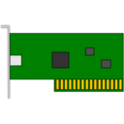
DMA Access to SMRAM
4GB
Low MMIO Range
TOLUD
GFx Mem Base
SMRAM
DMA access to SMRAM is blocked due to TSEG covering SMRAM
TSEG Base

Slide 256
DMA Access to SMRAM: DMA Attacks
4GB
Low MMIO Range
Access to GFx Aperture is redirected to SMRAM
GTT MMIO
Graphics Aperture
TOLUD
GTT PTEs
GFx Mem Base
TSEG Base
SMRAM
DMA access to SMRAM is not blocked as TSEG Base moved

Slide 257
Checking with smm_dma
# chipsec_main.py --module smm_dma
[*] running module: chipsec.modules.smm_dma
[x][ =======================================================================
[x][ Module: SMRAM DMA Protection
[x][ =======================================================================
[*] Registers:
[*] PCI0.0.0_TOLUD = 0xDFA00001 << Top of Low Usable DRAM (b:d.f 00:00.0 + 0xBC)
[*] PCI0.0.0_BGSM = 0xDD800001 << Base of GTT Stolen Memory (b:d.f 00:00.0 + 0xB4)
[*] PCI0.0.0_TSEGMB = 0xDD000001 << TSEG Memory Base (b:d.f 00:00.0 + 0xB8)
[*] IA32_SMRR_PHYSBASE = 0xDD000006 << SMRR Base Address MSR (MSR 0x1F2)
[*] IA32_SMRR_PHYSMASK = 0xFF800800 << SMRR Range Mask MSR (MSR 0x1F3)
[*] Memory Map:
[*] Top Of Low Memory : 0xDFA00000
[*] TSEG Range (TSEGMB-BGSM) : [0xDD000000-0xDD7FFFFF]
[*] SMRR Range (size = 0x00800000): [0xDD000000-0xDD7FFFFF]
[*] checking locks..
[+] TSEGMB is locked
[+] BGSM is locked
[*] checking TSEG alignment..
[+] TSEGMB is 8MB aligned
[*] checking TSEG covers entire SMRR range..
[+] TSEG covers entire SMRAM
[+] PASSED: TSEG is properly configured. SMRAM is protected from DMA attacks

Slide 258
4.5 Attacking Hardware Configuration

Slide 259
BIOS Top Boot-Block Swap Attack
Top Swap Mode allows fault-tolerant update of the BIOS boot-block
Enabled by BUC[TS] in Root Complex MMIO range
Chipset inverts A16 line (A16-A20 depending on the size of boot-block) of the address targeting ROM, e.g. when CPU fetches reset vector on reboot
Thus CPU executes from 0xFFFEFFF0 inside “backup” boot-block rather than from 0xFFFFFFF0
Top Swap indicator is not reset on reboot (requires RTC reset)
When not locked/protected, malware can redirect execution of reset vector to alternate (backup) boot-block
Mitigations: BIOS has to lock down Top Swap configuration (BIOS Interface Lock in General Control & Status register) & protect swap boot-block range in SPI
References: BIOS Boot Hijacking and VMware Vulnerabilities Digging

Slide 260
BIOS Top Boot-Block Swap Attack
CPU normally fetches reset vector at FFFFFFF0h
0xFFFFFFF0
Original BIOS Boot-Block
0xFFFEFFF0
When TS is not locked:
Malware sets BUC[TS]
Out of reset, CPU starts at reset vector
Chipset inverts A16
CPU fetches instr. from alternate BB (at FFFEFFF0h) instead of FFFFFFF0h
Alternate BIOS Boot-Block
(BUC[TS] = 1)
Source: BIOS Boot Hijacking and VMware Vulnerabilities Digging

Slide 261
Checking with common.bios_ts
# chipsec_main.py --module common.bios_ts
[*] running module: chipsec.modules.common.bios_ts
[x][ =======================================================================
[x][ Module: BIOS Interface Lock and Top Swap Mode
[x][ =======================================================================
[*] BC = 0x2A << BIOS Control (b:d.f 00:31.0 + 0xDC)
[00] BIOSWE = 0 << BIOS Write Enable
[01] BLE = 1 << BIOS Lock Enable
[02] SRC = 2 << SPI Read Configuration
[04] TSS = 0 << Top Swap Status
[05] SMM_BWP = 1 << SMM BIOS Write Protection
[*] BIOS Top Swap mode is disabled
[*] BUC = 0x00000000 << Backed Up Control (RCBA + 0x3414)
[00] TS = 0 << Top Swap
[*] RTC version of TS = 0
[*] GCS = 0x00000021 << General Control and Status (RCBA + 0x3410)
[00] BILD = 1 << BIOS Interface Lock Down
[10] BBS = 0
[+] PASSED: BIOS Interface is locked (including Top Swap Mode)

Slide 262
4.6 (1) Attacking SMI Handlers: SMI Call-Outs

Slide 263
SMI Call-Out Vulnerabilities
OS level exploit stores payload in F-segment below 1MB (0xF8070 physical address)
Exploit has to also reprogram PAM to write to F-segment
Then triggers SW SMI via APMC port (I/O 0xB2)
SMI handler does CALL 0F000:08070 in SMM
References:
In 2009, SMI call-out vulnerabilities were discovered by Rafal Wojtczuk and Alex Tereshkin in EFI SMI handlers (Attacking Intel BIOS) and by Filip Wecherowski in legacy SMI (BIOS SMM Privilege Escalation Vulnerabilities)
Also discussed by Loic Duflot in System Management Mode Design and Security Issues
In 2015, researchers from LegbaCore found that many modern systems are still vulnerable to these issues How Many Million BIOS Would You Like To Infect (paper)

Slide 264
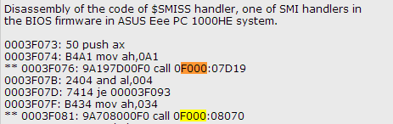
Legacy SMI Call-Out Vulnerabilities
14 call-out vulnerabilities in one SMI handler!
BIOS SMM Privilege Escalation Vulnerabilities

Slide 265
Legacy SMI Handlers Calling Out of SMRAM
Phys Memory
SMRAM
CALL F000:8070
Legacy BIOS Shadow
(F/ E-segments)
PA = 0xF0000
1 MB

Slide 266
SMI Handlers Calling Out of SMRAM
Phys Memory
SMRAM
CALL F000:8070
Legacy BIOS Shadow
(F/ E-segments)
PA = 0xF0000
1 MB
Code fetch
in SMM

Slide 267
SMI Handlers Calling Out of SMRAM
Phys Memory
SMRAM
CALL F000:8070
Legacy BIOS Shadow
(F/ E-segments)
PA = 0xF0000
1 MB
Code fetch
in SMM
0F000:08070 = 0xF8070 PA
0xF8070: payload

Slide 268
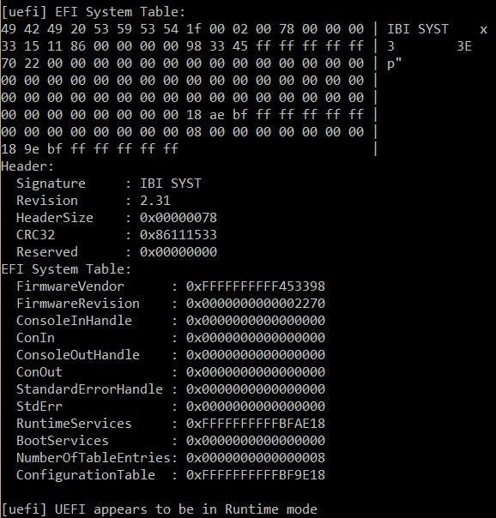
UEFI SMI Call-Outs

Slide 269
Modern EFI Firmware Also Affected
SMRAM
Trusted SMM Code and Data
UEFI RT API called by SMM code
Untrusted Address Space
Untrusted UEFI RT/OS Code and Data
UEFI services
How Many Million BIOS Would You Like To Infect by LegbaCore

Slide 270
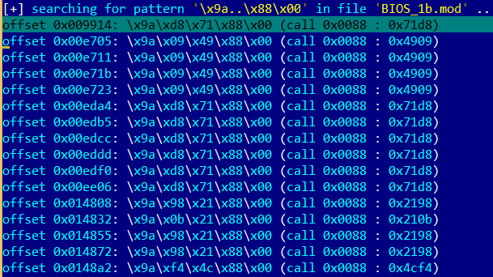
Statically analyzing SMI handlers for call-outs
Legacy SMI handlers do far calls to BIOS functions in F/E – segments (0xE0000 – 0xFFFFF physical memory) with specific code segment selectors

Slide 271
Statically analyzing SMI handlers for call-outs
Searching where EFI DXE SMM drivers reference/fetch outside of SMRAM range of addresses with IDAPython plugin by LegbaCore:
How Many Million BIOS Would You Like To Infect by LegbaCore

Slide 272
Dynamically detecting SMM call-outs
DXE SMI drivers may call Runtime, Boot or DXE services API
Find Runtime, Boot and DXE service tables containing UEFI API function pointers in memory (EFI System Table)
Patch each function with detour code chaining the original function
Enumerate and invoke all SMI handlers
If SMI handler calls-out to some UEFI API, patch will get invoked
Difficulties with this approach:
it needs enumeration of all SMI handlers (with proper interfaces)
SMI handlers may call functions not in RT/BS/DXE service tables

Slide 273
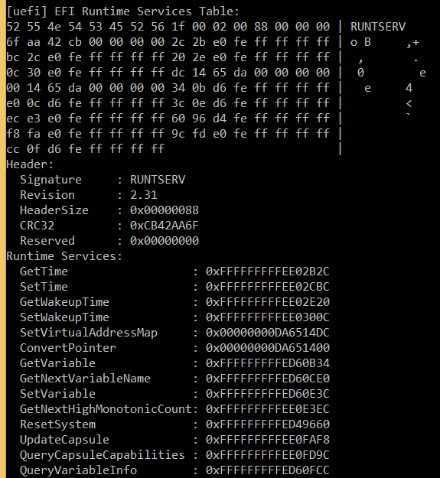
Hooking runtime UEFI services…

Slide 274
BIOS developers can easily detect call-outs
A “simple” ITP debugger script to step on branches and verify that target address of the branch is within SMRAM
Enable SMM Code Access Check HW feature on pre-production systems based on newer CPUs to weed out all “intended” code fetches outside of SMRAM from SMI drivers
NX based soft SMM Code Access Check patches by Phoenix look promising

Slide 275
Using Paging to detect SMM call-outs
NX based soft SMM Code Access Check patches by Phoenix
SMM paging/NX are enabled when CPU enters SMM
PTEs outside of SMRAM have XD=1
#PF is signaled when SMI handler attempts to fetch from any page outside of SMRAM
SMRAM
#PF handler is executed inside SMRAM
Code fetch from a page outside SMRAM causes #PFault due to XD=1
XD == 1
Page Fault

Slide 276

4.6 (2) Attacking SMI Handlers: SMI Input Pointers

Slide 277
SMI Input Pointer Vulnerabilities
When OS triggers SMI (e.g. SW SMI via I/O port 0xB2) it passes arguments to SMI handler via general purpose registers
OS may also pass an address (pointer) to a structure through which an SMI handler can read arguments & returns result
SMI handlers traditionally were not validating that such pointers are outside of SMRAM
If an exploit passes an address which is inside SMRAM, SMI handler may write onto itself on behalf of the exploit
References: A New Class of Vulnerability in SMI Handlers

Slide 278
Pointer Arguments to SMI Handlers
Phys Memory
SMI Handlers in SMRAM
OS Memory
SMI
RAX (code)
RBX (pointer)
RCX (function)
RDX
RSI
SMI handler specific structure
RDI
SMI Handler writes result to a buffer at address passed in RBX…

Slide 279
Pointer Vulnerabilities
Phys Memory
SMI Handlers in SMRAM
OS Memory
SMI
RAX (code)
RBX (pointer)
Fake structure inside SMRAM
RCX (function)
RDX
RSI
RDI
Exploit tricks SMI handler to write to an address inside SMRAM

Slide 280
What can exploit overwrite in SMRAM?
Depending on the vulnerability, caller may control address to write, the value written, or both.
Often the caller controls the address (and knows offset off of the address) but doesn’t completely control the values written to the address by the SMI handler
What can an exploit overwrite in SMRAM without crashing?
SMI entry point at SMBASE + 8000h
Internal SMI handler’s state/flags inside SMRAM
Contents of SMM state save area (registers)
Current value of SMBASE MSR is also saved in SMM state save at SMBASE + FEF8h area by CPU upon SMI
Saved value of SMBASE is restored upon executing RSM
Exploit can relocate SMRAM! Overwrite saved SMBASE to relocate SMRAM to unprotected memory location on next SMI

Slide 281
How does exploit know where to write?
Exploit needs to know location of saved SMBASE
Dump contents of SMRAM
Use another vulnerability (e.g. S3 boot script) to disable SMRAM protections and use DMA or graphics to read SMRAM
Dump SPI flash contents, extract DXE SMM binaries and find SMRAM Init there
Use similar SMI pointer read/write vulnerability
Use hardware ITP offline
Find SMM state save area for each logical CPU
SMM state save is at SMBASE + FC00h but SMBASE is different per CPU thread and per BIOS and some offset of TSEG/SMRR base
Find SMI entry point (@ SMBASE + 8000h)
Exploit can guess several locations of SMBASE (SMRR_PHYSBASE = SMBASE or SMM entry point, blind iteration through all offsets within SMRAM as potential saved SMBASE value)
Or exploit can invoke SMI handler with known values in GPRs, then find where they are saved in SMRAM

Slide 282
How does the attack work?
Phys Memory
SMI Handler
OS Memory
SMI
RAX (code)
Saved SMBASE value
SMM State Save Area
RBX (pointer)
SMI Entry Point (SMBASE + 8000h)
RCX (function)
SMBASE
SMI handler specific structure
CPU stores current value of SMBASE in SMM save state area on SMI and restores it on RSM

Slide 283
How does the attack work?
Phys Memory
SMI Handler
OS Memory
Saved SMBASE value
SMM State Save Area
SMI Entry Point (SMBASE + 8000h)
SMBASE
Fake SMI handler
Exploit prepares fake SMRAM with fake SMI handler outside of SMRAM

Slide 284
How does the attack work?
Phys Memory
OS Memory
SMI Handler
SMI
RAX (code)
Saved SMBASE value
SMM State Save Area
RBX (pointer)
SMI Entry Point (SMBASE + 8000h)
RCX (function)
SMBASE
Fake SMI handler
Exploit triggers SMI w/ RBX pointing to saved SMBASE address in SMRAM
SMI handler overwrites saved SMBASE on exploit’s behalf with address of fake SMI handler outside of SMRAM (e.g. 0 PA)

Slide 285
How does the attack work?
Phys Memory
OS Memory
SMI Handler
Saved SMBASE value
SMM State Save Area
SMI
Fake SMI handler
New SMI Entry Point
SMBASE
Exploit triggers another SMI
CPU executes fake SMI handler at new entry point outside of original protected SMRAM because SMBASE location changed

Slide 286
How does the attack work?
Phys Memory
OS Memory
SMI Handler
(SMRAM is not protected)
Original saved SMBASE value
SMM State Save Area
Fake SMI handler
New SMI Entry Point
SMBASE
Fake SMI handler disables original SMRAM protection (disables SMRR)
Then restores original SMBASE values to switch back to original SMRAM

Slide 287
How does the attack work?
Phys Memory
OS Memory
SMI Handler
(SMRAM is not protected)
SMI Entry Point (SMBASE + 8000h)
SMBASE
The SMRAM is restored but not protected by HW anymore
Any SMI handler may be installed/modified by malware

Slide 288
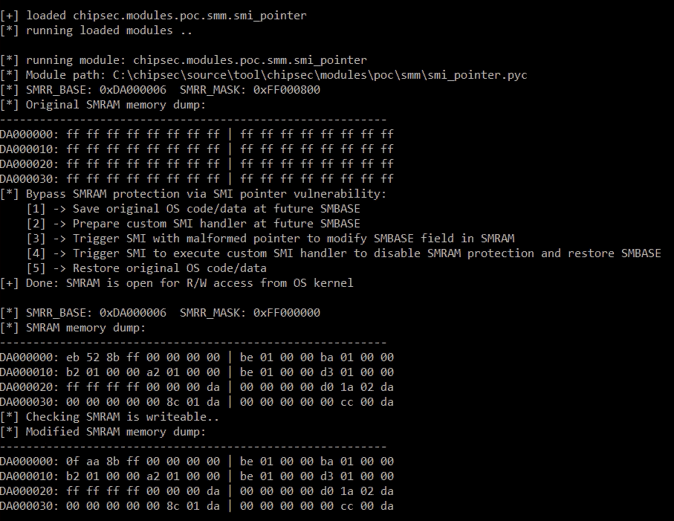

Slide 289
Input Pointers in EDKII: CommBuffer
CommBuffer is a memory buffer used as a communication protocol between OS runtime and DXE SMI handlers
Pointer to CommBuffer is stored in “UEFI” ACPI table in ACPI NVS memory accessible to OS
Contents of CommBuffer are specific to SMI handler. Variable SMI handler read UEFI variable GUID, Name and Data from CommBuffer
Vulnerability | Ref | Affected | Reported by
CommBuffer SMM Overwrite/Exposure (3 issues) | Tianocore | EDK2 | Intel ATR
TOCTOU (race condition) Issue with CommBuffer (2 issues) | Tianocore | EDK2 | Intel ATR
SMRAM Overwrite in Fault Tolerant Write SMI Handler (2 issues) | Tianocore | EDK2 | Intel ATR
SMRAM Overwrite in SmmVariableHandler (2 issues) | Tianocore | EDK2 | Intel ATR

Slide 290
Attacking CommBuffer Pointer
SecurityPkg/VariableAuthenticated/RuntimeDxe:
SmmVariableHandler (
...
SmmVariableFunctionHeader = (SMM_VARIABLE_COMMUNICATE_HEADER *)CommBuffer;
switch (SmmVariableFunctionHeader->Function) {
case SMM_VARIABLE_FUNCTION_GET_VARIABLE:
SmmVariableHeader = (SMM_VARIABLE_COMMUNICATE_ACCESS_VARIABLE *)
SmmVariableFunctionHeader->Data;
Status = VariableServiceGetVariable (
...
(UINT8 *)SmmVariableHeader->Name + SmmVariableHeader->NameSize
);
VariableServiceGetVariable (
...
OUT VOID *Data
)
...
CopyMem (Data, GetVariableDataPtr (Variable.CurrPtr), VarDataSize);
CommBuffer
SMRAM

Slide 291
Mitigating CommBuffer Attack
SMI Handlers often have multiple commands, calling a different function for each command and take command specific arguments
Note the calls to SmmIsBufferOutsideSmmValid. This checks for addresses to overlap with SMRAM range
SmiHandler() {
// check CommBuffer is outside SMRAM
if (!SmmIsBufferOutsideSmmValid(CommBuffer, Size)) {
return EFI_SUCCESS;
}
switch(command)
case 1: do_command1(CommBuffer);
case 2: do_command2(CommBuffer);
…
CommBuffer
SMRAM

Slide 292
CommBuffer TOCTOU Issues
SMI handler checks that it won’t access outside of CommBuffer
What if SMI handler reads CommBuffer memory again after the check
DMA engine (for example GFx) can modify contents of CommBuffer
InfoSize = .. + SmmVariableHeader->DataSize + SmmVariableHeader->NameSize;
if (InfoSize > *CommBufferSize - SMM_VARIABLE_COMMUNICATE_HEADER_SIZE) {
Status = VariableServiceGetVariable (
...
(UINT8 *)SmmVariableHeader->Name + SmmVariableHeader->NameSize
);
VariableServiceGetVariable (
...
OUT VOID *Data
)
...
if (*DataSize >= VarDataSize) {
CopyMem (Data, GetVariableDataPtr (Variable.CurrPtr), VarDataSize);
Time of Check
Time of Use

Slide 293
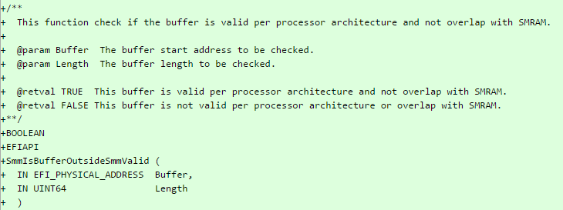
Validate input addresses before using them!
Read pointer issues are also exploitable to expose SMRAM contents
SMI handlers have to validate each address/pointer (+ offsets) they receive from OS prior to reading from or writing to it including returning status/error codes
E.g. use/implement a function which validates address + size for overlap with SMRAM similar to SmmIsBufferOutsideSmmValid in EDKII

Slide 294
Exercise 4.3
Security of SMI Handler Firmware

Slide 295
Exercise 4.4
Attacking SMI Handlers

Slide 296
4.7 Attacking UEFI Variables

Slide 297
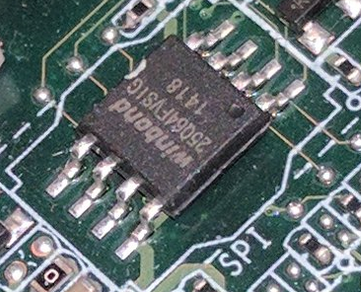
Where does firmware store its settings?
UEFI BIOS stores persistent config as ”UEFI Variables” in NVRAM part of SPI Flash chip
UEFI Variables can be Boot-time or Run-time
Run-time UEFI Variables are accessible by OS via run-time Variable API (via SMI Handler)
OS exposes UEFI Variable API to [privileged] user-mode applications
SetFirmwareEnvironmentVariable
/sys/firmware/efi/efivars/ or /sys/firmware/efi/vars

Slide 298
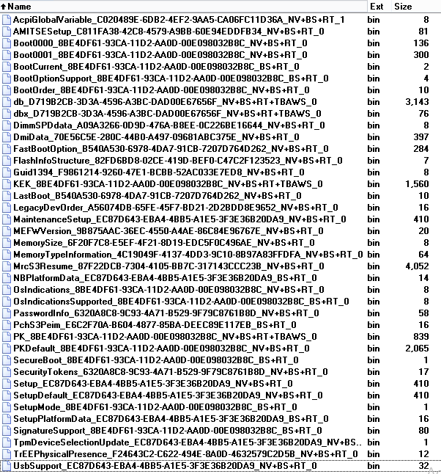
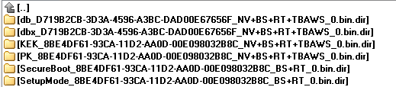
Lots of settings..
AcpiGlobalVariable
BootOrder
Secure Boot certificates
(PK, KEK, db, dbx)
Setup

Slide 299

Dangerous Contents in UEFI Variables
Secure Boot configuration settings (see our All Your Boot Are Belong To Us)
Addresses to structures/buffers which firmware reads from or writes to during boot
Policies for hardware protections & locks such as BIOS Write Protection, Flash LockDown, BIOS Interface Lock
Policies disabling security features
Values of hardware configuration registers which firmware locks down
Data which firmware really really needs to just boot
Secrets: BIOS passwords in clear
Image Source: KEEP CALM-O-MATIC

Slide 300
This cannot be good…
Overwrite early firmware code/data if (physical addresses) pointers are stored in unprotected variables
Bypass UEFI and OS Secure Boot if its configuration or keys are stored in unprotected variables
Bypass or disable hardware protections if their policies are stored in unprotected variables
Make the system unable to boot (brick) if setting essential to boot the system are stored in unprotected variables

Slide 301
Who needs a Setup variable, anyway?
VU#758382
Storing Secure Boot settings in Setup could be bad
Now user-mode malware can clobber contents of Setup UEFI variable with garbage or delete it
Malware may also clobber/delete default configuration StdDefaults
The system may never boot again
The attack has been co-discovered with researchers from LegbaCore (Corey Kallenberg, Xeno Kovah) and MITRE Corporation (Sam Cornwell, John Butterworth).
Source: Setup For Failure

Slide 302
Variable Attribute Checks in CHIPSEC
# chipsec_main.py --module common.uefi.access_uefispec
[*] running module: chipsec.modules.common.uefi.access_uefispec
[x][ =======================================================================
[x][ Module: Access Control of Variables Defined in UEFI Spec
[x][ =======================================================================
[*] Testing UEFI variables ..
[*] Variable BootOrder
[*] Variable dbx
[*] Variable ConOut
[*] Variable db
[*] Variable PK
[*] Variable BootCurrent
[*] Variable Timeout
[*] Variable KEK
[*] Variable Boot0000
[*] Variable Boot0001
[*] Variable SecureBoot
[*] Variable ConIn
..
[+] PASSED: All checked UEFI spec variables are protected according to spec

Slide 303
Exercise 4.5
Security of UEFI Variables

Slide 304
4.8 Attacking Firmware S3 Resume

Slide 305
VU# 976132 (CVE-2014-8274)
Security issues in system firmware due to handling of S3 resume boot script have been independently discovered by other security researchers
Rafal Wojtczuk of Bromium and Corey Kallenberg (@coreykal) of LegbaCore first published Attacks on UEFI Security (paper)
PoC exploit was described and developed by Dmytro Oleksiuk (@d_olex) in Exploiting UEFI boot script table vulnerability
Pedro Vilaça (@osxreverser) found related vulnerability in Mac EFI firmware (SPI Flash Configuration HW lock bit FLOCKDN is gone after resuming from S3)

Slide 306
Waking the system from S3 “sleep” state
Operating System
Apps
NORMAL BOOT
U/EFI System Firmware
S3 RESUME
BDS
DXE
UEFI core
& drivers
S3 Boot
Script Table
Restores
hardware config
Script Engine
Platform Init
Platform Init

Slide 307
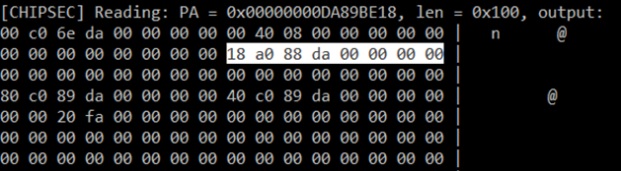
Searching for ACPI global structure…
AcpiGlobalVariable UEFI variable points to a structure in memory (ACPI_VARIABLE_SET_COMPATIBILITY)
[CHIPSEC] Reading EFI variable Name=‘AcpiGlobalVariable’..
[uefi] EFI variable AF9FFD67-EC10-488A-9DFC-6CBF5EE22C2E:AcpiGlobalVariable:
18 be 89 da

Slide 308
Searching for “S3 Boot Script”…
Pointer AcpiBootScriptTable at offset 0x18 in the structure ACPI_VARIABLE_SET_COMPATIBILITY points to the script table
typedef struct {
//
// Acpi Related variables
//
EFI_PHYSICAL_ADDRESS AcpiReservedMemoryBase;
UINT32 AcpiReservedMemorySize;
EFI_PHYSICAL_ADDRESS S3ReservedLowMemoryBase;
EFI_PHYSICAL_ADDRESS AcpiBootScriptTable;
..
} ACPI_VARIABLE_SET_COMPATIBILITY;

Slide 309
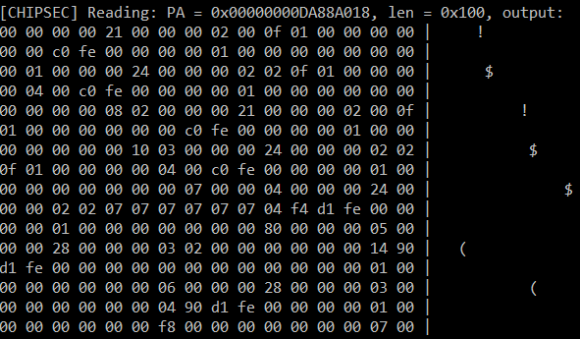
“S3 Boot Script” table in memory

Slide 310
Why “S3 Resume Boot Script”?
To speed up S3 resume, required HW configuration actions are written to an “S3 Resume Boot Script” by DXE drivers instead of running all configuration actions normally performed during boot

Slide 311
S3 Boot Script is a Sequence of Platform Dependent Opcodes
00 00 00 00 21 00 00 00 02 00 0f 01 00 00 00 00
00 00 c0 fe 00 00 00 00 01 00 00 00 00 00 00 00
00 01 00 00 00 24 00 00 00 02 02 0f 01 00 00 00
00 04 00 c0 fe 00 00 00 00 01 00 00 00 00 00 00
00 00 00 00 08 02 00 00 00 21 00 00 00 02 00 0f
01 00 00 00 00 00 00 c0 fe 00 00 00 00 01 00 00
00 00 00 00 00 10 03 00 00 00 24 00 00 00 02 02
..
01 00 00 00 00 00 00 00 f0 00 02 00 67 01 00 00
20 00 00 00 01 02 30 04 00 00 00 00 21 00 00 00
00 00 00 00 de ff ff ff 00 00 00 00 68 01 00 00
..
d3 d1 4b 4a 7e ff

Slide 312
Decoding Opcodes
[000] Entry at offset 0x0000 (length = 0x21):
Data:
02 00 0f 01 00 00 00 00 00 00 c0 fe 00 00 00 00
01 00 00 00 00 00 00 00 00
Decoded:
Opcode : S3_BOOTSCRIPT_MEM_WRITE (0x02)
Width : 0x00 (1 bytes)
Address: 0xFEC00000
Count : 0x1
Values : 0x00
..
[359] Entry at offset 0x2F2C (length = 0x20):
Data:
01 02 30 04 00 00 00 00 21 00 00 00 00 00 00 00
de ff ff ff 00 00 00 00
Decoded:
Opcode : S3_BOOTSCRIPT_IO_READ_WRITE (0x01)
Width : 0x02 (4 bytes)
Address: 0x00000430
Value : 0x00000021
Mask : 0xFFFFFFDE
# chipsec_util.py uefi s3bootscript

Slide 313
S3 Boot Script Opcodes
I/O port write (0x00)
I/O port read-modify-write (0x01)
Memory write (0x02)
Memory read-modify-write (0x03)
PCIe configuration write (0x04)
PCIe configuration read-modify-write (0x05)
SMBus execute (0x06)
Stall (0x07)
Dispatch (0x08)
Dispatch2

Slide 314
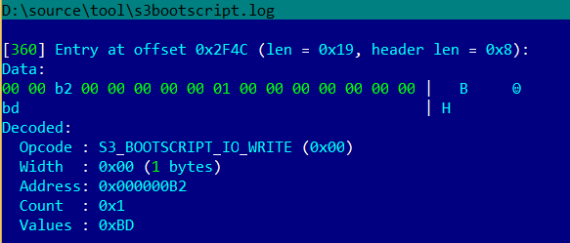
Processor I/O Port Opcodes
S3_BOOTSCRIPT_IO_WRITE/READ_WRITE opcodes in the S3 boot script write or RMW to processor I/O ports
Opcode below sends SW SMI by writing value 0xBD port 0xB2

Slide 315
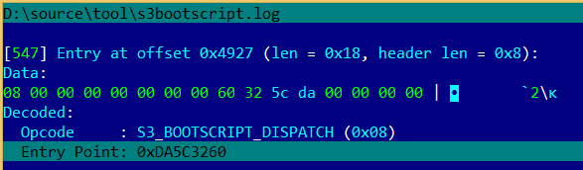
“Dispatch” Opcodes
S3_BOOTSCRIPT_DISPATCH/2 opcodes in the S3 boot script jumps to entry-point defined in the opcode

Slide 316
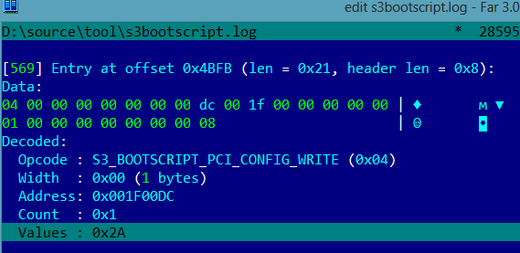
Opcode Restoring BIOS Write Protection
S3_BOOTSCRIPT_PCI_CONFIG_WRITE opcode in the S3 boot script restores BIOS hardware write-protection (value 0x2A means BIOS hardware write protection is ON)

Slide 317
Things that can go wrong
Address (pointer) to S3 boot script is stored in a runtime UEFI variable (e.g. NV+RT+BS AcpiGlobalTable)
The S3 boot script itself is stored in unprotected memory (ACPI NVS) accessible to the OS or DMA capable devices
The PEI executable parsing and interpreting the S3 boot script or any other executable needed for S3 resume is running out of unprotected memory
S3 boot script contains Dispatch (Dispatch2) opcodes with entry-points in unprotected memory
EFI firmware “forgets” to store opcodes which restore all required hardware locks and protections in S3 boot script

Slide 318
Attacking FW on resume from sleep
Exploit modifies S3 boot script table in memory
Operating System
Upon resume, firmware executes rogue S3 script which disables HW protections
Exploit
MODIFY
NORMAL BOOT
U/EFI System Firmware
S3 RESUME
BDS
DXE
UEFI core
& drivers
S3 Boot
Script Table
Restores
hardware config
Script Engine
Platform PEI
Platform PEI

Slide 319

Lucky you! BIOS protection is ON
PASSED: BIOS is write protected

Slide 320

Sleep well
Found Boot Script in unprotected memory
Script Opcode restores BIOS Protection == ON
Changing it to OFF

Slide 321

Oh wait…
FAILED: BIOS is NOT protected completely

Slide 322

Opcode restoring BIOS Write Protection has been modified
S3_BOOTSCRIPT_PCI_CONFIG_WRITE opcode in the S3 boot script restored BIOS hardware write-protection in OFF state

Slide 323
Checking with common.uefi.s3bootscript
# chipsec_main.py –m common.uefi.s3bootscript
[x][ ==========================================
[x][ Module: S3 Resume Boot-Script Protections
[x][ ==========================================
[!] Found 1 S3 boot-script(s) in EFI variables
[*] Checking S3 boot-script at 0x00000000DA88A018
[!] S3 boot-script is not in SMRAM
[*] Reading S3 boot-script from memory..
[*] Decoding S3 boot-script opcodes..
[*] Checking entry-points of Dispatch opcodes..
[-] Found Dispatch opcode (offset 0x014E) with Entry-Point: 0x00000000DA5C3260 : UNPROTECTED
[-] Entry-points of Dispatch opcodes in S3 boot-script are not in protected memory
[-] FAILED: S3 Boot Script and entry-points of Dispatch opcodes do not appear to be protected

Slide 324
Exercise 4.6
Security of Firmware S3 Resume

Slide 325
4.9 Other Firmware Issues

Slide 326
Pre-Boot Passwords Exposed in BIOS Keyboard Buffer
BIOS and Pre-OS applications store keystrokes in legacy BIOS keyboard buffer in BIOS data area (at physical address 0x41E)
BIOS, HDD passwords, Full-Disk Encryption PINs etc.
Some BIOS’es didn’t clear keyboard buffer
References:
Bypassing Pre-Boot Authentication Passwords

Slide 327
Checking with common.bios_kbrd_buffer
# chipsec_main.py --module common.bios_kbrd_buffer
[*] running module: chipsec.modules.common.bios_kbrd_buffer
[x][ =======================================================================
[x][ Module: Pre-boot Passwords in the BIOS Keyboard Buffer
[x][ =======================================================================
[*] Keyboard buffer head pointer = 0x1A (at 0x41A), tail pointer = 0x1C (at 0x41C)
[*] Keyboard buffer contents (at 0x41E):
1e 1f 20 21 22 23 24 25 26 27 28 29 2a 2b 2c 2d | !"#$%&'()*+,-
2e 2f 30 31 32 33 34 35 36 37 38 39 3a 3b 3c 3d | ./0123456789:;<=
[+] PASSED: Keyboard buffer is filled with common fill pattern
* Better check from EFI shell as OS/pre-boot app might have cleared the keyboard buffer

Slide 328
Training materials are available on Github
https://github.com/advanced-threat-research/firmware-security-training
Yuriy Bulygin @c7zero
Alex Bazhaniuk @ABazhaniuk
Andrew Furtak @a_furtak
John Loucaides @JohnLoucaides

Slide 329
Security of BIOS/UEFI System Firmware from Attacker and Defender Perspectives Section 5. Hands-On Learning of EFI Environment
Yuriy Bulygin *
Alex Bazhaniuk *
Andrew Furtak *
John Loucaides **
* Advanced Threat Research, McAfee
** Intel

Slide 330
License
Training materials are shared under Creative Commons “Attribution” license CC BY 4.0
Provide the following attribution:
Derived from “Security of BIOS/UEFI System Firmware from Attacker and Defender Perspective” training by Yuriy Bulygin, Alex Bazhaniuk, Andrew Furtak and John Loucaides available at https://github.com/advanced-threat-research/firmware-security-training

Slide 331
Section 5. Hands-On Learning of EFI Environment

Slide 332
5.1 UEFI Shell

Slide 333
Exercise 5.1
Getting Familiar with UEFI Shell

Slide 334
Booting in UEFI Shell and Using Built-in Shell Commands
Replace bootloader with uefi shell:
$cp /boot/efi/EFI/boot/bootx64.efi /boot/efi/EFI/boot/bootx64.efi.bak
$cp /boot/efi/EFI/boot/shell_bootx64.efi /boot/efi/EFI/boot/bootx64.efi
Reboot system: $shutdown –r now
Test built-in shell commands from UEFI shell (list in next slide)
Recover original bootloader in UEFI shell:
shell> fs0:
shell> rm EFI\boot\bootx64.efi
shell> cp EFI\boot\bootx64.efi.bak EFI\boot\bootx64.efi

Slide 335
Full UEFI Shell Commands/Apps
Tool | Description
help –b | Displays all UEFI shell internal commands
mode | Displays or changes the console output device mode.
memmap | Displays the memory map maintained by the EFI environment.
dmem | Displays the contents of system or device memory.
mm | Displays or modifies MEM/MMIO/IO/PCI/PCIE address space.
pci | Displays PCI device list or PCI function configuration space.
drivers | Displays the EFI driver list.
dmpstore | Displays all EFI NVRAM variables.
dh | Displays EFI handle information.
openinfo | Displays the protocols and agents associated with a handle.
dblk | Displays the contents of one or more blocks from a block device.
eficompress | Compress a file
efidecompress | Decompress a file
smbiosview | Displays SMBIOS information
loadpcirom | Loads a PCI Option ROM from the specified file.
edit/hexedit | Editor, hex editor
map | Defines a mapping between a user-defined name and a device handle.
vol | Displays the volume information for the file system that is specified by fs.

Slide 336
5.2 Building UEFI Firmware with EDK II

Slide 337
Exercise 5.2
Building EDK2 and flashing SPI image

Slide 338
Exercise Outline
Pre-requirement: Boot your system from USB stick. Connect your system to minnowboard through Ethernet cable and change IP address of your system to 192.168.1.1/24
Build open source EDK2 BIOS image for MinnowBoard on your system
Copy newly build Flash image to MinnowBoard (use scp command for it)
Flash it onto SPI using CHIPSEC
Read SPI image using CHIPSEC
Read SPI image using Dediprog HW SPI Flash programmer (optional)

Slide 339
MinnowBoard MAX Build Resources
Documents, Release Nodes, Pre-built Firmware Binary images, Buildable Development Tree, Flash Update Utilities:
http://firmware.intel.com/projects/minnowboard-max
Using EDK II with Native GCC:
http://tianocore.sourceforge.net/wiki/Using_EDK_II_with_Native_GCC

Slide 340
Create a Full Source Tree
Create a new folder (directory) on the root of your local hard drive (development machine) for use as your work space (In USB stick work space: "/home/user/Desktop/bios").
Checkout packages from: https://svn.code.sf.net/p/edk2/code/branches/UDK2014.SP1/
Download: MinnowBoard_MAX-{version}-Binary.Objects.zip
Download and patch openssl
Download edksetup.sh
Patch Vlv2TbltDevicePkg/bld_vlv.sh depends on GCC version
Or use script: bios_download_and_build.sh

Slide 341
Apply debug patch
Apply debug patch to Vlv2TbltDevicePkg directory:
$cd Vlv2TbltDevicePkg
$patch –p 0 < ~/Desktop/patches/debug.patch
$cd ..

Slide 342
Build MinnowBoard UEFI Firmware
Install iASL compiler
Install python, gcc, build-essential, subversion, uuid-dev
Run: $source edksetup.sh
Run:
$cd Vlv2TbltDevicePkg
$chmod +x bld_vlv.sh Build_IFWI.sh GenBiosId
Build EDKII Firmware:
$./Build_IFWI.sh MNW2 Debug # also use this to rebuild BIOS
Firmware binary MNW2MAX_X64_D_0079_01_GCC.bin should now be in directory Stitch/
$ ls -lah Stitch/
-rw-r--r-- 1 user user 8.0M Jun 4 18:06 MNW2MAX_X64_D_0079_01_GCC.bin
Copy SPI image to MinnowBoard system (use scp command for coping).

Slide 343
Read SPI Image Using CHIPSEC
Check SPI flash before/after erase and write operations.
CHIPSEC SPI commands:
$ chipsec_util spi dump rom.bin

Slide 344
Flash Image Onto SPI Using CHIPSEC
Disable BIOS Write Protection in UEFI Setup (DONE)
Enable writes to BIOS region of SPI flash memory
$python chipsec_util.py spi disable-wp
Erase full SPI flash memory chip
for(( i=0; i<2048; i++ ))
do
R=$(echo "obase=16; $i*4096" | bc)
python chipsec_util.py spi erase $R;
done
Write newly built firmware image to SPI flash memory
$python chipsec_util.py spi write 0x0 <NEW_BUILT_BIOS_FILE>

Slide 345

Changing BIOS WP in UEFI Setup

Slide 346

Manipulating SPI Image Using Dediprog Hardware SPI Flash Programmer

Slide 347
DediProg Software

Slide 348


Manipulating SPI image using Bus Pirate as HW SPI Flash programmer

Slide 349
Manipulating SPI Image Using Bus Pirate as HW SPI Flash Programmer
Minnowboard Max
power
USB
brown
purple
Ethernet
gray
Power
SATA
uHDMI
SD
card
red
white
black
Bus Pirate
brown
red
orange
yellow
USB
green
blue
purple
gray
white
black

Slide 350
5.3 EDK II Debug

Slide 351
Exercise 5.3
EFI Debug

Slide 352
Exercise Outline
Serial connection setup
Configure host system for debugging
Debug example with GDB

Slide 353
Debug & Release Differences
DEBUG has a slower boot than RELEASE because of time it takes to display debug info
DEBUG has a larger image than RELEASE because the embedded debug info
DEBUG uses the serial port for debug string output
DEBUG contains the debug strings
DEBUG contains detailed debug strings that show the boot process and various ASSERT/TRACE errors

Slide 354

Connect to UART port
To read UART output run minicom:
$minicom -D /dev/ttyUSB0

Slide 355
Configuring the Debug Host (Done)
UDK debugger configuration:
Download 2013-WW52-UDK.Debugger.Tool-1.4-Linux.zip from:
http://firmware.intel.com/develop/intel-uefi-tools-and-utilities/intel-uefi-development-kit-debugger-tool
Install UDK debugger tool:
$./UDK_Debugger_Tool_v1_4_x86_64.bin
Check/change configuration file: /etc/udkdebugger.conf
$ cat /etc/udkdebugger.conf
[Debug Port]
Channel = Serial
Port = /dev/ttyUSB0
FlowControl = 0
BaudRate = 115200

Slide 356
GDB on Debug Host System (Done)
Rebuild GDB on HOST:
Download gdb source code:
$ apt-get install gdb-source
$ cp /usr/src/gdb.tar.bz2 ~/Desktop/udk-debugger/
$ cd ~/Desktop/udk-debugger/
$ bzip2 -dc gdb.tar.bz2| tar -xf –
$ cd gdb
Download (from http://expat.sourceforge.net ) and install expat
Configure and build gdb with expat:
$./configure --with-expat --with-python
$ make && make install

Slide 357
UEFI Firmware Debugging
Run UDK-GDB-SERVER
$/opt/intel/udkdebugger/bin/udk-gdb-server
Reboot Debug Target
Run GDB on Debug Host
$/home/user/Desktop/udk-debugger/gdb/gdb
(gdb) target remote :1234
Remote debugging using :1234

Slide 358
Source Level Debug
(gdb) source /opt/intel/udkdebugger/script/udk-gdb-script
##############################################################
# This gdb configuration file contains settings and scripts
# for debugging UDK firmware.
# WARNING: Setting pending breakpoints is NOT supported!
# Additional commands for source level debugging will be added!
##############################################################
Loading symbol for address: 0x78e1472c
add symbol table from file "/home/user/Desktop/bios/Build/Vlv2TbltDevicePkg/DEBUG_GCC48/X64/MdeModulePkg/Core/Dxe/DxeMain/DEBUG/DxeCore.debug" at
.text_addr = 0x78dde260
.data_addr = 0x78e180e0
(udb) where

Slide 359
Example: Setting Breakpoints
Set breakpoint on CoreLoadPeImage/CoreLoadImage functions
(udb) b CoreLoadPeImage
Breakpoint 1 at 0x78de2b22: file /home/user/Desktop/bios/MdeModulePkg/Core/Dxe/Image/Image.c, line 462.
(udb) b CoreLoadImage
Breakpoint 2 at 0x78de477c: file /home/user/Desktop/bios/MdeModulePkg/Core/Dxe/Image/Image.c, line 1409.
(udb) c
Continuing.
Loading symbol for address: 0x78de477c
Breakpoint 2, CoreLoadImage (BootPolicy=0 '\000', ParentImageHandle=0x78d78f18, FilePath=0x78d5f018, SourceBuffer=0x0, SourceSize=0, ImageHandle=0x78d5ee98)
at /home/user/Desktop/bios/MdeModulePkg/Core/Dxe/Image/Image.c:1409
1409 Tick = 0;

Slide 360
Example: Setting Breakpoints
Set breakpoint to CoreExitBootServices:
(udb) break CoreExitBootServices
Breakpoint 1 at 0x78ddfdac: file /home/user/Desktop/bios/MdeModulePkg/Core/Dxe/DxeMain/DxeMain.c, line 731.
(udb) c
Continuing.
Loading symbol for address: 0x78ddfdac
Breakpoint 1, CoreExitBootServices (ImageHandle=0x768d8798, MapKey=3615) at /home/user/Desktop/bios/MdeModulePkg/Core/Dxe/DxeMain/DxeMain.c:731
731 gTimer->SetTimerPeriod (gTimer, 0);

Slide 361
Example: Setting Breakpoints
Set breakpoint to DxeImageVerificationHandler which contains PE/TE header confusion vulnerability in Secure Boot implementation
(udb) break DxeImageVerificationHandler
(udb) c
Continuing.
Debug function DxeImageVerificationHandler using step:
(udb) step

Slide 362
Useful GDB commands
Disassembly:
(gdb) display/i $pc
(gdb) set disassemble-next-line on
(gdb) show disassemble-next-line
(gdb) layout asm(udb)
Other:
(gdb) info breakpoints
(gdb) info args # Print args to the function of the current stack frame
(gdb) list # Shows the current or given source context.
(gdb) info registers # Show registers
(gdb) info frame # Show the stack frame info

Slide 363
5.4 EDK II Overview

Slide 364
EDK II
Most of the source code written in C
Provides Flash Mapping Tool generating Firmware Volumes and the resulting SPI flash image
Build Existing EDK Modules
EDKII projects are made up of packages (DEC files)
Compiles to .EFI files: UEFI/DXE Driver, PEIM, UEFI Application, DXE Library

Slide 365

MinnowBoard Max EDKII Source Tree
Package concept for each EDK II sub-directory
Platform specific packages (Vlv2..Pkg) are also there
EDK II build process reflects the package
# edksetup
# build -p Nt32Pkg\Nt32Pkg.dsc -a IA32

Slide 366
EDK II Packages
MdePkg - Include files and libraries for Industry Standard Specifications
MdeModulePkg - Modules only definitions from the Industry Standard Specification are defined in the MdePkg
SecurityPkg – Implements security related functionality (Secure Boot, Authenticated Variables, etc.)
CryptoPkg – Provides crypto functionality
ShellPkg & NetworkPkg - Functionality of shell & network stack
IA32FamilyCpuPkg – Package supporting IA32 family processors
IntelFrameworkPkg - Include files and libraries for those parts of the Intel Platform Innovation Framework for EFI specifications not adopted “as is” by the UEFI or PI specifications
Nt32Pkg – Windows UEFI emulator

Slide 367
EDKII File Extensions
.DSC - Platform Description file (recipe for creating a package, contains definitions to build the package)
.DEC - Package Declaration file
.INF - Module Definition (defines a component)
.FDF - Flash Description File (describes information about flash parts)
.FV - Firmware volume (FV) binary file

Slide 368
Platform Configuration Database (PCD)
PCD options define parameters which allow modules to define firmware configuration without recompile/rebuild or source code change
There’s an API to access to PCD options
PCD options can store platform or feature configuration settings

Slide 369
PCD Example
PCD options are defined in the DEC files in any package
./SecurityPkg/SecurityPkg.dec:
gEfiSecurityPkgTokenSpaceGuid.PcdOptionRomImageVerificationPolicy
|0x04|UINT32|0x00000001
Values of PCD options are set in DSC files
[PcdsFixedAtBuild.IA32]
...
gEfiIchTokenSpaceGuid.PcdIchAcpiIoPortBaseAddress|0x400

Slide 370
5.5 Building UEFI Applications/Drivers

Slide 371
Building UEFI Application
UDKII User Manual describes a module building process in Chapter 3.4. You need to create a new package containing the module or add the module to existing package
http://tianocore.sourceforge.net/wiki/EDK_II_User_Documentation
UEFI Driver Wizard is of great help for module creation
http://tianocore.sourceforge.net/wiki/UEFI_Driver_Wizard

Slide 372
Building UEFI Application
For this exercise, there’s a myapp package and a module generated with UEFI Driver Wizard and located in myapp folder in the UEFI source tree
myapp/
myapp.h
myapp.c
myapp.dec – package declaration file
myapp.dsc – platform build description file
myapp.inf – module information file
myapp.uni – unicode string file

Slide 373
UEFI Driver Wizard

Slide 374
Building a UEFI application
Linux:
#!/usr/bin/env bash
source edksetup.sh
build -a X64 -p myapp/myapp.dsc -m myapp/myapp.inf
Windows:
call edksetup.bat
build -a X64 -p myapp\myapp.dsc -m myapp\myapp.inf

Slide 375
UEFI Shell

Slide 376
Reading Command-Line Arguments
Some information can be found here:
Creating a Shell Application
http://tianocore.sourceforge.net/wiki/Creating_a_Shell_Application
From ShellLib we’ll use following structure
SHELL_PARAM_ITEM,
and functions
ShellCommandLineParseEx
ShellCommandLineGetFlag
ShellCommandLineGetValue

Slide 377
Reading Command-Line Arguments
EFI_STATUS EFIAPI ShellCommandLineParseEx ( IN CONST SHELL_PARAM_ITEM * CheckList,
OUT LIST_ENTRY ** CheckPackage,
OUT CHAR16 **ProblemParam OPTIONAL,
IN BOOLEAN AutoPageBreak,
IN BOOLEAN AlwaysAllowNumbers )
Checks the command line arguments passed against the list of valid ones. Optionally removes NULL values first. If no initialization is required, then return RETURN_SUCCESS.
Parameters:
[in] CheckListThe pointer to list of parameters to check.
[out] CheckPackageThe package of checked values.
[out] ProblemParamOptional pointer to pointer to unicode string for the paramater that caused failure.
[in] AutoPageBreakWill automatically set PageBreakEnabled.
[in] AlwaysAllowNumbersWill never fail for number based flags.
Return values:
EFI_SUCCESS The operation completed sucessfully.
EFI_OUT_OF_RESOURCES A memory allocation failed.
EFI_INVALID_PARAMETER A parameter was invalid.
EFI_VOLUME_CORRUPTED The command line was corrupt.
EFI_DEVICE_ERROR The commands contained 2 opposing arguments. One of the command line arguments was returned in ProblemParam if provided.
EFI_NOT_FOUND A argument required a value that was missing. The invalid command line argument was returned in ProblemParam if provided.

Slide 378
Reading Command-Line Arguments
BOOLEAN EFIAPI ShellCommandLineGetFlag ( IN CONST LIST_ENTRY *CONST CheckPackage,
IN CONST CHAR16 *CONST KeyString )
Checks for presence of a flag parameter.
Flag arguments are in the form of "-<Key>" or "/<Key>", but do not have a value following the key.
If CheckPackage is NULL then return FALSE. If KeyString is NULL then ASSERT().
Parameters:
[in] CheckPackage The package of parsed command line arguments.
[in] KeyStringThe Key of the command line argument to check for.
Return values:
TRUE The flag is on the command line.
FALSE The flag is not on the command line.

Slide 379
Reading Command-Line Arguments
CONST CHAR16* EFIAPI ShellCommandLineGetValue ( IN CONST LIST_ENTRY *CONST CheckPackage,
IN CONST CHAR16 *CONST KeyString )
Checks for presence of a flag parameter.
Value parameters are in the form of "-<Key> value" or "/<Key> value".
If CheckPackage is NULL then return NULL.
Parameters:
[in] CheckPackage The package of parsed command line arguments.
[in] KeyStringThe Key of the command line argument to check for.
Return values:
NULL The flag is not on the command line.
!=NULL The pointer to unicode string of the value.

Slide 380
Reading Command-Line Arguments
#define NAME_OPTION (L”-n”)
#define GUID_OPTION (L”-g”)
#define HELP_OPTION (L”-?”)
SHELL_PARAM_ITEM ParamList[] = {
{ NAME_OPTION, TypeValue },
{ GUID_OPTION, TypeValue },
{ HELP_OPTION, TypeFlag },
{ NULL, TypeMax },
};
LIST_ENTRY *ParamPackage;
ShellCommandLineParseEx(ParamList, &ParamPackage, NULL, TRUE, FALSE);

Slide 381
Reading Command-Line Arguments
CONST CHAR16 *name_str = 0;
CONST CHAR16 *guid_str = 0;
if (ShellCommandLineGetFlag(ParamPackage,NAME_OPTION)){
name_str = ShellCommandLineGetValue (ParamPackage, NAME_OPTION);
}
if (ShellCommandLineGetFlag(ParamPackage, GUID_OPTION )) {
guid_str = ShellCommandLineGetValue (ParamPackage, GUID_OPTION );
}

Slide 382
Using UEFI Runtime Services
Good reference: http://wiki.phoenix.com/wiki/index.php/EFI_RUNTIME_SERVICES
Global variable gRT, points to runtime service table, declared in
Library/UefiRuntimeServicesTableLib.h
Calling the service function:
gRT->GetVariable((CHAR16*)name_str, &guid,
&attributes, &size, buffer);

Slide 383
Dependencies
Add include files to myapp.h:
#include <Library/ShellLib.h>
#include <Protocol/EfiShell.h>
#include <Protocol/EfiShellInterface.h>
#include <Protocol/EfiShellParameters.h>

Slide 384
Dependencies
ShellPkg is used. Add ShellPkg and its dependencies to package files.
Add to myapp.inf [Packages] section
ShellPkg/ShellPkg.dec
Add [LibraryClasses] section
ShellLib to myapp.inf
Specify the location of ShellLib module INF file and dependecies in myapp.dsc [LibraryClasses]:
ShellLib|ShellPkg/Library/UefiShellLib/UefiShellLib.inf
FileHandleLib|ShellPkg/Library/UefiFileHandleLib/UefiFileHandleLib.inf
HiiLib|MdeModulePkg/Library/UefiHiiLib/UefiHiiLib.inf
SortLib|ShellPkg/Library/UefiSortLib/UefiSortLib.inf UefiHiiServicesLib|MdeModulePkg/Library/UefiHiiServicesLib/UefiHiiServicesLib.inf

Slide 385
Exercise 5.4
Building UEFI Application

Slide 386
References
TianoCore.org site documentation
http://sourceforge.net/projects/edk2/files/
EDK II INF File Specification, Version 1.2, Intel, 2009.
EDK II DSC File Specification, Version 1.2, Intel, 2009.
EDK II DEC File Specification, Version 1.2, Intel, 2009.
EDK II FDF (Flash Description File) File Specification, Version 1,2, Intel, 2009.
EDK II Build Specification, Version 1.2, Intel, 2009.

Slide 387
Training materials are available on Github
https://github.com/advanced-threat-research/firmware-security-training
Yuriy Bulygin @c7zero
Alex Bazhaniuk @ABazhaniuk
Andrew Furtak @a_furtak
John Loucaides @JohnLoucaides

Slide 388
Security of BIOS/UEFI System Firmware from Attacker and Defender Perspectives 6. Mitigations
Yuriy Bulygin *
Alex Bazhaniuk *
Andrew Furtak *
John Loucaides **
* Advanced Threat Research, McAfee
** Intel

Slide 389
License
Training materials are shared under Creative Commons “Attribution” license CC BY 4.0
Provide the following attribution:
Derived from “Security of BIOS/UEFI System Firmware from Attacker and Defender Perspective” training by Yuriy Bulygin, Alex Bazhaniuk, Andrew Furtak and John Loucaides available at https://github.com/advanced-threat-research/firmware-security-training

Slide 390
Section 6. Mitigations

Slide 391
6.1 UEFI Security Mechanisms

Slide 392
UEFI Security Mechanisms in SecurityPkg
UEFI Secure Boot (DxeVerificationLib, Chapter 27.2 of UEFI 2.4 Spec)
Authenticated UEFI Variables (Chapter 7 of UEFI 2.4 Spec)
Random Number Generator (UEFI driver implementing the EFI_RNG_PROTOCOL from the UEFI2.4 specification)
User Identification (DXE drivers that support multi-factor user authentication), Chapter 31 of UEFI 2.4 spec
TCG Measured Boot (PEI Modules & DXE drivers implementing Trusted Computing Group measured boot EFI_TCG_PROTOCOL and EFI_TREE_PROTOCOL from the TCG and Microsoft MSDN websites, respectively)
Reference implementation in UDK SecurityPkg: https://svn.code.sf.net/p/edk2/code/trunk/edk2/SecurityPkg

Slide 393
Other UEFI Security Mechanisms
UEFI Secure “Capsule” Update
http://comments.gmane.org/gmane.comp.bios.tianocore.devel/8402
Variable Lock Protocol (Read-Only Variables)
https://github.com/tianocore/edk2/blob/master/MdeModulePkg/Include/Protocol/VariableLock.h
Lock Box (protects memory contents across S3 sleep state):
https://github.com/tianocore/edk2-MdeModulePkg/blob/master/Include/Protocol/LockBox.h

Slide 394
Signed UEFI “Capsule” Update

Slide 395
Signed Firmware Update
BIOS Update Software Runs
Copy Firmware Update Payload and Signature to Memory
Set update Flag for BIOS
Request OS Reboot
Before Reboot
After Reboot
BIOS Update Flag Set
Verify Update Payload Signature
Sign. Valid
Update BIOS and Firmware
Yes
Yes
No
BIOS Update Fail Error Msg
Reset BIOS Update Flag
No
Continue Boot
Reboot
Source: Dell Signed Firmware Update (NIST 800-147)

Slide 396
Firmware Update Methods
UEFI Signed Capsule Update (update on reboot/S3)
Run-time SMM based update (by an SMI handler)
Update during BIOS Setup or from UEFI Shell
Remote BMC/IPMI Based Update
Update with physical switch

Slide 397
UEFI “Capsules”
EFI_FIRMWARE_MANAGEMENT
_CAPSULE_HEADER
EFI Capsule Header
DXE Driver 1 (optional)
Capsule Body
…
DXE Driver n (optional)
Payload 1
…
Payload n
Source: UEFI Spec 2.4 Facilitates Secure Update by Jeff Bobzin (Insyde Software)

Slide 398
UEFI Firmware Secure “Capsule” Update
Capsule update is a runtime service used to update UEFI FW
0xFFFFFFFF
Update is initiated by update application/OS run‐time
Update application stores update “capsule” in DRAM or HDD on ESP (e.g. \EFI\CapsuleUpdate)
Upon reboot or S3 resume, FW finds and parses update capsule
After FW verifies digital signature of the capsule, FW writes new BIOS FV(s) to SPI flash memory
UEFI/BIOS code
EFI capsule header
Update capsule
Firmware (optional DXE driver or update payload)
Firmware (optional DXE driver or update payload)
0x00000000
Source: UEFI Spec Version 2.4 Facilitates Secure Update UEFI Summerfest 2013

Slide 399
Windows Firmware Update Package
Windows Firmware Update Package
INF
CAT
UEFI Capsule
Signed by Microsoft
Signed by platform manufacturer or ODM
Signed by platform manufacturer
UEFI Capsule
Signed by Independent HW vendor (IHV)
Signed with key matching cert in UEFI “db” variable for Secure Boot
Update System Firmware (UEFI FVs)
Update Device Firmware (e.g. EC)
UEFI DXE Drivers
Source : Windows UEFE Firmware Update Platform

Slide 400
Firmware Update Rollback Protection
Version 1
Version 1
Version 1
Version 2
Version 2
Version 2
Version 3
Version 3
Version 3
“Fence”
Each version fixes some issues with the previous. Since none are known to have security flaws, each new version allows updates to all older versions.
Version 4
Version 4
Version 5 can now accept only versions 5 and 4.
In V4, one of the issues fixed in V3 is realized to be a security fix. V4 will not allow updates to earlier versions, even V3 since it allows update to V2.
Version 5

Slide 401
Protecting UEFI Variables

Slide 402
Protecting UEFI Variables
Separate critical settings from other and stored in different variables
If a variable is only used by the FW then it shouldn’t be Runtime
Make variables, not updateable by the OS, “read-only” (Variable Lock)
Use authenticated variables or Pcd for security settings
Don’t store debug/validation config. (e.g. HW locks) in variables
Whenever possible, allow only predefined values written to the variables
Validate contents of the variables (e.g. check pointers)
Have default config to allow system to boot if variable is corrupted
No sensitive data like BIOS passwords in variables in clear
Update of some variables may require physically present user
Other integrity checks on the contents of critical variables

Slide 403
Why Authenticating Variables?
Secure Boot stores Platform Key (PK), Key Exchange Keys (KEK), white-list and black-list (db, dbx) in UEFI Variables
These need to be updateable yet protected from unauthorized software changing them
UEFI Authenticated Variable allows update/removal of authenticated variables only if new variable is signed and corresponding public cert already present in NVRAM (e.g. in KEK)
Counter or Time Based Authenticated Variable to prevent from replay attacks

Slide 404
UEFI Variable Update
Runtime
Memory
Communication
Buffer
OS
SMRAM
SMM Variable Handler
SMM Comm Header
Variable Comm Header
VarAccess Comm Data
GetVariable()
SetVariable()
Header GUID
OS
Consumer
UEFI Variable
Driver
Message Lengh
SmmGetVar()
SmmSetVar()
Function Id
Data []
Return Status
……
GUID
GUID[]
Data Size
Crypto Service
Name Size
Name[]
Attributes
Name[]
Flash Access
RING 0
Data[]
Source: A Tour Beyond Implementing UEFI Auth Variables in SMM with EDKII (Jiewen Yao, Vincent Zimmer)

Slide 405
UEFI Variable Authentication
Variable
Counter-based authenticated variable
Monotonic counter against replay
SHA256 and RSA-2048
Time-based authenticated variable
EFI_TIME as rollback protection
SHA256 and X.509 certificate chains
Intermediate certificate support (non-root certificate as trusted certificate)
Hash
Sign
Private Key
Variable
Digital Signature
Authenticated variable
Implementing a Secure Boot Path with UEFI by Jeff Bobzin (Insyde Software), UEFI Plugfest 2011

Slide 406
Variables Protection Attributes
Boot Service (BS)
Accessible to DXE drivers / Boot Loaders at boot time
No longer accessible at run-time (after ExitBootServices)
Authenticated Write Access
Digitally signed with MonotonicCount incrementing each successive variable update to protect from replay attacks
List of signatures supported by the firmware is stored in SignatureSupport variable
Time Based Authenticated Write Access
Signed with TimeStamp (time at signing) to protect from replay attacks
TimeStamp should be greater than TimeStamp in existing variable
Used by Secure Boot: PK verifies PK/KEK update, KEK verifies db/dbx update
certdb variable stores certificates to verify non PK/KEK/db(x) variables

Slide 407
Time Based Authenticated Variables
PKCS #7
ContentInfo
Input VariableData
N/A
Authentication
Certificate
Time Stamp
X.509
Certificate
Type
Certificate
SignInfo
Signed Hash
(VariableName, VariableGuid, Attributes, TimeStamp, DataContent)
Data Content
Source: A Tour Beyond Implementing UEFI Auth Variables in SMM with EDKII (Jiewen Yao, Vincent Zimmer)

Slide 408
Authenticated Variable Update Flow
ProcessVarWithPk
SetVariable
PASS?
Yes
UpdateVar
Is PK?
Yes
No
No
Return ERROR
Is KEK?
Yes
ProcessVarWithPk
No
Yes
Is db/dbx?
No
PASS?
Yes
UpdateVar
No
ProcessVariable
ProcessVarWithKek
PASS?
Yes
UpdateVar
Yes
PASS?
No
No
Return ERROR
Return ERROR
Source: A Tour Beyond Implementing UEFI Auth Variables in SMM with EDKII (Jiewen Yao, Vincent Zimmer)

Slide 409
UEFI Variable Lock Protocol (Read-Only Variables)

Slide 410
UEFI Read-Only Variables
EDKII implements VARIABLE_LOCK_PROTOCOL which provides a mechanism to make some variables “Read-Only” during Run-time OS
DXE drivers make UEFI variables Read-Only using RequestToLock() API before EndOfDxe event
After EndOfDxe event (e.g. during OS runtime), all registered variables cannot be updated or removed (enforced by SetVariable API)
Lock is transient, firmware has to request locking variables every boot. Before EndOfDxe variables are not locked

Slide 411
Variable Lock Flow
Read only Variable Services
Read Write Variable Services With Reclaim
Variable Lock
Do not have variable Reclaim
EarlyPei
RO Variable
EarlyDxe
RO Variable
RWC Variable
RWCL Variable
RWL Variable
ReadOnly
VariablePpi
VariableWrite
ArchProtocol
ExitBootService
Variable
ArchProtocol
EndOfDxe
PEI PHASE
DXE PHASE
RT PHASE
SMM PHASE
RWC Variable
RW Variable
Source: A Tour Beyond Implementing UEFI Auth Variables in SMM with EDKII (Jiewen Yao, Vincent Zimmer)

Slide 412
Protecting S3 Resume Boot Script (LockBox)

Slide 413
EDK2 LockBox Overview
LockBox is a protected storage inaccessible to OS or DMA even across S3 sleep state
LockBox can be backed by anything (e.g. ReadOnly NV UEFI variable or encrypted media)
Current implementation uses SMRAM as LockBox
Firmware copies data it needs to protect from the OS and DMA to SMRAM via SaveLockBox() API
SMM LockBox is used in EDKII reference implementation to protect the S3 Resume Boot Script across S3 transition
UEFI LockBox details: A Tour Beyond BIOS Implementing S3 Resume with EDKII

Slide 414
Saving S3 Boot Script to LockBox
SMRAM
SCRIPT_TABLE
PRIVATE_DATA
…
SCRIPT_TABLE
PRIVATE_DATA
…
TableBase
TableBase
TableLength
TableLength
AtRuntime (TRUE)
AtRuntime (TRUE)
InSmm (FALSE)
InSmm (TRUE)
EFI_BOOT_SCRIPT
EFI_BOOT_SCRIPT
Script Header
Script Header
Script Len (Opt)
Script Len (Opt)
Opcode 1
Opcode 1
Opcode 2
Opcode 2
Terminate Opcode
Terminate Opcode
SAVE

Slide 415
Saving S3 Boot Script to LockBox
SaveBootScriptDataToLockBox():
…
//
// mS3BootScriptTablePtr->TableLength does not include EFI_BOOT_SCRIPT_TERMINATE, because we need add entry at runtime.
// Save all info here, just in case that no one will add boot script entry in SMM.
//
Status = SaveLockBox (
&mBootScriptDataGuid,
(VOID *)mS3BootScriptTablePtr->TableBase,
mS3BootScriptTablePtr->TableLength +
sizeof(EFI_BOOT_SCRIPT_TERMINATE)
);
ASSERT_EFI_ERROR (Status);
Status = SetLockBoxAttributes (&mBootScriptDataGuid, LOCK_BOX_ATTRIBUTE_RESTORE_IN_PLACE);
https://svn.code.sf.net/p/edk2/code/trunk/edk2/MdeModulePkg/Library/PiDxeS3BootScriptLib/BootScriptSave.c

Slide 416
6.2 Hardware Based Firmware Protections

Slide 417
Protection From SMM Cache Attacks

Slide 418
System Management Range Registers (SMRR)
2 MSRs: SMRR_PHYSBASE, SMRR_PHYSMASK
Physical address PA hits SMRR range when:
PA & SMRR_PHYSMASK == SMRR_PHYSBASE & SMRR_PHYSMASK
Force region of memory defined by SMRR as un-cacheable (UC) for non-SMM software access (e.g. from OS) to prevent cache fills in the range
Non-SMM memory writes are dropped, non-SMM memory reads return all F’s
If CPU is in SMM, SMRR define memory type (typically WB)

Slide 419
SMM Code Access Check

Slide 420
Mitigating SMM Call-Outs
Don’t call any function outside of protected SMRAM
Violates “No read down” rule of classical Biba integrity model
Enable SMM Code Access Check CPU protection
Available starting in Haswell based CPUs
Available if MSR_SMM_MCA_CAP[58] == 1
When enabled, attempts to execute code not within the ranges defined by the SMRR while inside SMM result in a Machine Check Exception

Slide 421
Blocking Code Fetch Outside of SMRAM
Phys Memory
SMRAM
CALL F000:8070
Legacy BIOS Shadow
(F/ E-segments)
PA = 0xF0000
1 MB
Code fetch
in SMM → causes MC exception
0F000:08070 = 0xF8070 PA
0xF8070: payload

Slide 422
Function Pointers Outside of SMRAM (DXE SMI)
Phys Memory
SMRAM
mov ACPINV+x, %rax
call *0x18(%rax)
ACPI NV Area
1. Read function pointer from ACPI NVS memory (outside SMRAM)
Pointer to payload
2. Call function pointer (payload outside SMRAM)
-- causes MCE!
payload

Slide 423
Paging based SMM code access check
NX based soft SMM Code Access Check patches by Phoenix
SMM paging/NX are enabled when CPU enters SMM
PTEs outside of SMRAM have XD=1
#PF is signaled when SMI handler attempts to fetch from any page outside of SMRAM
SMRAM
#PF handler is executed inside SMRAM
Code fetch from a page outside SMRAM causes #PFault due to XD=1
XD == 1
Page Fault

Slide 424
Hardware Secure Boot

Slide 425
Example: Intel® Boot Guard
CPU/SOC
(Intel)
Start Block PEI
(OEM)
BIOS DXE/UEFI
(OEM)
OS Loader/Kernel
(OSV)
Intel Boot Guard
Executable
Executable
Executable
Enforces
Enforces
Enforces
Policy Engine
Policy Engine
Policy Engine
Policy
Policy
Policy
OEM PI Verification
Using PI Signed
Firmware Volumes Vol 3, section 3.2.1.1
of PI 1.3 Specification
OEM UEFI 2.4 Secure Boot
Chapter 27.2 of
The UEFI 2.4 Specification
http://www.intel.com/content/dam/www/public/us/en/documents/product-briefs/4th-gen-core-family-mobile-brief.pdf

Slide 426
Example: Intel® Boot Guard
CPU loads BootGuard specific Authenticated Code Module (ACM) to validate the initial firmware boot block (IBB)
IBB validation includes signature verification and/or measurement into the TPM PCR
Verified boot uses 2 manifests: OEM public key manifest and IBB manifest structures
OEM programs 256 bits of SHA-256 of RSA public key used by ACM to verify the IBB signature into one-time field programmable fuses at the manufacturing
OEM programs policies into the fuses
Verified and/or Measured Boot
ACM or IBB verification failure response

Slide 427
Verified vs Measured Boot
Legacy Boot
Credit: Monty Wiseman
Assumption
Reset
Execute
Execute
OS/Apps
Check measurements (attestation)
TPM signs “measurements” used to verify against manifest
Measured Boot
Reset
Execute
Execute
OS/Apps
“Measure”
“Measure”
Decrypt secrets (unseal)
TPM decrypts secrets to OS (e.g. FDE key)
Verified Boot
TPM
TPM
TPM
Check signatures
Reset
Execute
Execute
OS/Apps
Verify sig
Verify sig

Slide 428
Hardware Based System Firmware Update

Slide 429
Example: Intel® BIOS Guard
OEM signed updated package
BIOS Guard runs in
AC-RAM for this function
BIOS
SMM
Enable-able only by BIOS Guard enforced by HW
BIOS Guard update agent
Flash control hardware
SPI Flash with BIOS
Source: http://www.intel.com/content/dam/www/public/us/en/documents/white-papers/security-technologies-4th-gen-core-retail-paper.pdf

Slide 430
SMM BIOS Update Trust Boundary
For runtime BIOS Update (e.g. on server platforms), all complex SMI handlers code is in the trust boundary of the firmware update
Different systems have different SMI handlers which makes it difficult to ensure consistent security level of SMI code across all system and security level of firmware update
BIOS Guard reduces SMI handler attack surface, using one signed BIOS Guard authenticated code module (ACM)
Platforms enabling BIOS Guard only need to use one module for a given processor generation

Slide 431
Trust Boundary with BIOS Guard
SMM Based
System Firmware Update Trust Boundary
All BIOS until SMM lockdown
All SMI handlers
(vary between platforms)
Major advantage of Intel BIOS Guard is attack surface reduction from all possible SMI handlers on all platforms to one BIOS Guard ACM module
BIOS Guard Based
System Firmware Update Trust Boundary
Early BIOS
BIOS Guard module

Slide 432
BIOS Guard Based Firmware Update
BIOS Guard can update contents of the BIOS region in system SPI flash and EC firmware on EC flash memory
BIOS Guard module is authenticated code module (ACM) executing in internal processor AC RAM
When BIOS Guard is enabled, only BIOS Guard module is able to write to system SPI flash memory
BIOS Guard verifies the signature of a firmware update package signed by a platform manufacturer prior to writing to system SPI flash memory

Slide 433
6.3 Trusted (Measured) Boot with Trusted Platform Module

Slide 434
Secure or Measured Boot?
How do you mitigate risk of a lost/stolen laptop?
Example: Software based Full Disk Encryption like Microsoft BitLocker
How do you attack full disk encryption?
Example: Evil Maid attack infecting the firmware or boot loaders to log/steal FDE PIN

Slide 435
Protecting Against the Evil Maid Attack
Evil Maid Attack
Get a system with Trusted Platform Module (TPM)
You trust TPM (including its firmware) & system firmware (BIOS)
Problem: Angry Evil Maid Attack
During measured boot process, initial firmware creates hashes of the next firmware stages and boot loaders what is known as measuring
Initial firmware is Static Root of Trust for Measurement (STRM)
FDE enabled boot loader then seals volume encryption key(s) to these measurements in the PCRs
Thus each boot, the keys can only be decrypted (unsealed) and the volume decrypted when all firmware and boot loaders have the same measurements (hashes)

Slide 436
Measured Boot
Driver
Signing
OS Driver
OS Driver
Signed BIOS
Update
Hashing
OS Kernel
UEFI OS Loaders
DXE
Driver
DXE
OROM
UEFI App
UEFI
Boot Loader
Bootx64.efi
Bootmgfw.efi
DXE
Driver
DXE
OROM
UEFI App
UEFI DXE Core / Dispatcher
System Firmware (SEC/PEI)
TPM
Hardware
I/O
Memory
Network
Graphics
Hash into TPM PCRs instead of signature check

Slide 437
Measurements into TPM PCRs
⊗ Initial startup FW at CPU reset vector
PCR[0 ] ← CRTM, UEFI Firmware, PEI/DXE [BIOS], UEFI Boot and Runtime Services, Embedded EFI OROMs, SMI Handlers, Static ACPI Tables
PCR[1 ] ← SMBIOS, ACPI Tables, Platform Configuration Data
PCR[2 ] ← EFI Drivers from Expansion Cards [Option ROMs]
PCR[3 ] ← [Option ROM Data and Configuration]
PCR[4 ] ← UEFI OS Loader, UEFI Applications [MBR]
PCR[5 ] ← EFI Variables, GUID Partition Table [MBR Partition Table]
PCR[6 ] ← State Transitions and Wake Events
PCR[7 ] ← UEFI Secure Boot keys (PK/KEK) and variables (db, dbx..)
PCR[8 ] ← TPM Aware OS specific hashes [NTFS Boot Sector]
PCR[9 ] ← TPM Aware OS specific hashes [NTFS Boot Block]
PCR[10] ← [Boot Manager]
PCR[11] ← BitLocker Access Control

Slide 438
UEFI Secure Boot vs TCG Trusted Boot
UEFI Secure Boot
UEFI authenticates OS loader (pub key and policy)
Checks signature of before loading
UEFI Secure boot will stop platform boot if signature is not valid
UEFI requires remediation mechanisms if boot fails
UEFI TCG Measured Boot
UEFI PI measures OS loader & UEFI drivers into TPM PCRs
TCG Trusted boot never fails to boot firmware/OS
Incumbent upon other SW to make security decision using attestation and/or unsealing
UEFI Firmware
UEFI OS Ldr, Drivers
UEFI
Kernel
TPM
Drivers
Record to PCR
Apps
Source: Secure Boot Ecosystem Challenges by Vincent Zimmer

Slide 439
What does it all mean?
Secure Boot
System firmware looks for authorized signature before execution
Measured Boot
System firmware hashes images into PCRs before execution
Both
Trust system firmware to do checks (hash or sig check)
Only do startup checks, not runtime

Slide 440
Example with Measured Boot
Let’s look at some PCRs
cat /sys/class/misc/tpm0/device/pcrs
Let’s seal something using the keyctl command:
the “trusted” keys are encrypted and sealed in the TPM
options include sealing to PCR values
keyctl add trusted name “new keylen [options]” ring

Slide 441
Training materials are available on Github
https://github.com/advanced-threat-research/firmware-security-training
Yuriy Bulygin @c7zero
Alex Bazhaniuk @ABazhaniuk
Andrew Furtak @a_furtak
John Loucaides @JohnLoucaides

Slide 442
Security of BIOS/UEFI System Firmware from Attacker and Defender Perspectives 7. Hands-On System Firmware Forensics
Yuriy Bulygin *
Alex Bazhaniuk *
Andrew Furtak *
John Loucaides **
* Advanced Threat Research, McAfee
** Intel

Slide 443
License
Training materials are shared under Creative Commons “Attribution” license CC BY 4.0
Provide the following attribution:
Derived from “Security of BIOS/UEFI System Firmware from Attacker and Defender Perspective” training by Yuriy Bulygin, Alex Bazhaniuk, Andrew Furtak and John Loucaides available at https://github.com/advanced-threat-research/firmware-security-training

Slide 444
Section 7. Hands-on System Firmware Forensics

Slide 445
7.1 Live Forensic / Incident Response
Important: software based forensics is not reliable to detect firmware compromise. Firmware rootkits can interfere with software based forensics.

Slide 446
Live System Forensics
To perform system firmware forensics, the following components can be extracted & analyzed:
Layout and entire contents of SPI Flash memory
BIOS/UEFI firmware including EFI binaries and NVRAM
Runtime or Boot UEFI Variables (non-volatile and volatile)
UEFI Secure Boot certificates (PK, KEK, db/dbx ..)
UEFI system and configuration tables (Runtime, Boot and DXE services)
UEFI S3 resume boot script table
PCIe option (expansion) ROMs

Slide 447
Live System Forensics
Settings stored in RTC-backed CMOS memory
ACPI tables
SMBIOS table
HW protection settings (e.g. SPI W/P)
System firmware protection settings (Secure Boot, etc.)
MBR/VBR or UEFI GUID Partition Table (GPT)
Files on EFI system partition (boot loaders)
Contents of TPM Platform Configuration Registers (PCR)
Firmware images from other components such as HDD/SSD, NIC, Embedded Controller, etc.

Slide 448
Live System Forensics
SPI Flash Memory Contents
chipsec_util spi info
chipsec_util spi dump SPI.bin
chipsec_util spi read <start> <size> BIOS.bin

Slide 449
Understanding Layout of SPI Flash Memory
# chipsec_util.py spi info
. . .
============================================================
SPI Flash Map
------------------------------------------------------------
BIOS Flash Primary Region
------------------------------------------------------------
BFPREG = 0BFF0500:
Base : 00500000
Limit : 00BFF000
Shadowed BIOS Select: 0
------------------------------------------------------------
Flash Region | FREGx Reg | Base | Limit
------------------------------------------------------------
0 Flash Descriptor | 00000000 | 00000000 | 00000FFF
1 BIOS | 0BFF0500 | 00500000 | 00BFFFFF
2 Intel ME | 04FF0003 | 00003000 | 004FFFFF
3 GBe | 00020001 | 00001000 | 00002FFF
4 Platform Data | 00001FFF | 01FFF000 | 00000FFF
List of Flash Regions
BIOS region

Slide 450
Extracting Contents of SPI Flash Memory...
Read/Write/Erase SPI flash memory
# chipsec_util.py spi
chipsec_util spi info|dump|read|write|erase [flash_address] [length] [file]
Examples:
chipsec_util spi info
chipsec_util spi dump rom.bin
chipsec_util spi read 0x700000 0x100000 bios.bin
chipsec_util spi write 0x0 flash_descriptor.bin
# chipsec_util.py spi dump spi.dump.bin
# dir spi.dump.bin
Directory of C:\Users\user\Desktop\chipsec\tool
03/05/2015 11:31 PM 8,388,608 spi.dump.bin
1 File(s) 8,388,608 bytes
0 Dir(s) 209,732,562,944 bytes free
CHIPSEC SPI command line interface
Full dump of SPI flash
SPI flash image
size: 8M

Slide 451
Live System Forensics
BIOS and UEFI System Firmware
chipsec_util uefi var-list
chipsec_util uefi var-find fTA
chipsec_util uefi var-read db D719B2CB.. db.bin
chipsec_util uefi tables
chipsec_util uefi s3bootscript
chipsec_util acpi list
chipsec_util acpi table FADT

Slide 452
Extracting Persistent EFI Configuration…
# chipsec_util.py uefi var-list
AcpiGlobalVariable
BootOrder vars
Secure Boot certificates (PK, KEK, db, dbx)
Setup Variable

Slide 453



Extracting UEFI Secure Boot keys…
# chipsec_util.py uefi keys db.bin / dbx.bin / kek.bin

Slide 454
Locating UEFI System Tables…
# chipsec_util.py uefi tables

Slide 455
Locating Runtime UEFI Services…
# chipsec_util.py uefi tables

Slide 456
Locating S3 Resume Boot Script Table…
AcpiGlobalVariable UEFI variable points to a structure in memory (ACPI_VARIABLE_SET_COMPATIBILITY)
[CHIPSEC] Reading EFI variable Name=‘AcpiGlobalVariable’..
[uefi] EFI variable AF9FFD67-EC10-488A-9DFC-6CBF5EE22C2E:AcpiGlobalVariable:
18 be 89 da
# chipsec_util.py uefi s3bootscript

Slide 457
Extracting S3 Boot Script Table…
# chipsec_util.py uefi s3bootscript

Slide 458
Decoding S3 Boot Script Opcodes…
[000] Entry at offset 0x0000 (length = 0x21):
Data:
02 00 0f 01 00 00 00 00 00 00 c0 fe 00 00 00 00
01 00 00 00 00 00 00 00 00
Decoded:
Opcode : S3_BOOTSCRIPT_MEM_WRITE (0x02)
Width : 0x00 (1 bytes)
Address: 0xFEC00000
Count : 0x1
Values : 0x00
..
[359] Entry at offset 0x2F2C (length = 0x20):
Data:
01 02 30 04 00 00 00 00 21 00 00 00 00 00 00 00
de ff ff ff 00 00 00 00
Decoded:
Opcode : S3_BOOTSCRIPT_IO_READ_WRITE (0x01)
Width : 0x02 (4 bytes)
Address: 0x00000430
Value : 0x00000021
Mask : 0xFFFFFFDE
# chipsec_util.py uefi s3bootscript

Slide 459

Extracting CMOS Settings…
# chipsec_util.py cmos dump

Slide 460

Locating ACPI Tables…
# chipsec_util.py acpi list

Slide 461
Live System Forensics
Platform Hardware Configuration
chipsec_util pci enumerate
chipsec_util mmio list
chipsec_util mmio dump GTTMMADR
chipsec_util io list
chipsec_util cpu info
chipsec_util cpu cupid
chipsec_util ucode id

Slide 462
Live System Forensics
Operating System
chipsec_util idt
chipsec_util gdt
chipsec_util cpu pt
chipsec_util mem read 0x41E 0x20 kbrd_buffer.bin
chipsec_util mem pagedump 0xFED00000 0x100000

Slide 463
Live System Forensics
Platform Components
chipsec_util cmos dump
chipsec_util ec dump
chipsec_util ec read 0x2F
chipsec_util tpm state
chipsec_util tpm command pccrread 0
chipsec_util spd detect
chipsec_util spd dump
chipsec_util smbus read 0xA0 0x0 0x100

Slide 464
Live System Forensics
Virtual Machine Monitor (VMM) Configuration
chipsec_util iommu list
chipsec_util iommu config
chipsec_util iommu pt
chipsec_util vm status
chipsec_util vm pt

Slide 465
Live System Forensics
Checking Platform Configuration
chipsec_main
chipsec_main –m common.bios_wp
chipsec_main –m common.smrr
chipsec_main –m common.spi_lock
chipsec_main –m common.spi_desc
chipsec_main –m common.secureboot.variables
chipsec_main –m common.uefi.s3bootscript
chipsec_main –m remap
chipsec_main –m smm_dma

Slide 466
Exercise 7.1
Online Forensics (UEFI Firmware and SPI Flash Contents)

Slide 467
7.2 Offline Forensic of Firmware Images
Important: ensure that firmware images were obtained using trusted hardware tools (that haven’t been tampered with)

Slide 469
Where to Start From?
Option 1: Find original firmware image
Check BIOS update (capsule) image or the BIOS image on the platform manufacturer’s web-site
Check BIOS security advisories to understand how the firmware could be compromised and infected
Compare multiple images including suspect and clean
Option 2: Extract a known good SPI memory image from a clean system (or from multiple systems)
Option 3: Make SPI memory dumps before and after the infection if you have an infector/dropper

Slide 470
Analyzing firmware images
Decode two images:
# chipsec_util.py decode original_bios.bin
# chipsec_util.py decode current_bios.bin
Extracted binaries and other artefacts extracted from the images are stored in directories: original_bios.bin.dir, current_bios.bin.dir
Compare the contents of the two directories with any tool of choice:
# diff –qr original_bios.bin.dir current_bios.bin.dir
Analyze/compare extracted EFI executables and analyze/compare extracted NV variables
Contents of NVRAM (NV EFI variables) are dynamic and will differ between platform reboots (and even within the same boot)
BIOS update images downloaded from the manufacturer’s web-site typically don’t contain NVRAM
Update images may not contain non-BIOS regions of SPI flash memory (e.g. flash descriptor)

Slide 471
BIOS/Firmware Forensics: Offline
Offline system firmware analysis
chipsec_util uefi keys PK.bin
chipsec_util uefi nvram vss bios.bin
chipsec_util uefi decode rom.bin
chipsec_util decode rom.bin
chipsec_util spidesc spi.bin

Slide 472


Extracting EFI Executables
# chipsec_util.py decode spi.dump.bin
spi.dump.bin.dir
1_180000-7FFFFF_BIOS.bin.dir - SPI Flash Region
FV
06_8C8CE578-8A3D-4F1C-9935-896185C32DD3.dir - FV (FW volume)
F7D22BCA-1BCA-5591-CC8B-1CA98F2890FE.FV_PEIM-06.dir - EFI Executable
01_S_PE32.pe32.efi - Section

Slide 473
UEFI FW Volume (FV) Structure
Volume offset : 0x00600000
File system GUID : 8C8CE578-8A3D-4F1C-9935-896185C32DD3
Volume length : 0x00080000 (524288)
Attributes : 0x0003FEFF
Header length : 0x00000048
Checksum : 0xE6AE (0xE6AE)
Extended Header Offset : 0x00000000
File offset : 0x00600048
Name : 92685943-D810-47FF-A112-CC8490776A1F
Type : 0x04
Attributes : 0x00000040
State : 0xF8
Checksum : 0xEAA3 (0xEAA3)
Size : 0x00E6DC (59100)
Section offset : 0x00600060
Name : S_PE32
Type : 0x10
File offset : 0x0060E728
Name : DF8556F0-3A61-11DE-8A39-0800200C9A66
Type : 0x06
Attributes : 0x00000040
State : 0xF8
Checksum : 0xA86D (0xA86D)
Size : 0x001E04 (7684)
Section offset : 0x0060E740
Name : S_PEI_DEPEX
Type : 0x1B
Section offset : 0x0060E748
Name : S_PE32
Type : 0x10
Firmware Volume
EFI Binary
Section

Slide 474
Flash Descriptor
# chipsec_util.py spidesc fd.bin
[spi_fd] Valid SPI flash descriptor found at offset 0x00000000
+ 0x0000 Reserved : FFFFFFFFFFFFFFFFFFFFFFFFFFFFFF
+ 0x0010 Signature: 0x0FF0A55A
...
Flash Regions
--------------------------------------------------------
Region | FLREGx | Base | Limit
--------------------------------------------------------
0 Flash Descriptor | 00000000 | 00000000 | 00000FFF
1 BIOS | 07FF0180 | 00180000 | 007FFFFF
2 Intel ME | 017F0003 | 00003000 | 0017FFFF
3 GBe | 00020001 | 00001000 | 00002FFF
4 Platform Data | 00007FFF | 07FFF000 | 00000FFF (not used)
+ 0x0060 Master Section:
========================================================
+ 0x0060 FLMSTR0 : 0x0A0B0000
+ 0x0064 FLMSTR1 : 0x0C0D0000
+ 0x0068 FLMSTR2 : 0x08080118
Master Read/Write Access to Flash Regions
--------------------------------------------------------
Region | CPU/BIOS | ME | GBe
--------------------------------------------------------
0 Flash Descriptor | R | R |
1 BIOS | RW | |
2 Intel ME | | RW |
3 GBe | RW | RW | RW
4 Platform Data | | |
Access permissions to SPI flash regions

Slide 475
Reading EFI Configuration
# chipsec_util.py uefi nvram nvar rom.dump.bin
Path to extracted/parsed NVRAM contents:
NVRAM dump: rom.dump.bin.dir\nvram_nvar.nvram.bin
Decoded variables: rom.dump.bin.dir\nvram_nvar.nvram.lst
Format of NVRAM and variables are platform/BIOS specific.
CHIPSEC supports multiple types of NVRAM (evsa, nvar, vss, vss_new)

Slide 476
Decoding NVRAM from SPI dump
# type nvram_nvar.nvram.lst
...
--------------------------------
EFI Variable (offset = 0x4ec4):
--------------------------------
Name : Setup
Guid : EC87D643-EBA4-4BB5-A1E5-3F3E36B20DA9
Attributes: 0x7 ( NV+BS+RT )
Data:
01 5b 00 53 00 5b 00 01 01 72 00 68 00 72 00 01 | [ S [ r h r
01 50 00 46 00 50 00 01 01 50 00 46 00 50 00 01 | P F P P F P
01 f8 11 18 15 b8 0b 10 0e b8 0b 10 0e 90 01 d0 |
07 00 00 00 00 e8 03 d0 07 02 fa 00 00 28 64 00 | (d
03 00 00 00 00 00 00 00 00 00 00 00 00 00 00 00 |
00 00 00 00 00 00 00 00 00 01 00 00 00 00 00 00 |
00 00 00 01 00 00 01 01 01 01 01 01 00 00 00 00 |
00 00 00 00 01 02 00 01 00 00 00 00 00 00 00 00 |
00 00 00 00 00 01 02 01 08 00 00 00 00 00 00 00 |
00 00 01 00 00 00 00 00 00 00 00 00 00 00 00 00 |
00 00 00 00 00 00 00 00 00 00 00 00 00 00 00 00 |
00 00 00 00 00 00 00 00 01 00 00 01 01 00 00 00 |
00 00 00 00 00 00 00 00 00 01 00 00 00 00 00 00 |
00 01 01 20 00 00 00 00 00 00 00 00 00 00 00 00 |
00 00 00 00 00 00 01 01 00 00 00 01 01 00 01 00 |
01 00 00 00 00 00 00 00 00 00 00 00 01 00 0a 00 |
00 01 00 00 02 01 00 01 00 00 00 01 00 00 00 00 |
...

Slide 477
Exercise 7.2
Offline Firmware Image Forensics

Slide 478
Case Study: ]HackingTeam[ UEFI Rootkit

Slide 479
Case Study: HackingTeam’s UEFI Rootkit
Leaked emails reveal Uefi_windows_persistent.zip with UEFI based firmware image
The image contains unexpected sections:
rkloader DXE driver executable
NTFS DXE driver executable
Unnamed PE executable
Initial analysis by ATR from July 2015

Slide 480

Case Study: HackingTeam’s UEFI Rootkit

Slide 481


Case Study: HackingTeam’s UEFI Rootkit
From leaked source code, we can see that the “rkloader” is a DXE driver that is automatically executed during boot
The module simply registers a callback (on the “READY_TO_BOOT” event) to execute the malicious payload

Slide 482


Case Study: HackingTeam’s UEFI Rootkit
The callback then loads a UEFI application, which does the following:
Check for infection by looking for UEFI variable “fTA”
Use NTFS module to drop a backdoor (scoute.exe) and RCS agent (soldier.exe) onto the filesystem

Slide 483
Case Study: HackingTeam’s UEFI Rootkit
Installation options
Physical Access and a SPI programmer
Booting a USB image to erase and reprogram firmware. Requires unlocked (vulnerable) firmware
Impact
Automatic reinfection after removal of remote access components
Detection
Look for fTA UEFI variable with GUID
8BE4DF61-93CA-11d2-aa0d-00e098302288
Examine SPI image for additional DXE modules

Slide 484
Exercise 7.3
Solve UEFI Crack Me

Slide 485
Training materials are available on Github
https://github.com/advanced-threat-research/firmware-security-training
Yuriy Bulygin @c7zero
Alex Bazhaniuk @ABazhaniuk
Andrew Furtak @a_furtak
John Loucaides @JohnLoucaides

Slide 486
Security of BIOS/UEFI System Firmware from Attacker and Defender Perspectives Miscellaneous Training Materials
Yuriy Bulygin *
Alex Bazhaniuk *
Andrew Furtak *
John Loucaides **
* Advanced Threat Research, McAfee
** Intel

Slide 487
License
Training materials are shared under Creative Commons “Attribution” license CC BY 4.0
Provide the following attribution:
Derived from “Security of BIOS/UEFI System Firmware from Attacker and Defender Perspective” training by Yuriy Bulygin, Alex Bazhaniuk, Andrew Furtak and John Loucaides available at https://github.com/advanced-threat-research/firmware-security-training

Slide 488
MinnowMax Platform and EDKII

Slide 489

MinnowMax
Open hardware platform
Baytrail single or dual core
From http://firmware.intel.com/projects
This project focus in on the firmware source code (and binary modules) required to create the boot firmware image for the MinnowBoard MAX. The UEFI Open Source (EDKII project) packages for MinnowBoard MAX are available at http://tianocore.sourceforge.net/wiki/EDK2. To learn more about getting involved in the UEFI EDKII project visit the How to Contribute page.
The source code builds using Microsoft Visual Studios and GNU C Compiler (for both 32 and 64 bit images) - production and debug execution environments. The source code builds the same UEFI firmware image shipping on MinnowBoard MAX.
- See more at: http://firmware.intel.com/projects#sthash.1oOc8srY.dpuf

Slide 490

MinnowBoard Interfaces
Source: https://01.org/android-ia/guides/android-5.x-lollipop-bring-guide

Slide 491

USB Ports in MinnowBoard
2 USB ports: USB3 on bottom and USB2 on top

Slide 492

UART Pinout Configuration

Slide 493
Connect to UART port

Slide 494

UART configuration
Baud rate – 115200
Flow control – 0
To read UART output
On Windows use: PUTTY or Tera Term
On Linux run minicom:
$minicom -D /dev/ttyUSB0

Slide 495

Successfully launch Linux

Slide 496

UEFI shell
For come to Setup Screen type exit & enter in the UEFI shell:

Slide 497


Boot from USB Device

Slide 498
MinnowBoard Configuration
Students need to configure Ethernet card in laptops with 192.168.1.1/24 IP address
Access to MinnowBoard board through SSH (22 port).
Recommended clients: PUTTY, MobaXterm
MinnowBoard Network configuration:
IP address: 192.168.1.2
Gateway: 192.168.1.1

Slide 499
MinnowBoard File System
~/Desktop/bios – MinnowBoard EDK2 FW sources
~/Desktop/chipsec – CHIPSEC framework
~/Desktop/image – binary BIOS images
~/Desktop/udk-debugger – udk-debugger installer & config
~/Desktop/patches – BIOS patches
~/Desktop/tools – misc useful BIOS/UEFI utilities
~/Desktop/exercises – materials for exercises

Slide 500
Useful UEFI Setup Options

Slide 501

Changing Boot Order On MinnowMax

Slide 502
Training materials are available on Github
https://github.com/advanced-threat-research/firmware-security-training
Yuriy Bulygin @c7zero
Alex Bazhaniuk @ABazhaniuk
Andrew Furtak @a_furtak
John Loucaides @JohnLoucaides

